Slide 1
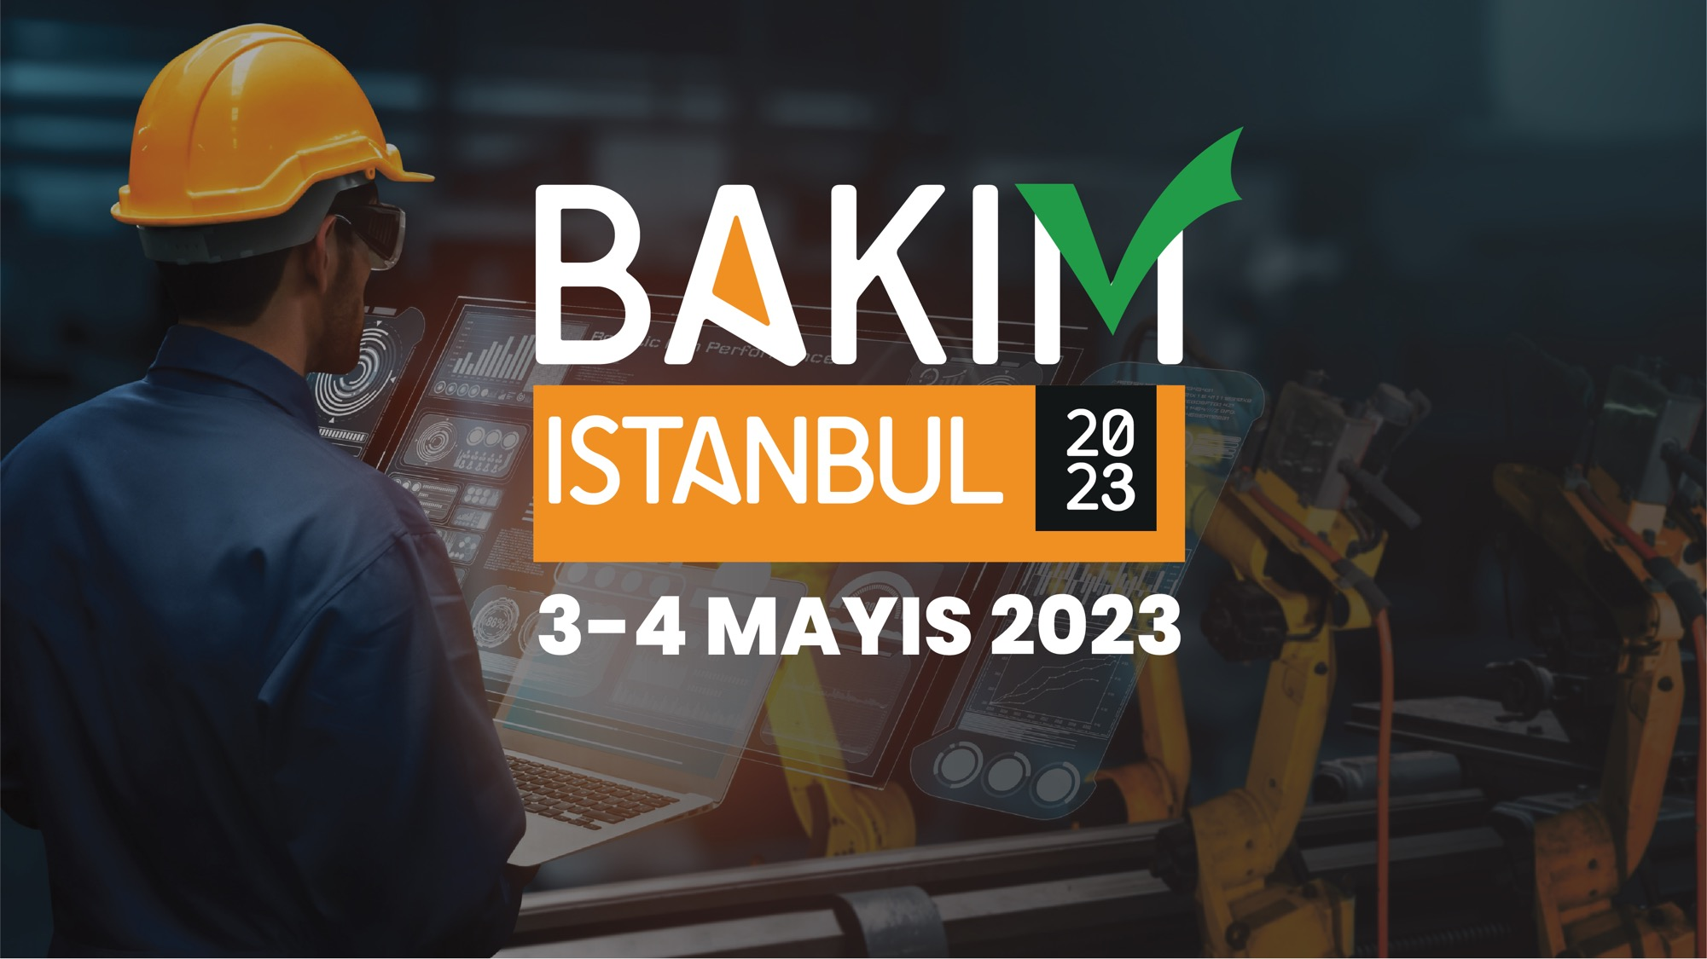


Slide 2

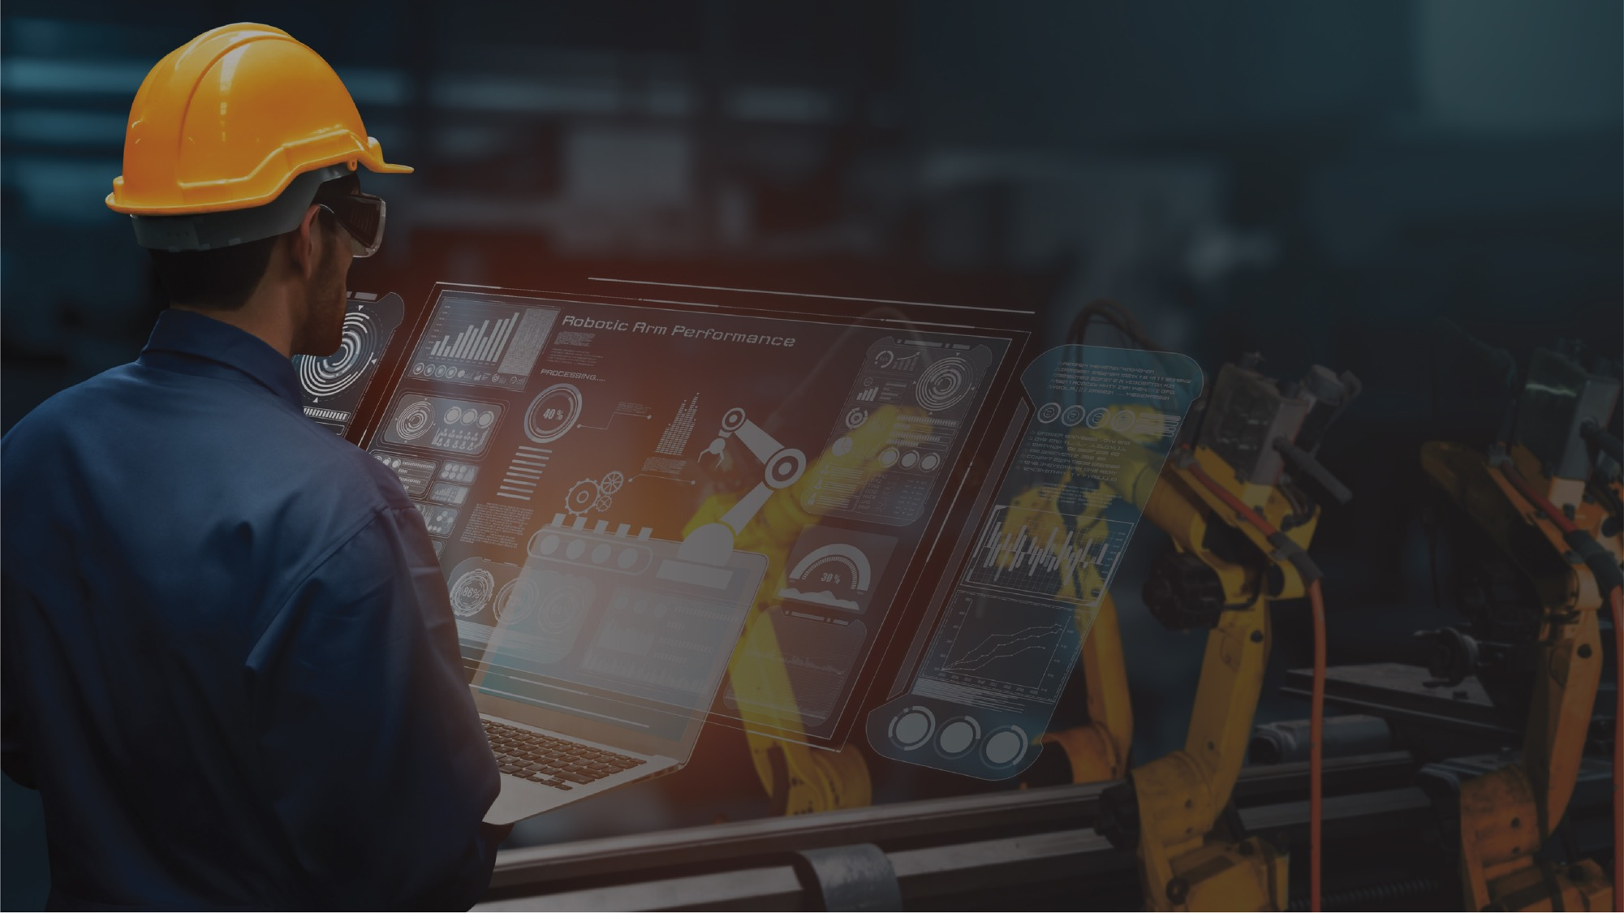

Reliability – engineer’s job only?

Slide 3

Haris Trobradovic
Proud member of SDT Ultrasound solutions team
Reliability engineer
Condition Monitoring specialist
Ultrasound instructor & implementation trainer
Passionate about Lubrication

Slide 4
Somewhere far, far away from the conferences​
People walk around with guns​
No arms control, no training, no licenses​
​
Victims are helpless, treatments are costly​
​​
Society silently approve “violence”​
Lubrication matters!
Take it seriously!
- grease guns -​
- bearings -​
- companies -​

Slide 5
The birth of the Reliability department
Location: Industry
Task: Improve Reliability

Slide 6

And there it starts …
You
  … have an idea
  talk to your manager

Slide 7

And there is starts …
Manager
  … should
  have all of the answers
  that’s his job

Slide 8
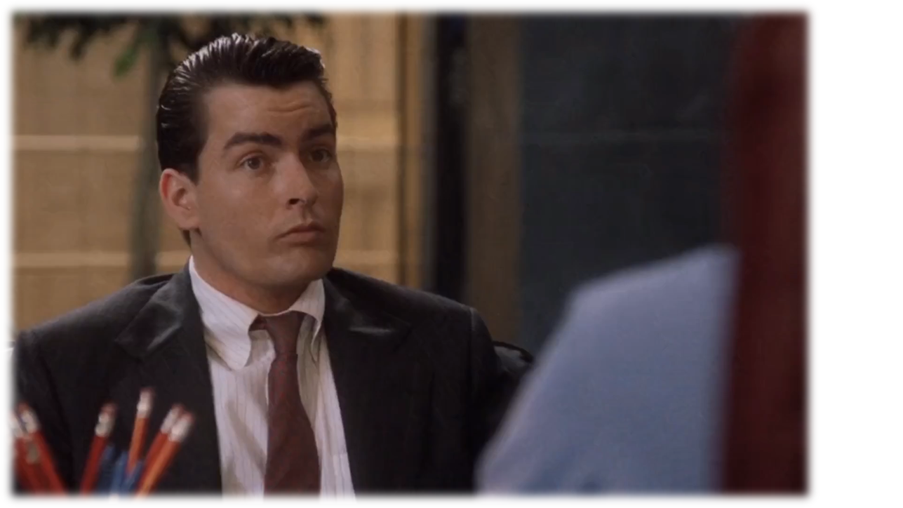
We need that…
You:
  -: We need to improve Reliability
  -: We need a team to do it

Slide 9
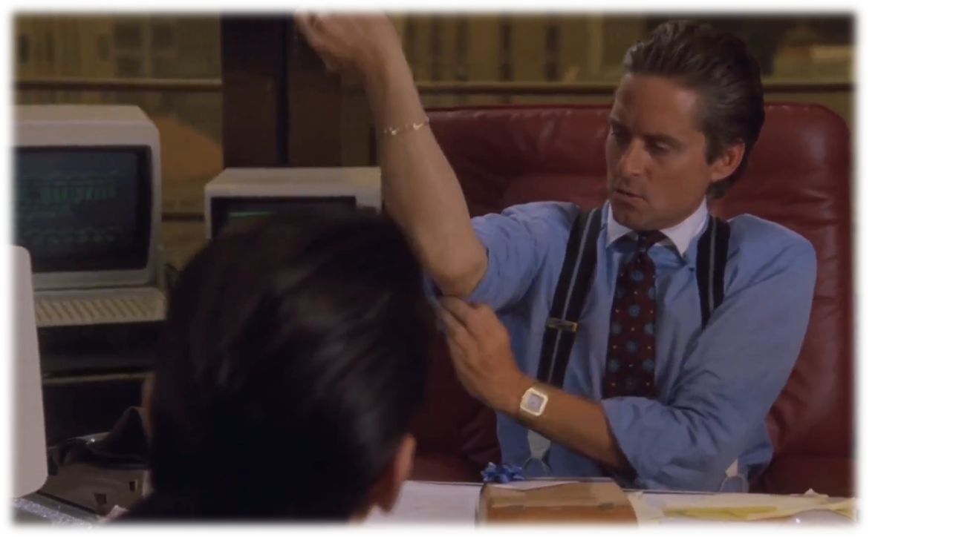
Ok, who?…
Manager:
  -: Good, let’s do it
  -: Who is available to take care of that?

Slide 10
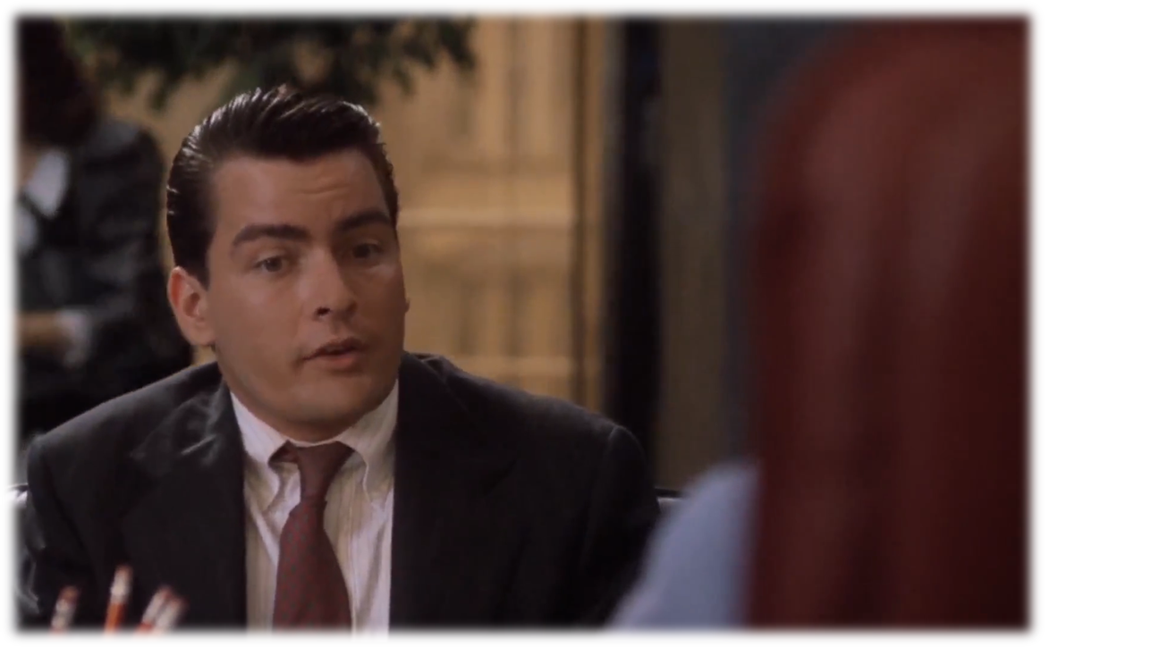
Well …
You:
  -: Engineers
  -: Condition Monitoring, and others

Slide 11
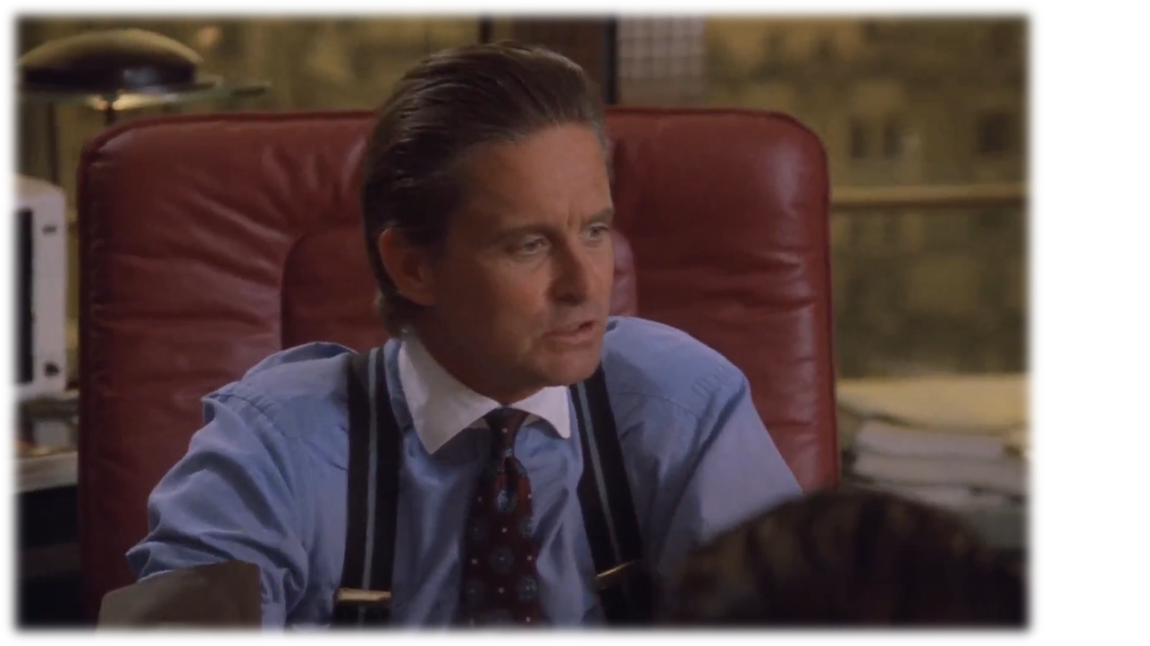
Good …
Manager:
  -: Ok, fine
  -: They’ll do it

Slide 12

Sure?…
You:
  -: Will that be enough?

Slide 13
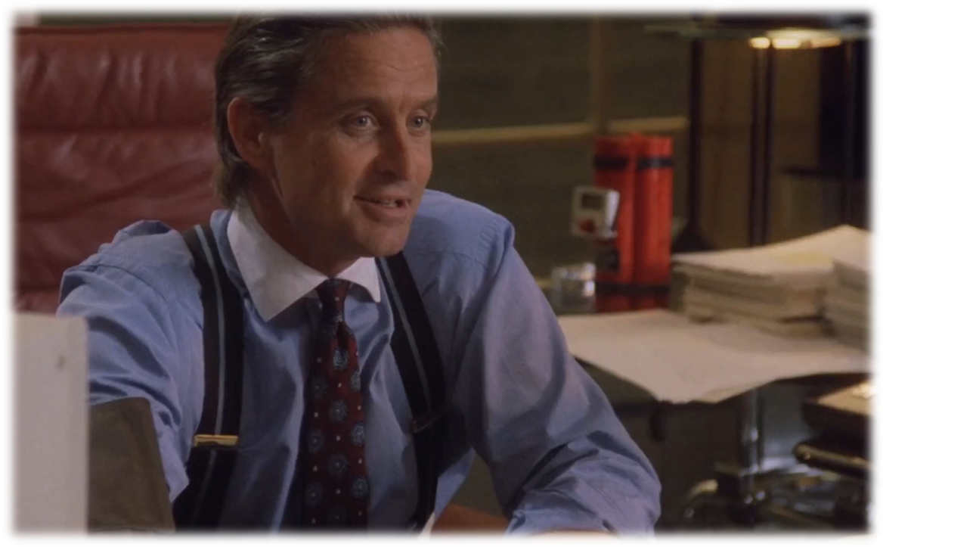
Better idea?…
Manager:
  -: Do you have anyone else?

Slide 14
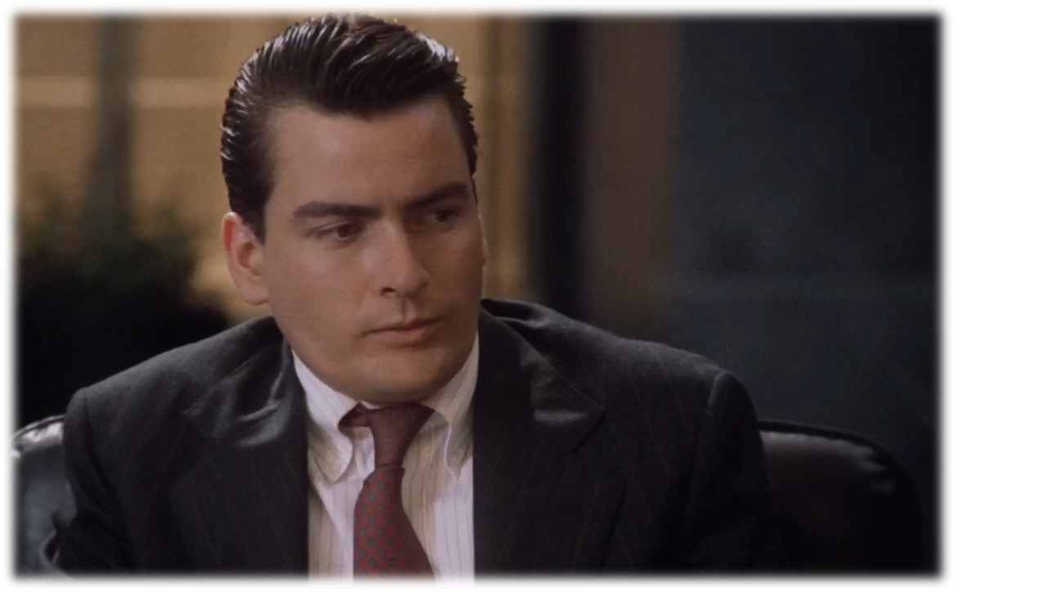
Well …
You:
  -: No

Slide 15
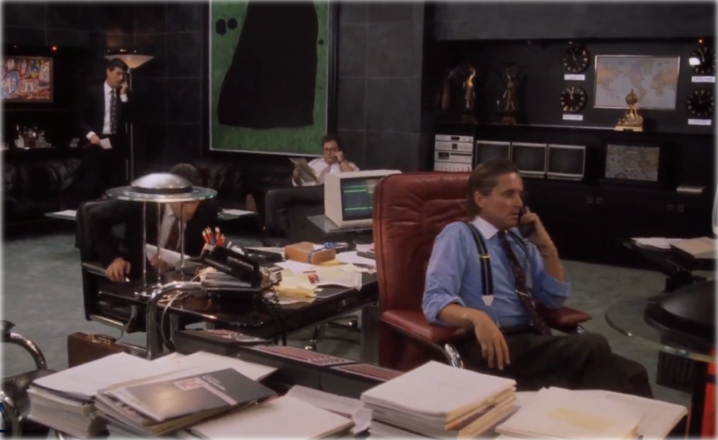
And off we go …
Manager:
  -: Then it will be enough!
  -: Come back soon with some results!
And the Reliability department was born!
Led by Maintenance and CM engineers only

Slide 16
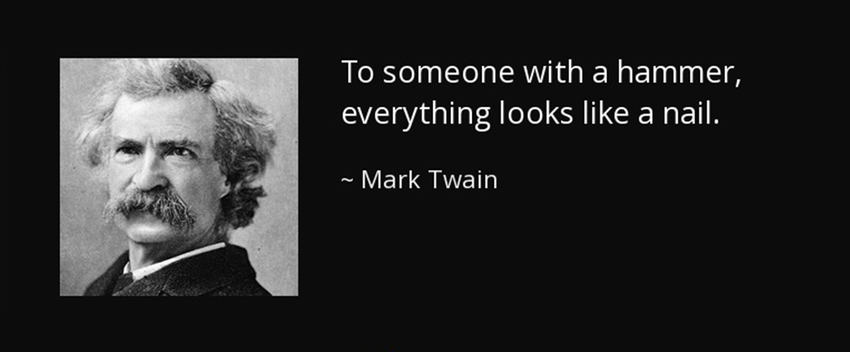

Slide 17
Engineers designed smartphones
  They did not build a culture of communication
Engineers built beautiful buildings
  They did not create communities
Gutenberg designed a printing machine
  Never wrote poetry that was printed on it

Slide 18
Reliability means;
Engineering Solutions in proper environment
That environment is culture, Reliability Culture

Slide 19
Reliability culture;
Like any sociological phenomenon we call culture;
Consist of:
  Values
    Beliefs
      Behaviour
        Rituals

Slide 20
Culture is built from top to bottom
Implementing values
Translating goals
Set up expectations in behaviour
Defining rituals (procedures)
It can be destroyed both ways

Slide 21
Obviously, it’s about people
Communicating values and beliefs
Translating goals and boundaries
Motivating for improvements
Harmonizing different personalities
What kind of skills are needed?

Slide 22
Understanding human nature
Behaviourism
Sociology
Psychology
Motivational skills
Diplomacy
…

Slide 23
When was the last time you met a mechanical engineer trained in those skills?
Me neither

Slide 24
Don’t you think it is frustrating and not fair?
  To ask engineer to do sociologist’s job
Don’t you think he is being pushed into a failure?
  In front of problems of non-engineering nature
Don’t you think the result is a loss for everyone?
  Poor culture means unsustainable Reliability improvement

Slide 25


Do you think it is an engineering skill to deal with:
“That’s NORMAL”
“It wasn’t me”

Slide 26
Values
Beliefs
Behaviour
Rituals
Rituals, are procedures, SOP
Engineers are excellent at doing this

Slide 27
But,
Rituals, Standard Operating Procedures;
Are the result of Values, Beliefs, Behaviour ...
Rituals CANNOT create a culture
Culture creates rituals

Slide 28
“That’s not my job”
“I will do it my way, not your way”
“I just install, defective part is not my problem”
“Someone else will do it”
“That is not mine, I just work here”
“My suggestions are never heard, anyway”
“It is not my job to improve”
“I don’t understand why”
“I don’t agree with this change”

Slide 29
Ask engineer to deal with those questions
Sit back, wait, and you will se the outcome:
No success, no sustainable improvements
Frustrated and burned-out engineer
Angry and dissatisfied team
Disappointed management

Slide 30
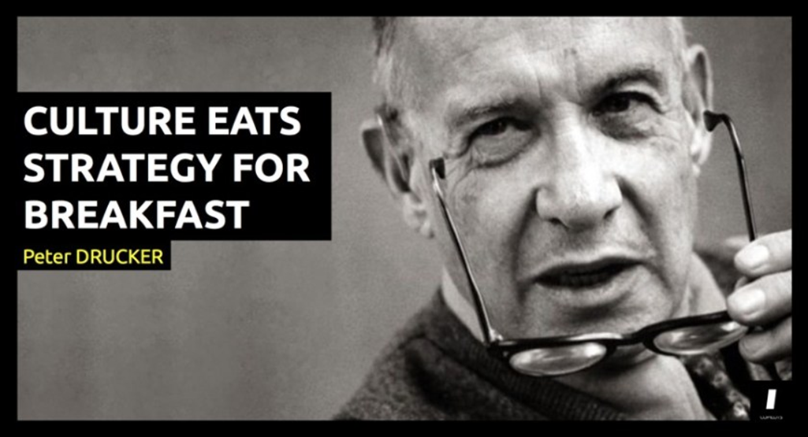

Slide 31
Somehow, many still insist on building culture exclusively with engineering skills
Is that why results are only partial?
and rarely sustainable?

Slide 32
Industry 4.0 needs “culture 4.0” (?)
Agree?
What is “culture 4.0”?
How is it different from “culture 1.0”?

Slide 33
It is the same culture!
Values are the same
Rituals might be differrent
  but they differ from industry to industry anyway

Slide 34
Ownership
Engagement
Belonging
Care
Those are all values our parents taught us
You live by that rules in your own home, right?

Slide 35
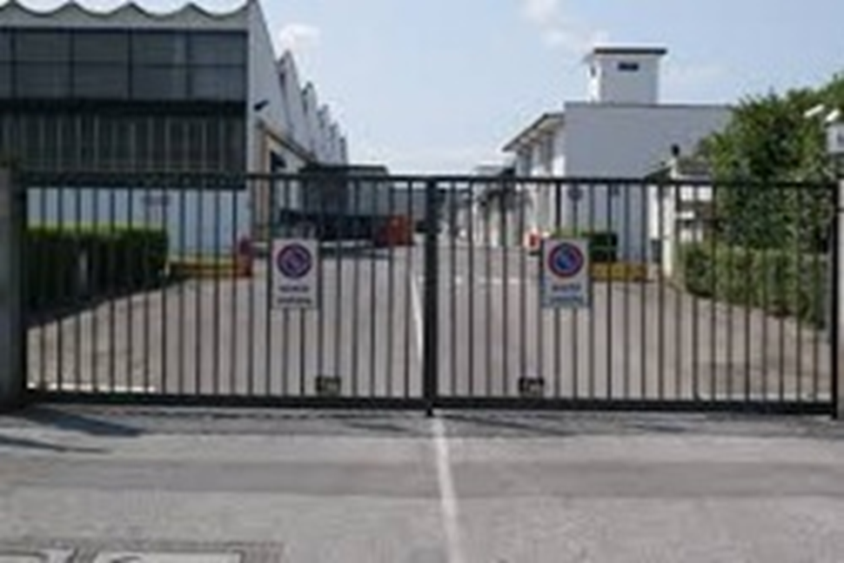
It seems that all that culture exists
But it does not pass the gate …

Slide 36
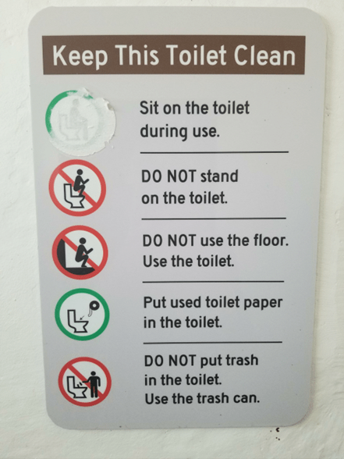
Look around, you will see the signs of the problem
This is trivial, but ..
4.0 ?

Slide 37
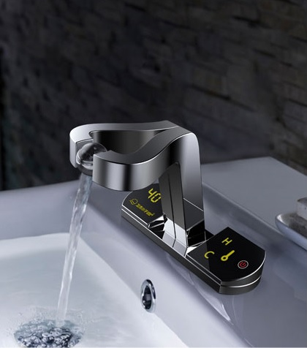

0.0 culture
4.0 machine
If you have to write this … you’ve already failed!

Slide 38
Writing a procedure for what people already know?
NOT a way to build a culture
It sends a message:
  “We don’t need what you already know”
  “We don’t want you to think”

Slide 39
Culture cannot be institutionalized!
Ownership, belonging, and care
  do not come from “the law”
You don’t get culture just because you ask for it

Slide 40
Define values
Define shared goals
Show appreciation
Respect and support personal goals
Give equal recognition to small and big initiatives
Let people run their own projects, within boundaries
Define boundaries
Do not write procedures for common sense issues

Slide 41
First teach why then tell how
You deal with people, not numbers
You pay for the time, not for the soul
If you′re good, you get soul for free

Slide 42
Do you still think that Reliability is exclusively an engineer’s job?

Slide 43


