Slide 1




End to end solutions for predictive maintenance
Bakim Istanbul
03 May 2023
Christian FRENEAT
International Sales & Business Development
Yasin DEMIRDELEN
Software End User Sales Leader

Slide 2
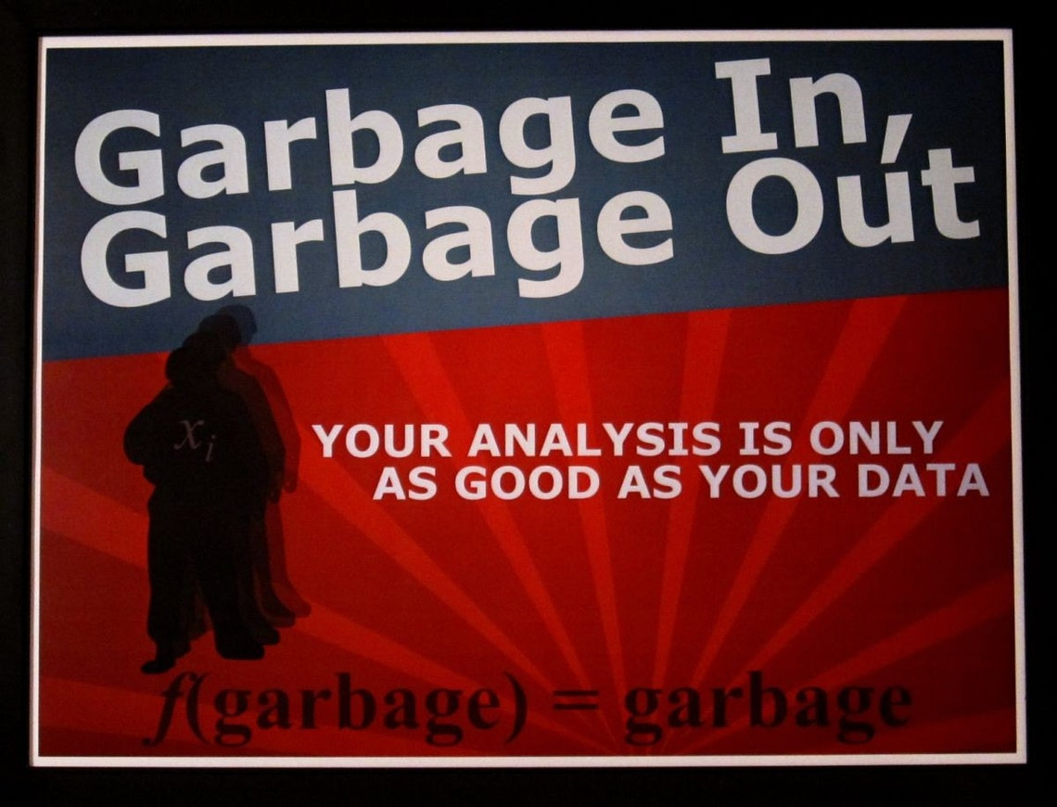

Slide 3
Quality Vibration Signals
Actionable Data
Data Analytics
Predict Failure Modes

Slide 4
Quality Vibration Signals
Actionable Data
Data Analytics
Predict Failure Modes

Slide 5




It all starts with quality signals.
Instrumentation
and software
Actionable data
AI-Driven processing
Expert diagnosis
Quality
vibration signals
Services

Slide 6
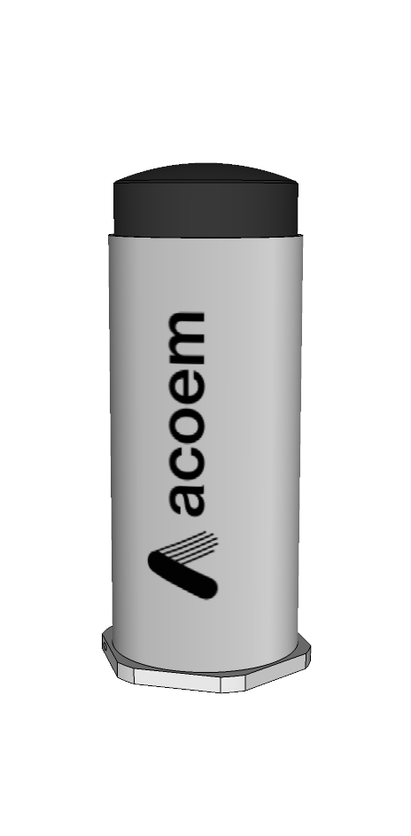
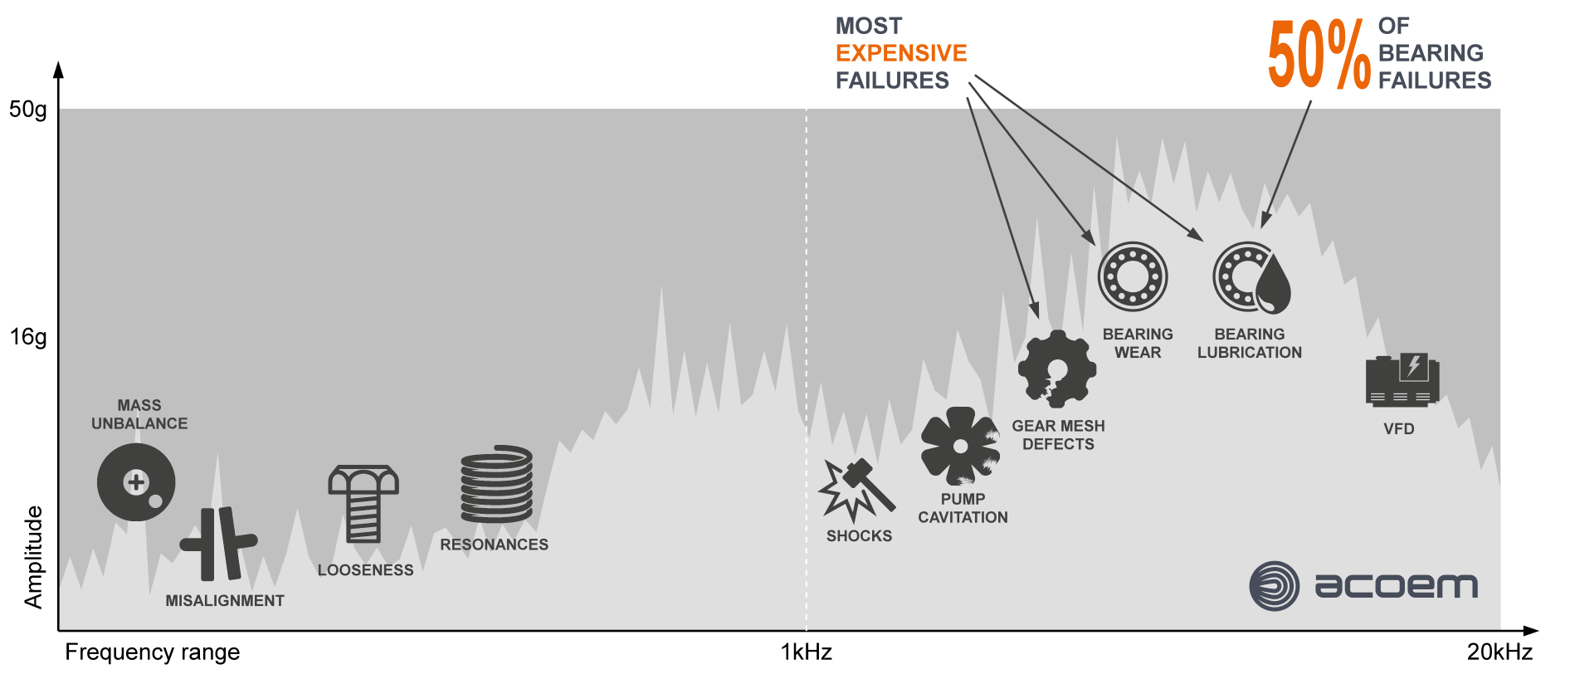
Full-range and accurate vibration sensors
Fault frequencies between 0.1Hz and 20kHz
Need to measure high amplitudes within a wide frequency range
EAGLE
Wireless Sensors

Slide 7
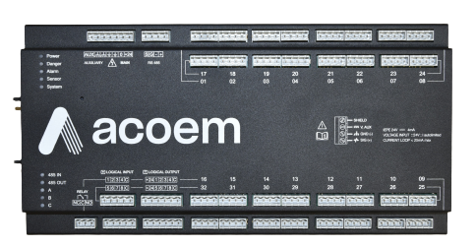
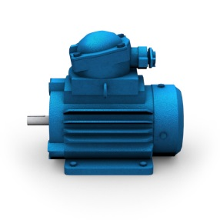
Repeatable measurements
Track On/Off, rotation speed, load, any process parameter
Trigger fast data acquisition at the right moment
Measure high-resolution signals in a short time window
MCT Machine Condition Tracking
High speed
Low speed
MV-x
Real-time monitoring

Slide 8
Quality Vibration Signals
Actionable Data
Data Analytics
Predict Failure Modes

Slide 9


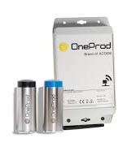
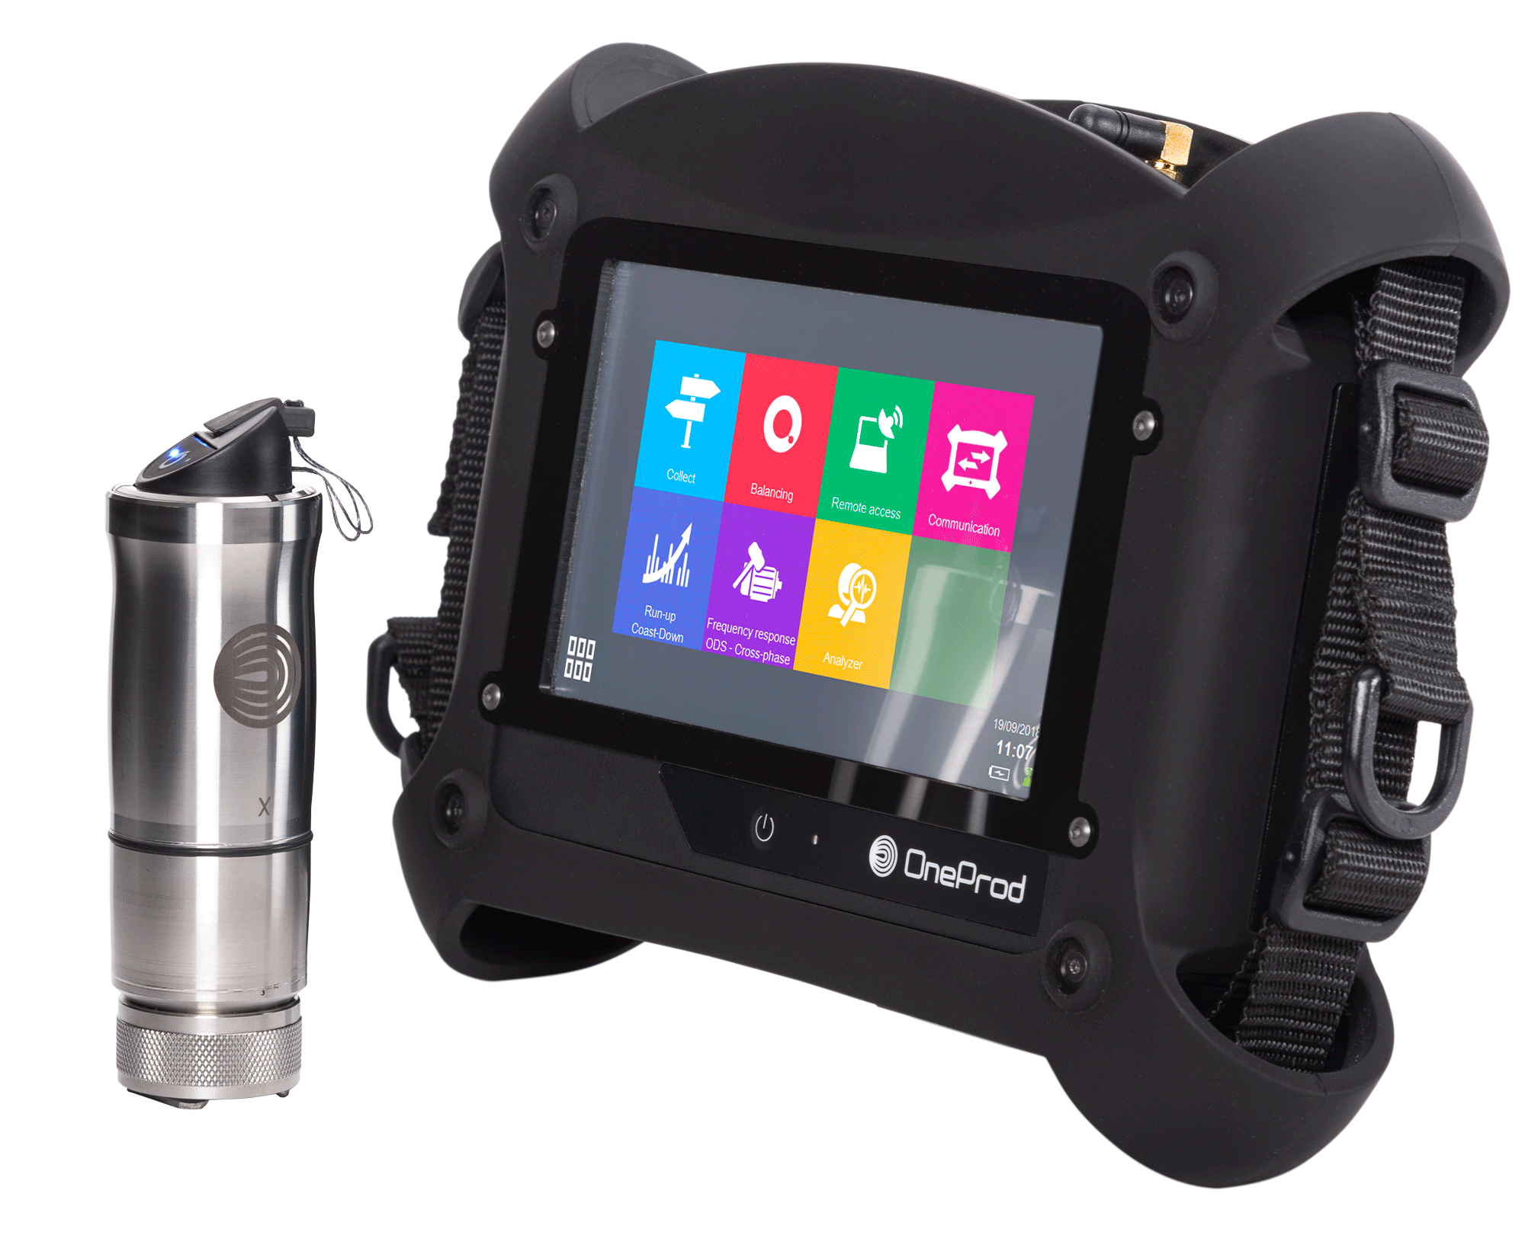
Edge computing and data processing
NESTi4.0
Predictive Maintenance Software
Industry 4.0 systems
CMMS, MES, Data lake…
Automation
Post-processing
OPC UA
CSV Files
ACOEM Data Loggers
Edge-computing
Modbus/TCP
OPC UA
FALCON
EAGLE
MVX

Slide 10
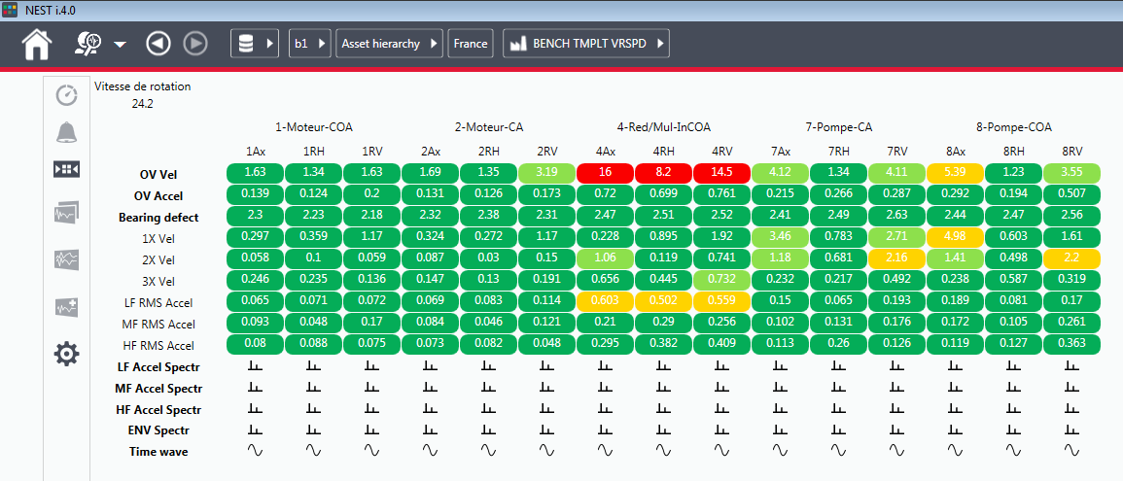
Machine Health Matrix
What is the defect
Your machine health in only one view
Productive analysis tool
Where is the defect

Slide 11
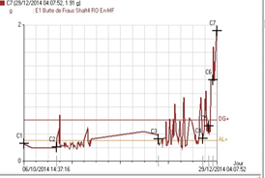
Machine Health Matrix
Overall parameters trends
What is the defect
Where is the defect

Slide 12
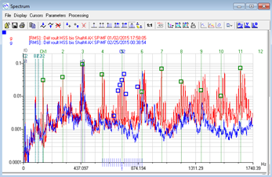
Machine Health Matrix
FFT spectra
What is the defect
Where is the defect

Slide 13
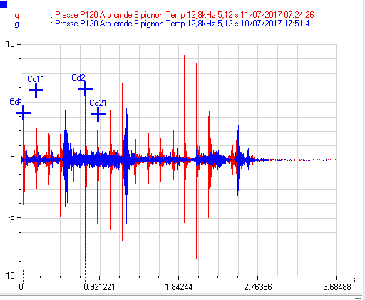
Machine Health Matrix
What is the defect
Time signals
Where is the defect

Slide 14
ACCUREX Automatic Diagnosis
Is the machine globally OK?
No action required
Monitoring required and/or action conceivable during scheduled shutdown
Action to be scheduled as soon as possible

Slide 15
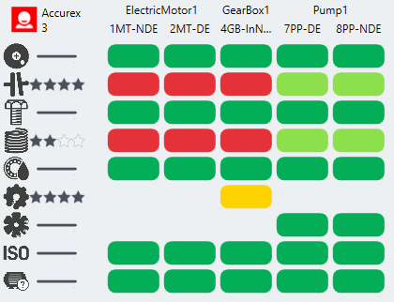
ACCUREX Automatic Diagnosis
1
Where
Is the machine globally OK?
If not, where is the defect, what is the defect severity and confidence level
2
What

Slide 16
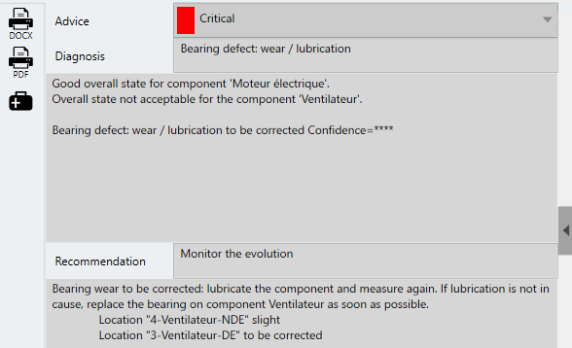
ACCUREX Automatic Diagnosis
1
Where
Is the machine globally OK?
If not, where is the defect, what is the defect severity and confidence level
First level of maintenance recommendation
2
What
e.g. “Bearing wear to be corrected: lubricate the component and measure again. If lubrication is not the cause, replace the bearing as soon as possible…”
Recommended actions!
3

Slide 17

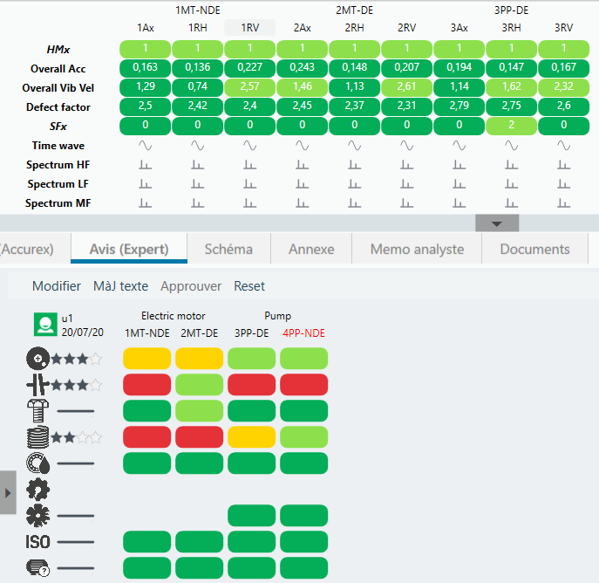

Automatic data publication
ACOEM NESTi4.0
Vibration indicators
Alarms
Diagnosis
Identified faults
Recommendations
Signals

Slide 18
Customer case

Slide 19

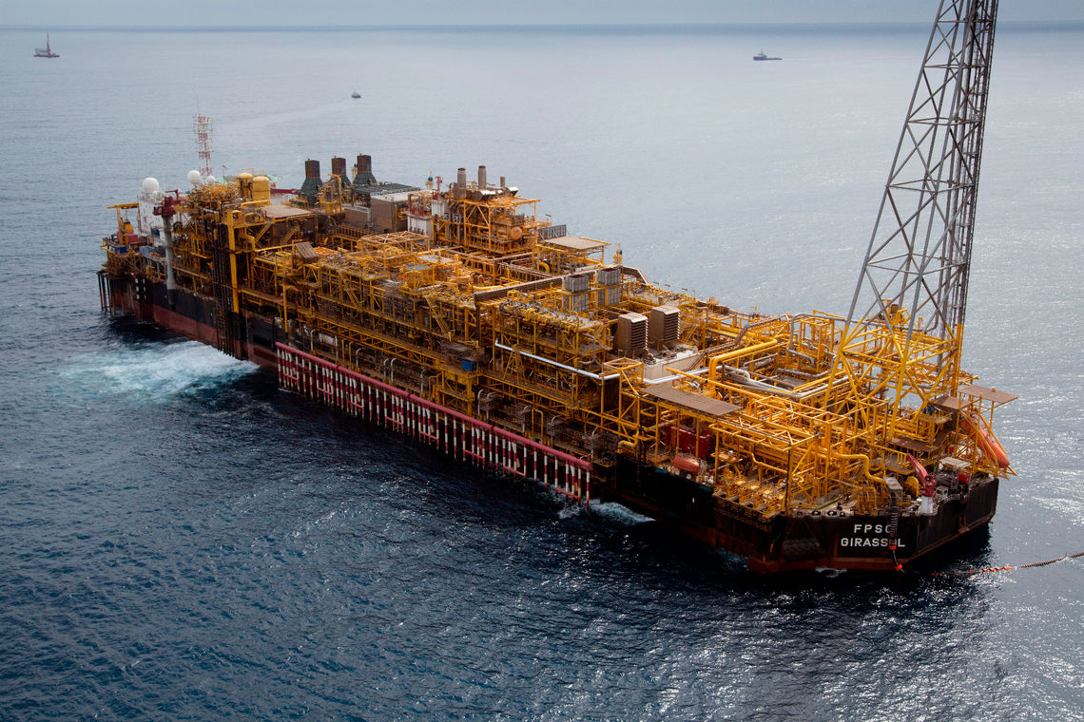

TotalEnergies E&P
Rotating machinery monitoring
Increase productivity with less unplanned shutdown
Reduce personnel in the hazardous area
50 critical machines
Explosive area
GIRASSOL FPSO

Slide 20
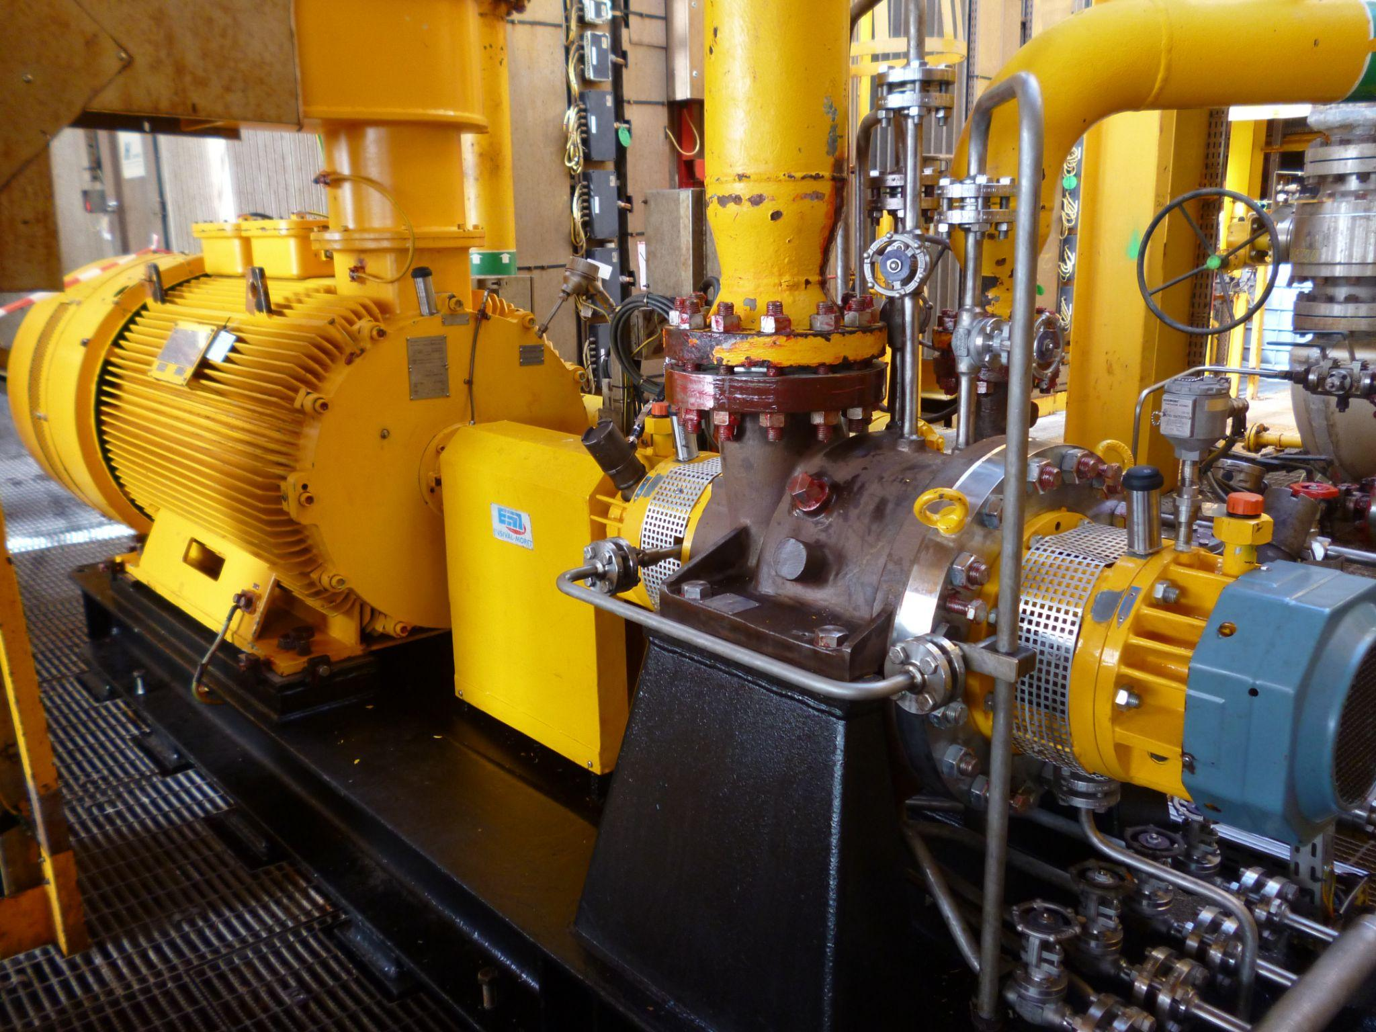
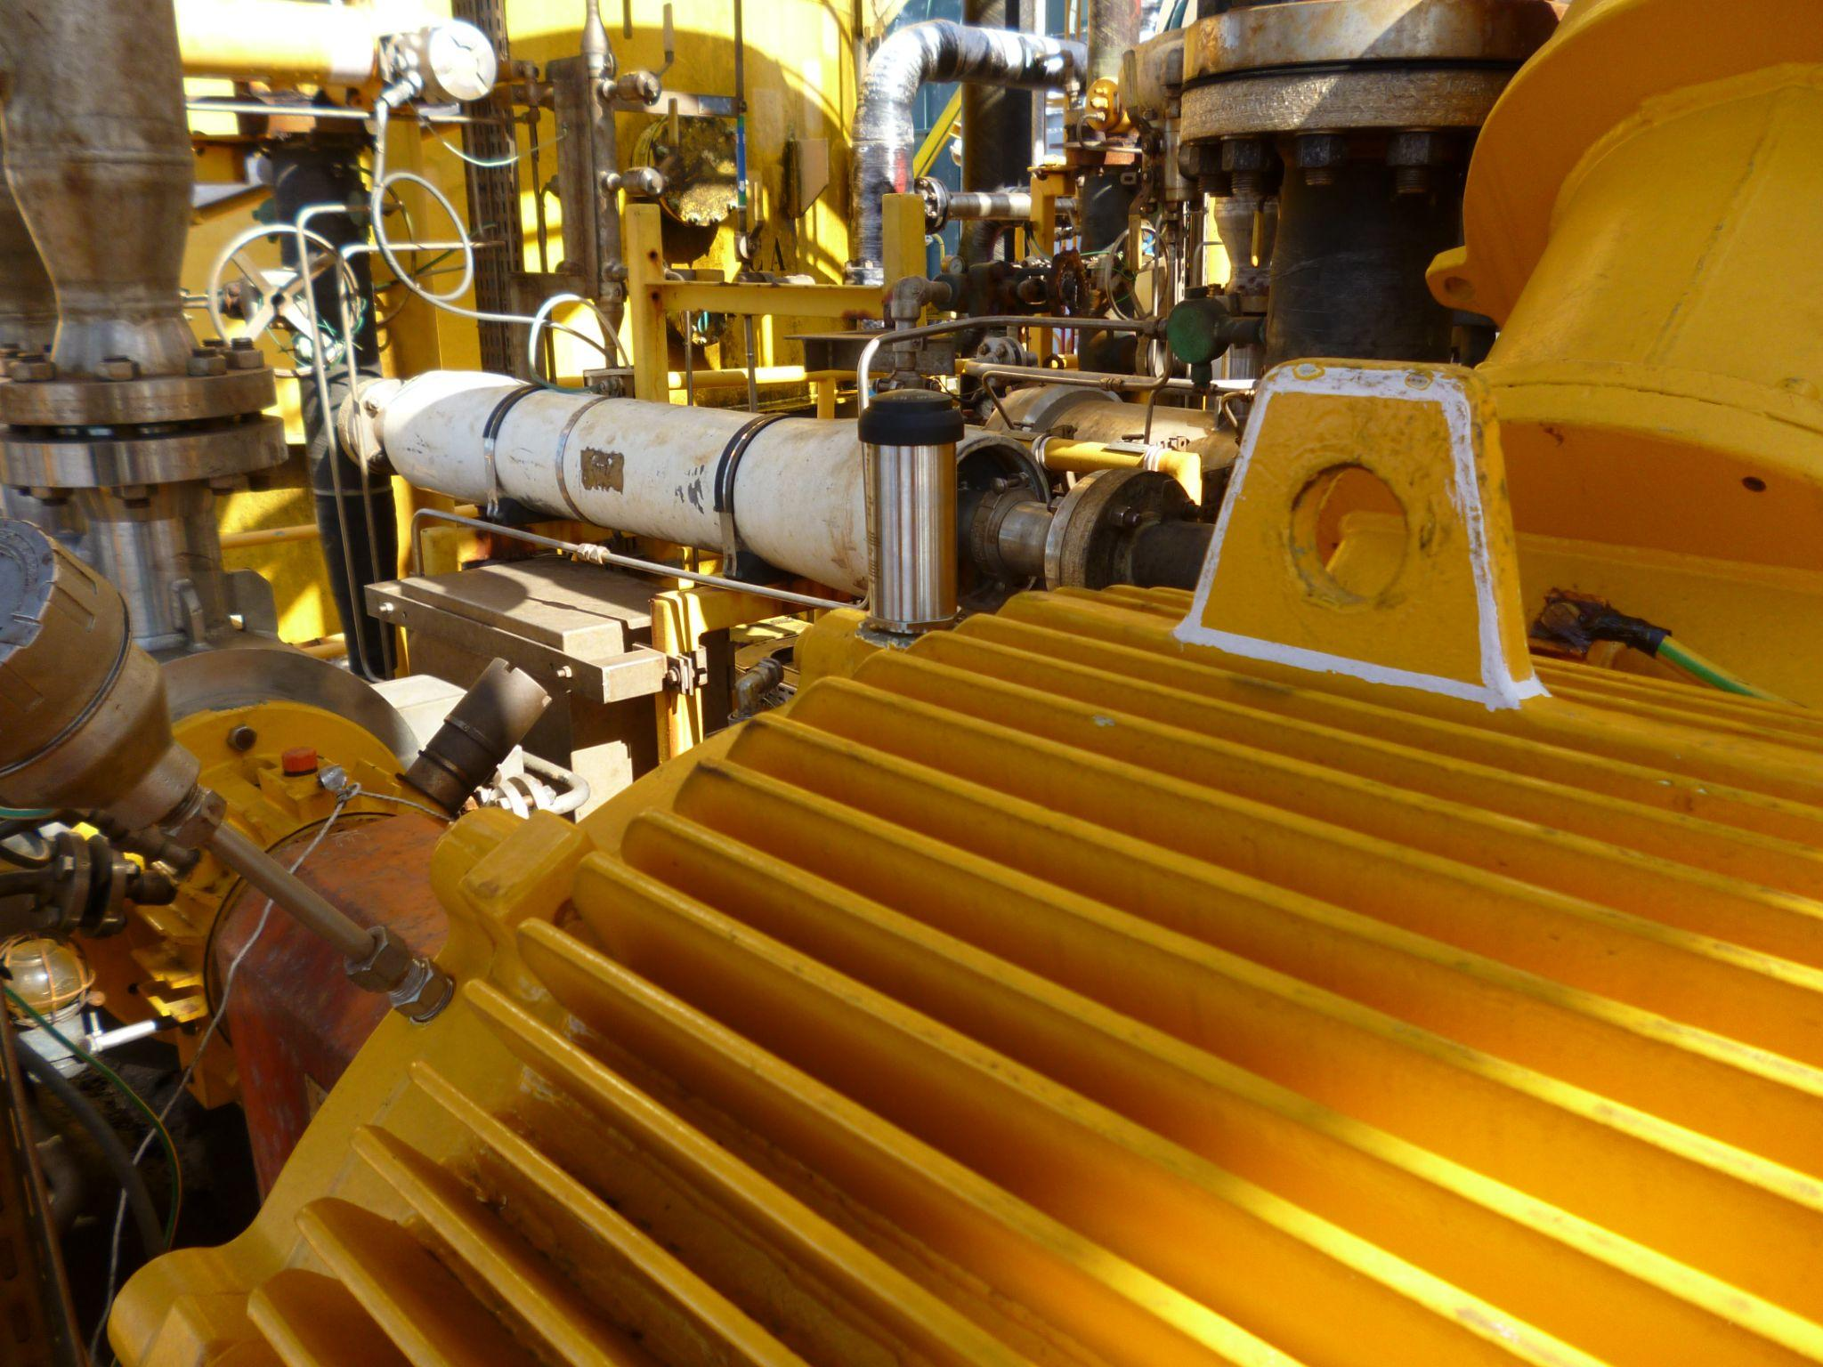
EAGLE Wireless Sensors
228 EAGLE Wireless Sensors in Explosive Area

Slide 21
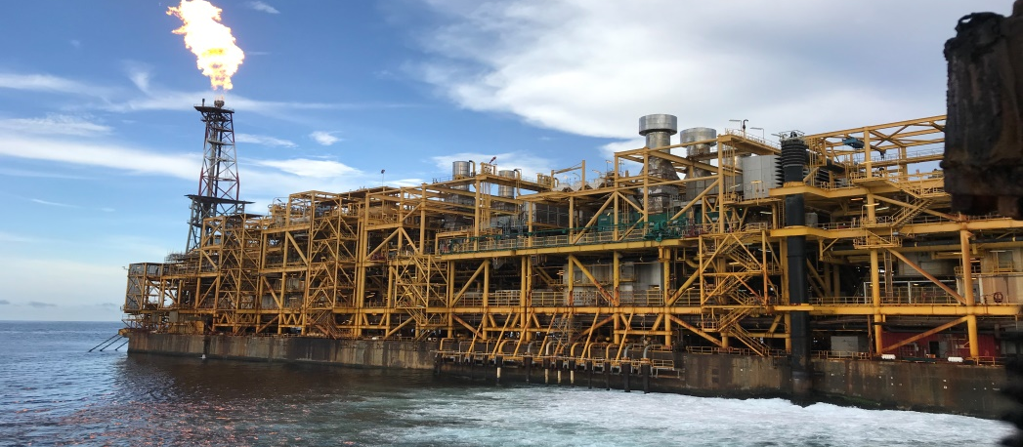

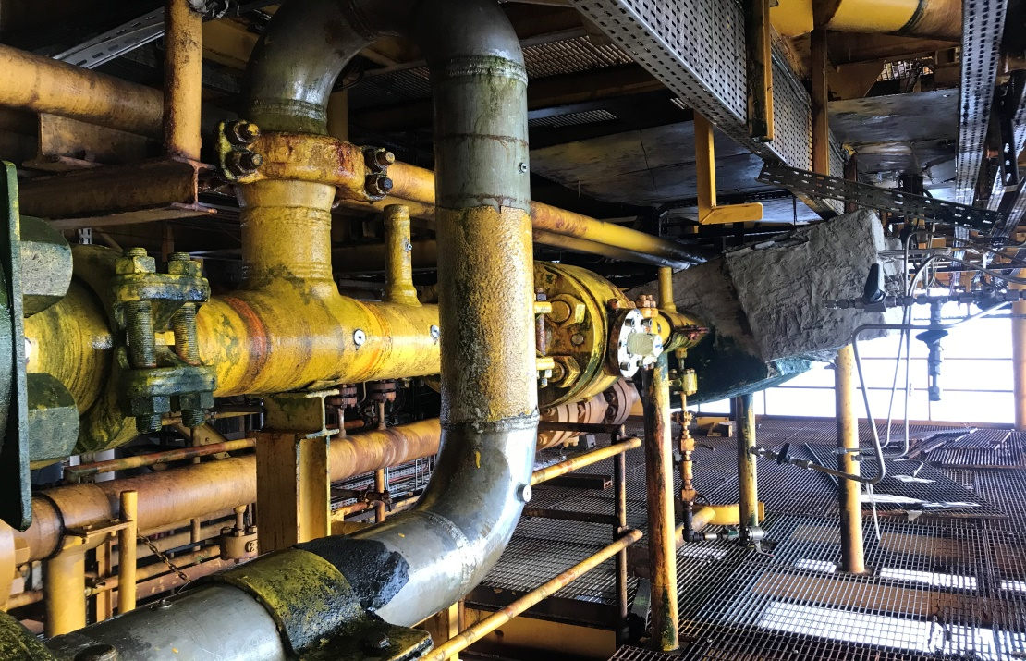
TotalEnergies E&P
Piping monitoring
Get piping vibration behavior at any time
Optimize production with preventing any piping damages
Riser piping structure
Explosive area

Slide 22
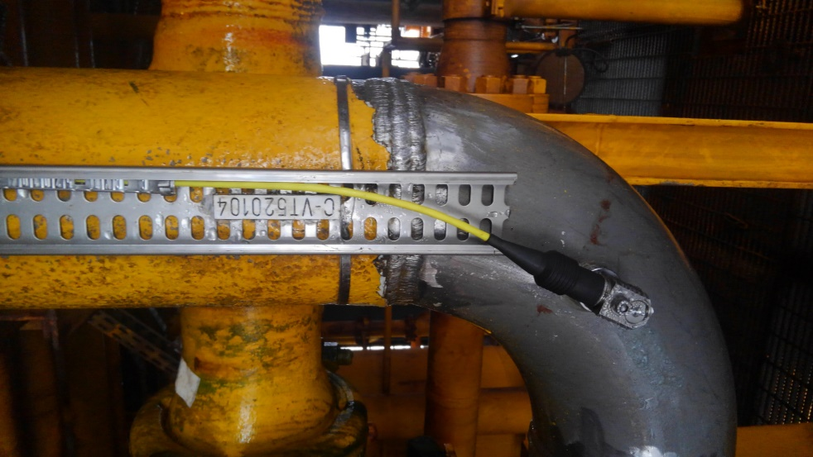
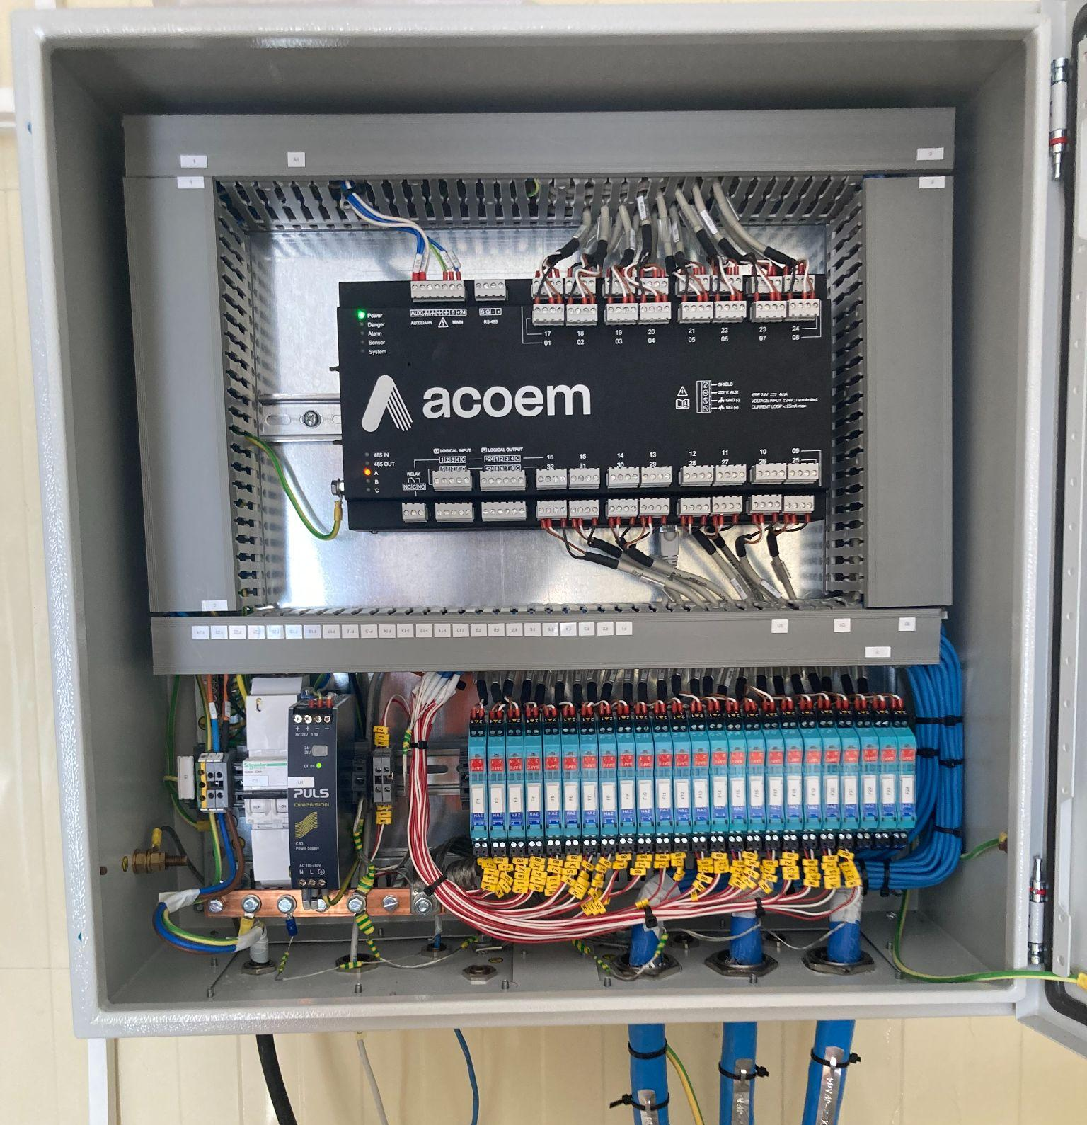
Accelerometers connected on MVX systems
EX Accelerometers in Explosive Area
MVX Enclosure in Safe Zone

Slide 23
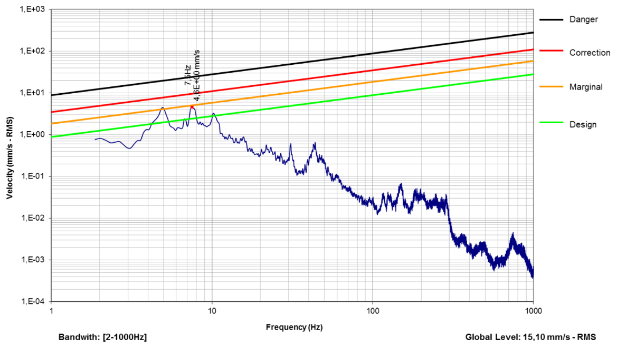
WACHEL piping vibration criteria
International standards
VDI 3842 (WACHEL) or EI 2018 (Energy Institute)
Embedded automatic piping criteria calculation
based on vibration spectra:
1Hz-300 Hz for EI
1Hz-1000 Hz for WACHEL
Vibration levels compared to limit values
at each frequency as specified by the standards
DANGER
CORRECTION
MARGINAL
DESIGN
WACHEL Standard

Slide 24
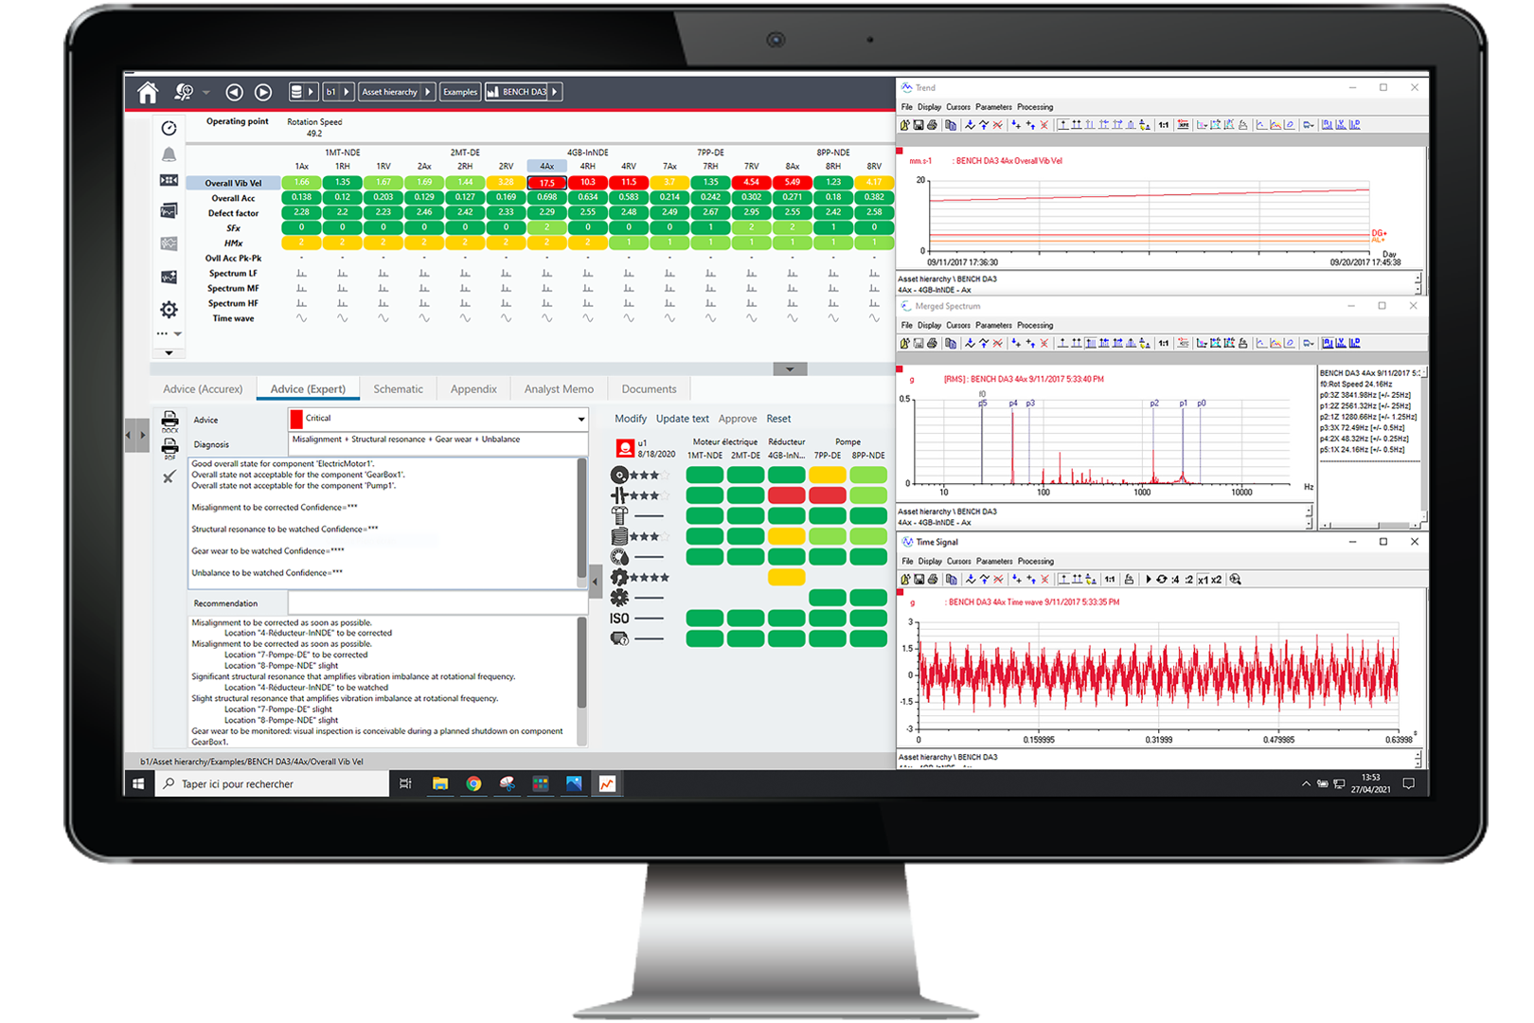

Vibration analysis tools for experts
Vibration Analysis
Experts
FALCON
EAGLE
MVX

Slide 25
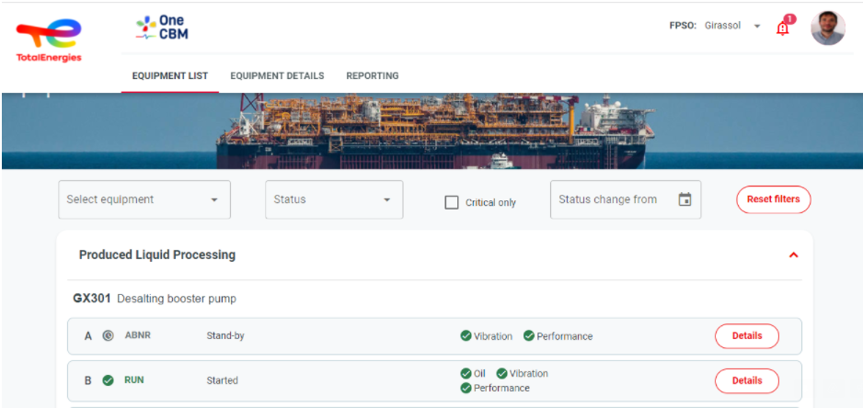


Dashboard for operators
Dashboard
Operators
Vibration Analysis
Experts
FALCON
EAGLE
MVX

Slide 26
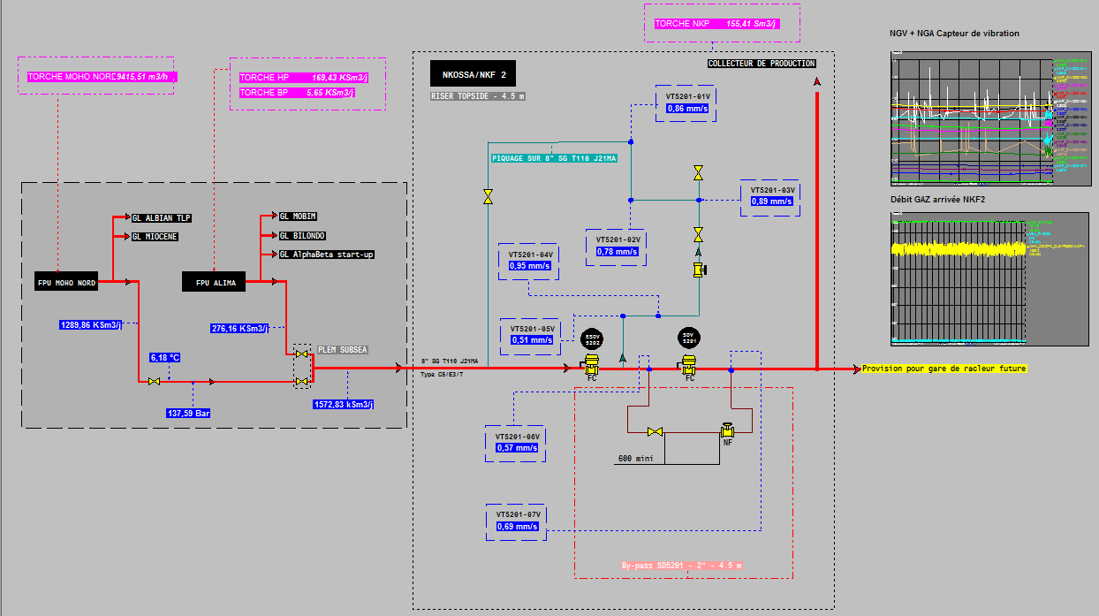
Quality data ready for data analytics
Real-time vibration levels
c
Process Data
c
WACHEL criteria automatically processed by MVX
Accelerometers on the riser

Slide 27
Quality Vibration Signals
Actionable Data
Data Analytics
Predict Failure Modes

Slide 28
Monitoring Without Data Analytics

Slide 29

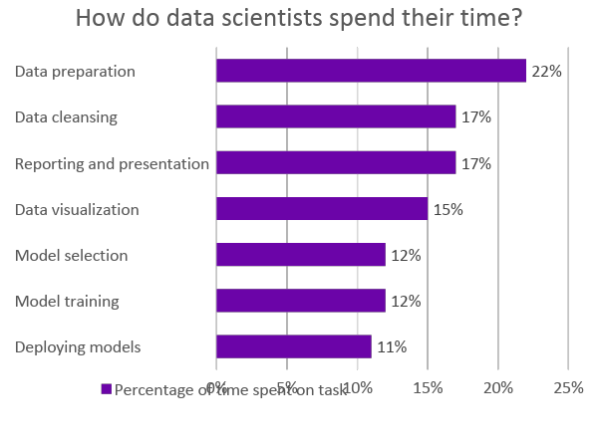
Preparing data for analytics
It’s time consuming, even for data scientists
39%
lost productivity
Source: Anaconda’s State of Data Science 2021 Survey
Notes:
Analitik için veri hazırlama
üretkenlik kaybı
Veri bilimciler için bile zaman alıcıdır
Veri bilimciler zamanlarını nasıl geçiriyor?
Veri Hazırlama
veri̇ temi̇zleme
Raporlama ve sunum
veri görselleştirme
model seçi̇mi̇
model eği̇ti̇mi̇
dağıtım modeli
Veri aramak ve geçerliliğini sağlamak için çok fazla zaman harcanır. Bazı yaygın genel örnekler şunlardır:
Veri gerektiren bir soruyla en son ne zaman karşılaştığınızı hatırlayın. Verilere hemen ulaşılabiliyor muydu?
Üst yönetimin üretim rakamlarını raporlamanıza ihtiyaç duyduğu son zamanı hatırlayın. Rapor sadece birkaç tık uzağınızda mıydı?
Size "güvenmeniz" için bir elektronik tablo verildiği bir zaman oldu mu?
Veriler elinizde olsa bile, bu raporun veya elektronik tablonun nasıl oluşturulduğuna dair standartlar veya yönetişim olmadığından, muhtemelen verilere tamamen güvenmiyorsunuzdur.
Bu ham, operasyonel verileri veri bilimciler veya iş analistleri gibi akıllı kişilere vermek, verilerin geçerliliği konusunda benzer bir kafa karışıklığına neden olacaktır. Daha da kötüsü, bu kişiler verileri anlamayacak ve veriler hakkında varsayımlarda bulunmaya başlayacaktır.
Preparing data for analytics
It’s time-consuming, even for data scientists
How do data scientists spend their time?
data Preparation
data cleansing
Reporting and presentation
data visulization
model sellection
model training
deploying model
A lot of time is wasted hunting down data and ensuring its validity. Some common generic examples are:
Remember the last time you had a question that required data. Was the data immediately available?
Remember the last time upper management needed you to report production numbers. Was the report merely a few clicks away?
Was there a time you were handed a spreadsheet to “trust”?
Even if you have the data in hand, since there may be no standards or governance around how that report or spreadsheet was created, you likely don’t trust the data completely.
Giving this raw, operations data to smart people, like data scientists or business analysts, will cause similar confusion about the validity of the data. Or worse, they won’t understand the data and start making assumptions about it.

Slide 30
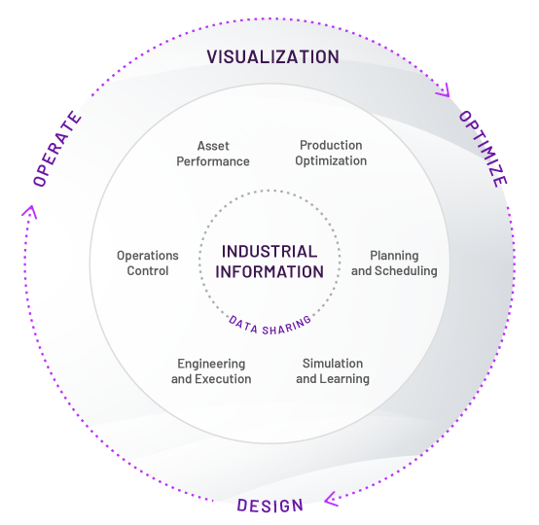
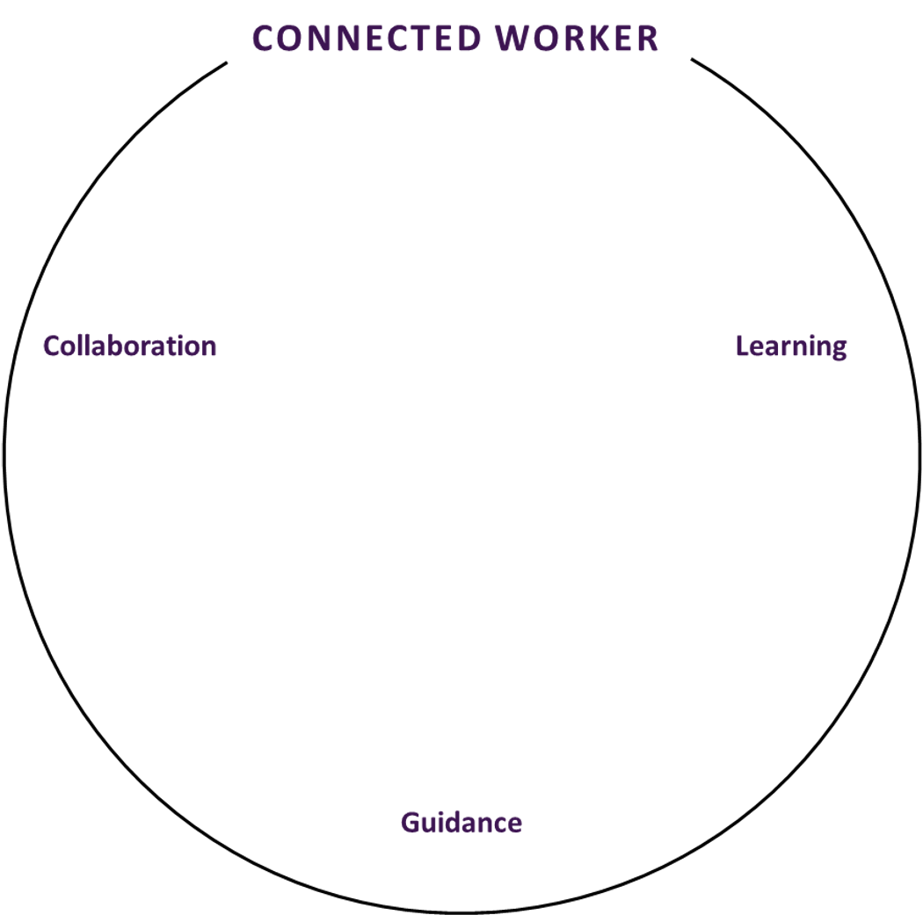
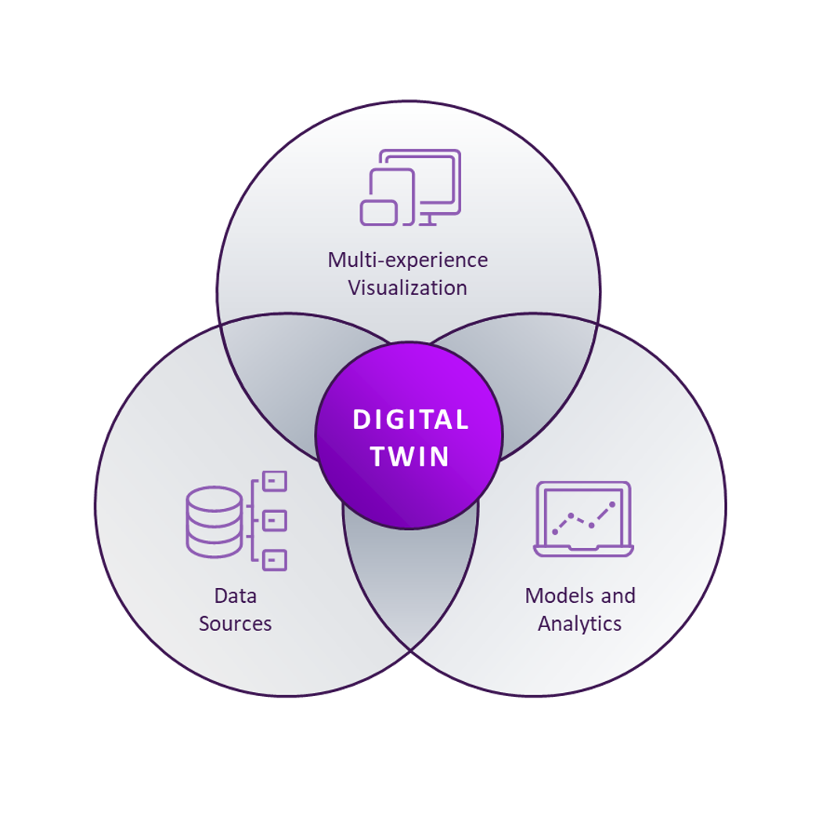




Digital Twin
Artificial Intelligence
Cloud
Big Data
Industrial IoT/Edge
Extended Reality

Slide 31
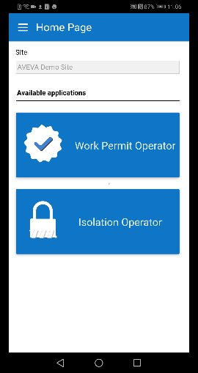
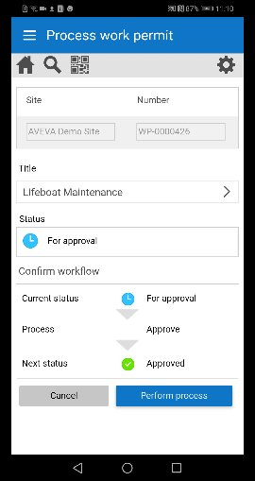
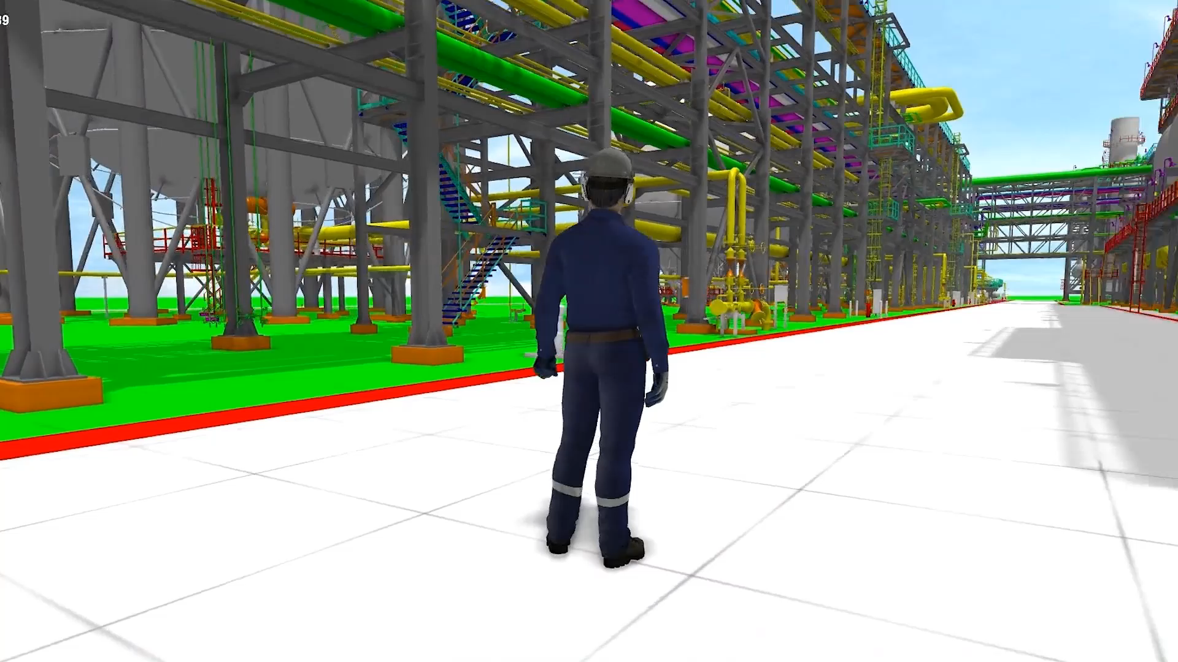
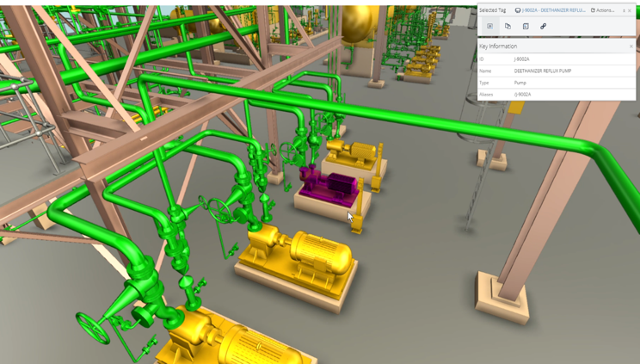
Connecting the workforce to the Digital Twin
30% time and cost savings
3D test environment
3% reduced maintenance budget

Slide 32


AVEVA APM – The Complete Picture
ASSET PERFORMANCE MANAGEMENT
Site 1
APM ASSESSMENT
DATA DRIVEN OUTCOMES
STRATEGIZE
FINANCIALLY OPTIMIZED APM
ASSET STRATEGY OPTIMIZATION
Site 2
VISUALIZE
OPERATION & ENG. INFORMATION
REGULATORY COMPLIANCE
PREDICTIVE ANALYTICS
AVEVA DIGITAL TWIN
Data Infrastructure
AVEVA CLOUD
ANALYZE
CONNECTED WORK &
CONTROL OF WORK
ASSET STRATEGY LIBRARY
Site 3
MOBILE OPERATOR
KNOWLEDGE RETENTION & TRAINING
EXECUTE
OPERARATIONAL SAFETY MANAGEMENT
Site (n)
SUSTAINABLE OPERATIONS
AR/VR GUIDANCE

Slide 33
Quality Vibration Signals
Actionable Data
Data Analytics
Predict Failure Modes

Slide 34
AVEVA APM Connects Asset Strategy to Corporate Objectives
Failure Patterns
It’s a Journey
Reactive Maintenance
Requires a comprehensive maintenance infrastructure
Strategic, Proactive, Optimized
Reactive and
Preventive Programs
Preventive Maintenance
AI and prescriptive analytics to predict impending failure
Condition-Based Maintenance
Rules-based logic using
sensor data
Predictive Technology
for Early Warnings
Predictive + Prescriptive
Maintenance
Planned based on time or usage statistics
Risk-
Based Maintenance
ARC studies show only 18% of asset failure is age-related. Based on these data, preventive maintenance provides a benefit for just 18 percent of assets and monitoring for predictive maintenance is a recommended option for the rest. www.arcweb.com/Lists/Posts/Post.aspx?ID=260
Run to failure

Slide 35
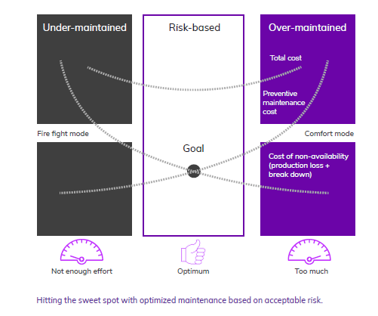
Is Your Asset Strategy Optimized?
STRATEGIZE
Under-Maintained
Risk-Based
Over-Maintained
Reduce Downtime
Total cost
Preventive maintenance cost
Prevent Asset Failures
Fire fight mode
Goal
Comfort mode
Reduce Maintenance Costs
Cost of non-availability (production loss + break down)
Improve Safety
Extend Equipment Life
Optimize Asset Strategy
Too Little
Optimum
Too Much

Slide 36
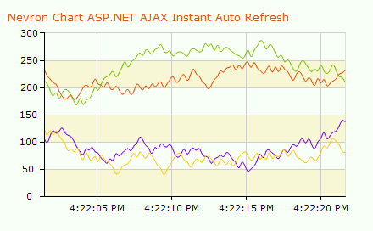
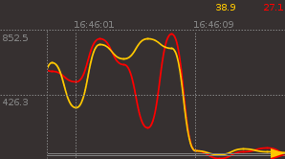




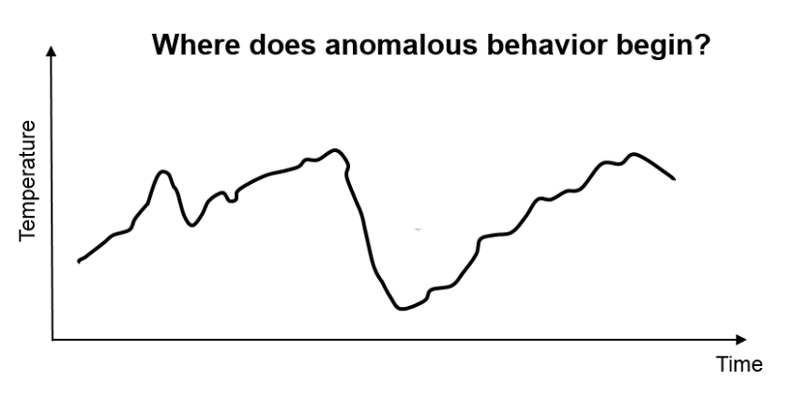
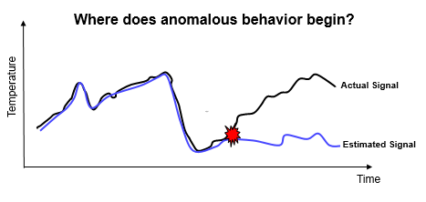
Predictive Asset Analytics
ANALYZE
Historical Data
Application learns normal operation from historical data
Pattern Recognition
Advanced algorithms create and organize operational profiles
Early Warning
Deviations from normal operation are identified and displayed
Predictive Asset Analytics
Artificial Intelligence continuously monitors behavior in real-time
Alerts when the operation differs from the historical norm
Early warning detection of equipment problems
Advanced analysis capabilities including problem identification and root cause analysis
Continuously monitors for degradations 24x7
Notes:
Tarihsel Veriler
Uygulama geçmiş verilerden normal çalışmayı öğrenir
Örüntü Tanıma
Gelişmiş algoritmalar operasyonel profiller oluşturur ve düzenler
Erken Uyarı
Normal çalışmadan sapmalar tespit edilir ve görüntülenir
Kestirimci Varlık Analitiği
Yapay Zeka, davranışları gerçek zamanlı olarak sürekli izler
Operasyon tarihsel normdan farklı olduğunda uyarılar
Ekipman sorunlarının erken uyarı tespiti
Sorun tanımlama ve kök neden analizi dahil olmak üzere gelişmiş analiz yetenekleri
Bozulmaları 7x24 sürekli olarak izler

Slide 37
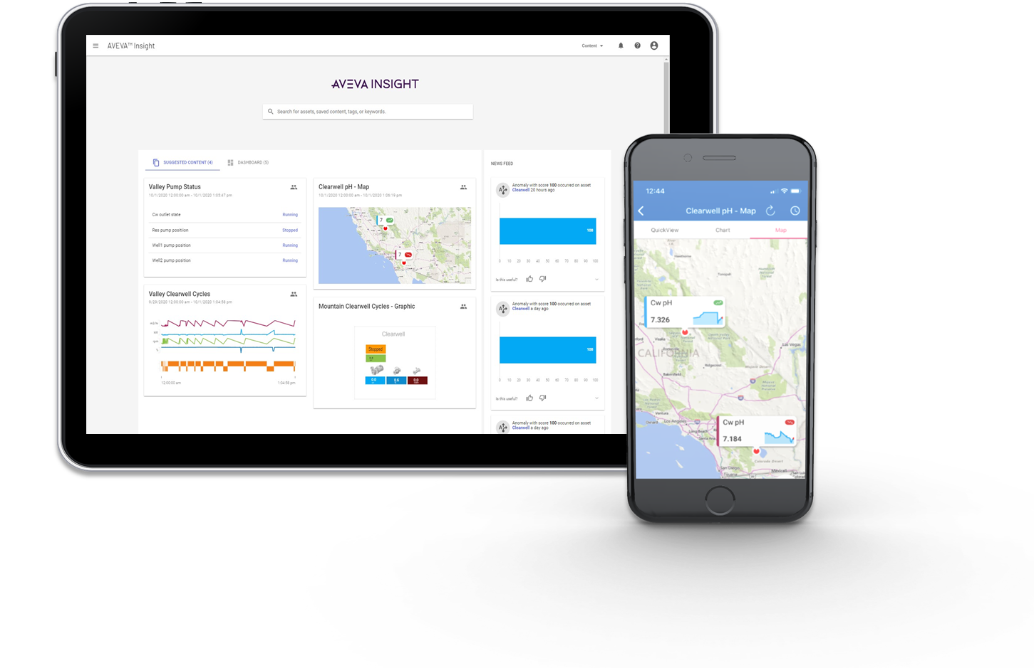
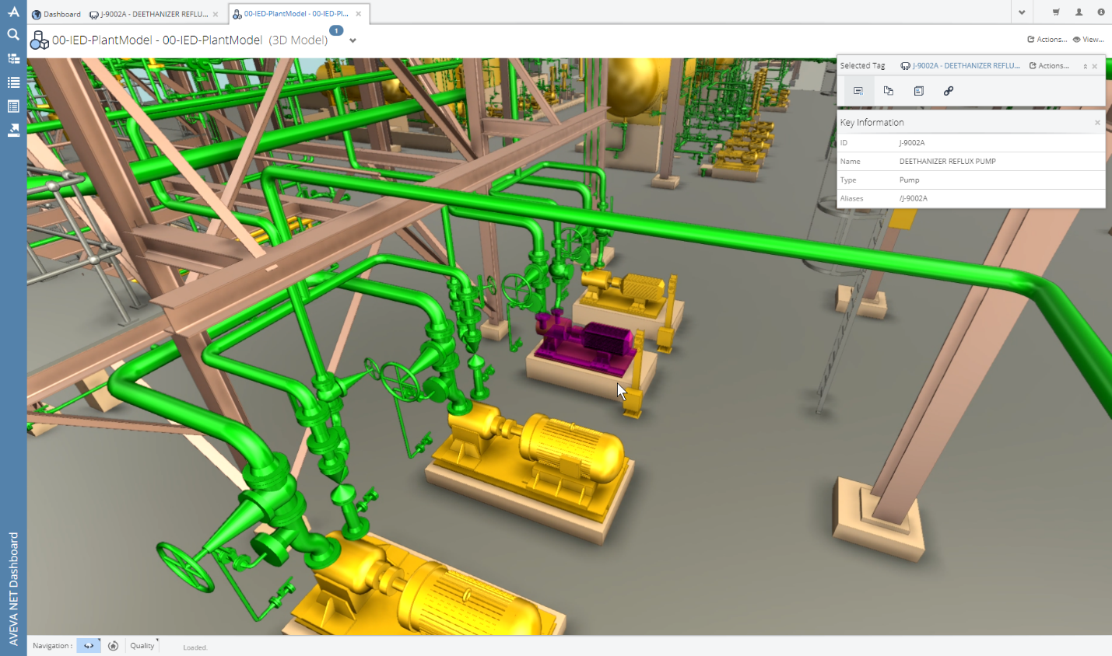

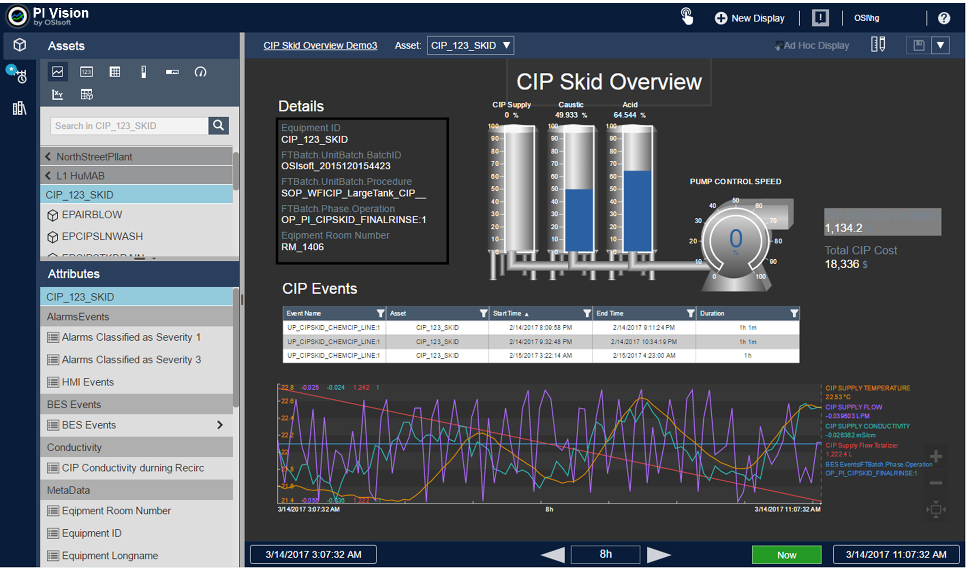
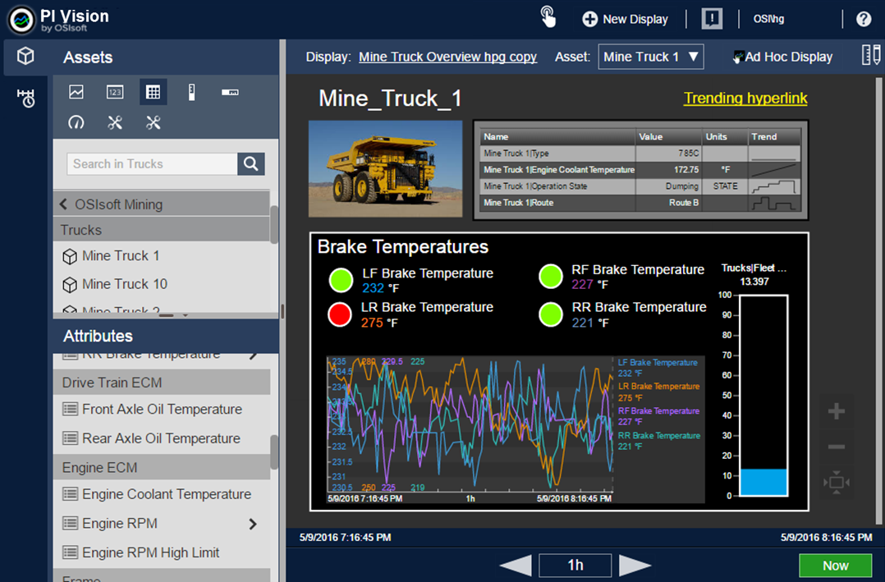
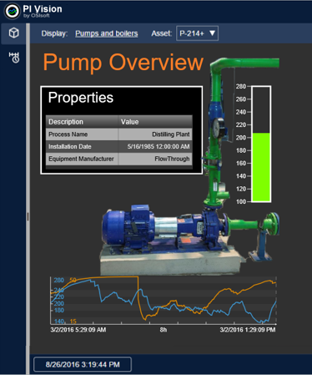
Digital Twin with AVEVA APM Closed Loop Predictive Maintenance
Manage risk, diagnose reliability and performance problems and optimize work planning and execution with visual APM
Problem diagnosis
Remote work planning
Risk assessment
Safe job analysis
Isolation plan assessment
Put Your
360° Digital Representation
37
© 2021 AVEVA Group plc and its subsidiaries. All rights reserved.

Slide 38
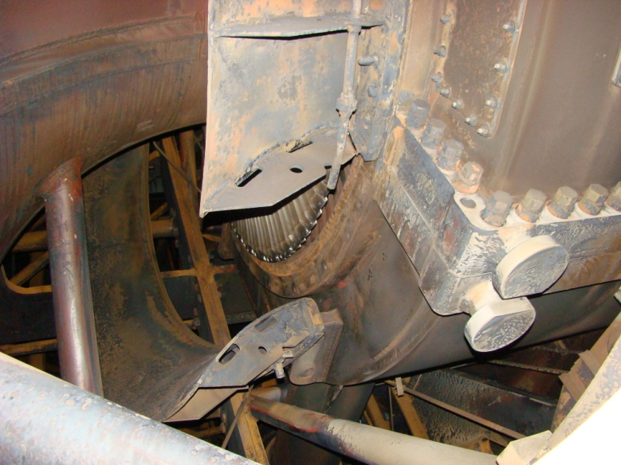
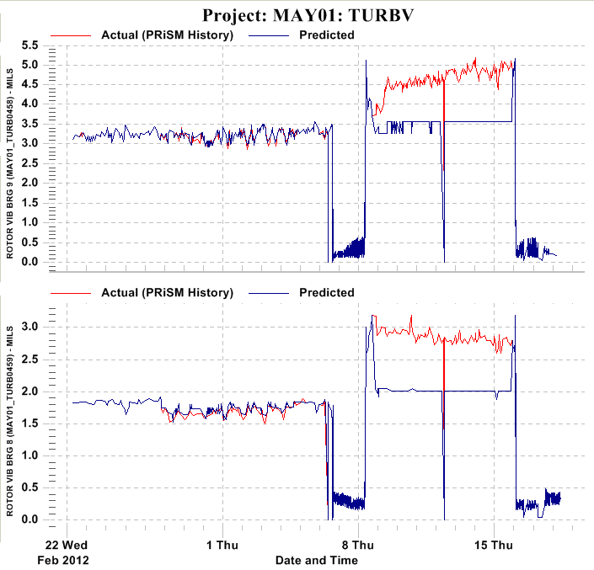
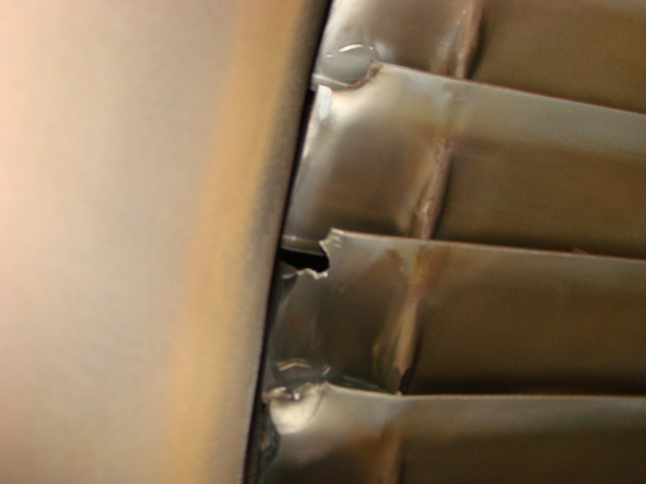
Duke Energy – LP Rotor - L-0 Blade Problem
    Unit was started after an outage and there was a vibration step change on one of the LP turbines (Vibration levels were well below the alarm level)
    Engineering and the plant were notified
    Vibration data was collected and unit was retired for an inspection
    Bolts on lower half of flow sleeve had broke and flow sleeve contacted L-0 blades
    Upper half of flow sleeve was no longer supported by lower half
    Although we had minor damage to the LP blades, we avoided damaging multiple stages of blades, packing, and diaphragms if we had a severe blade liberation.
    Estimated avoided cost - $4.1M

Slide 39
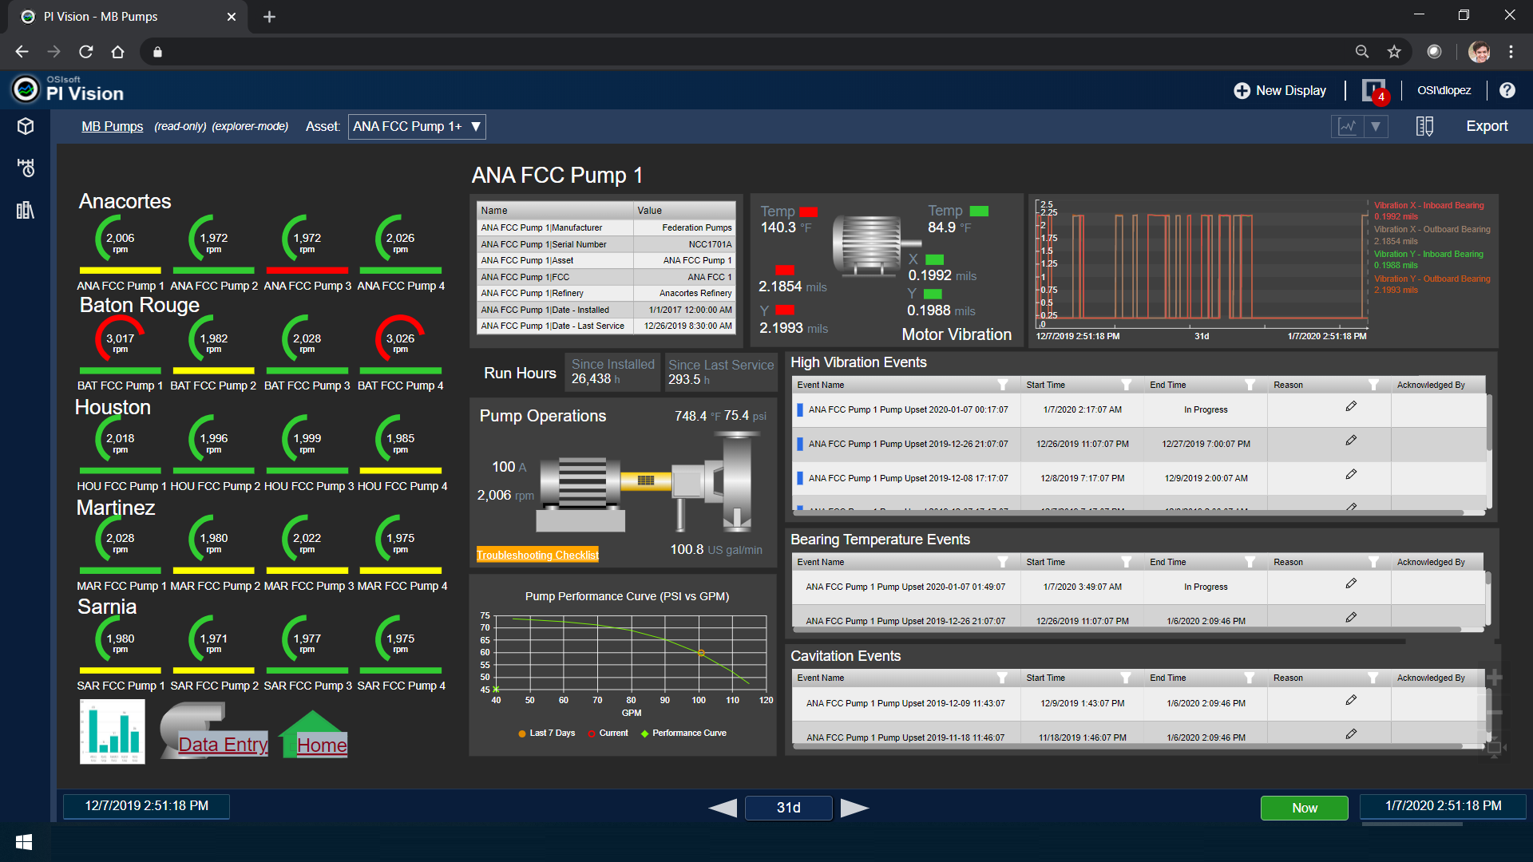


Slide 40

Thank you!
Meet us on the RISE stand
Christian FRENEAT
International Sales & Business Development
Yasin DEMIRDELEN
Software End User Sales Leader

