Slide 1

Vibration Sensors
in Reliability Journey

Slide 2

Every factory wants to start / develop their Reliability journey
Define and achieve
Goals
Create
Strategy
Develop
Culture

Slide 3
Do we need to listen to machines ?
Vibration Monitoring ≠ Reliability
Is a pulse measurement = healthy lifestyle ?
Can we achieve a success in Reliability without Vibration Monitoring ?
What is Reliability ?
What is the Goal ?
Where do we start ?
Challanges

Slide 4
What is Reliability?
Reliability
Healthy lifestyle
To have a vision and mission
We want to work in comfort and safe conditions enabling high productivity in the most cost effective way.
Experienced personnel with big trust of all company
Set your goals to be clear and measurable
Use industry recognised metrics
Compare your results with other sites and WCM leaders
I want to live 100+ years in good health and high quality life and achieve this as easy as possible
Wife/Husband / Friend
Set your goals to be clear and measurable
Use easy to control parameters (weight, height, pulse, blood pressure, sugar in blood level, etc..)
Compare yourself with healthy looking person at the gym or neighborhood
Advocate
KPI
Benchmark

Slide 5
How do I understand implementation of Reliability?
Reliability
Healthy lifestyle
Criticality analysis and RCM and …
We know which equipment can cause problems which will influence our way to achieve goal
We know what implications sugar, cigarettes and lack of sport activity can have, we analyse risk of diseases basing on history or genetics
Maintenance strategy
Let it break
Exchange maintain parts on fixed periods
Listen to machines
Improve their operation
Run to Failure
Preventative Maintenance
Predictive Maintenance
Proactive Maintenance
Carpe diem and … doctor help !!
Take pills, fix teeth, etc
Buy a pulsometer and install performance tracking App
Do not ignore any symptoms and perform actions

Slide 6



Why I failed, why some factories failed?
Reliability
Healthy lifestyle
Reasons
Lack of support
Lack of budget
Lack of faith
Lack of confidence
Too many false alarms or unexpected breakdowns can lead to …
I couldn’t get training results properly measured and…
… lost motivation
How many ‚Pilot’ projects not developed ?

Slide 7
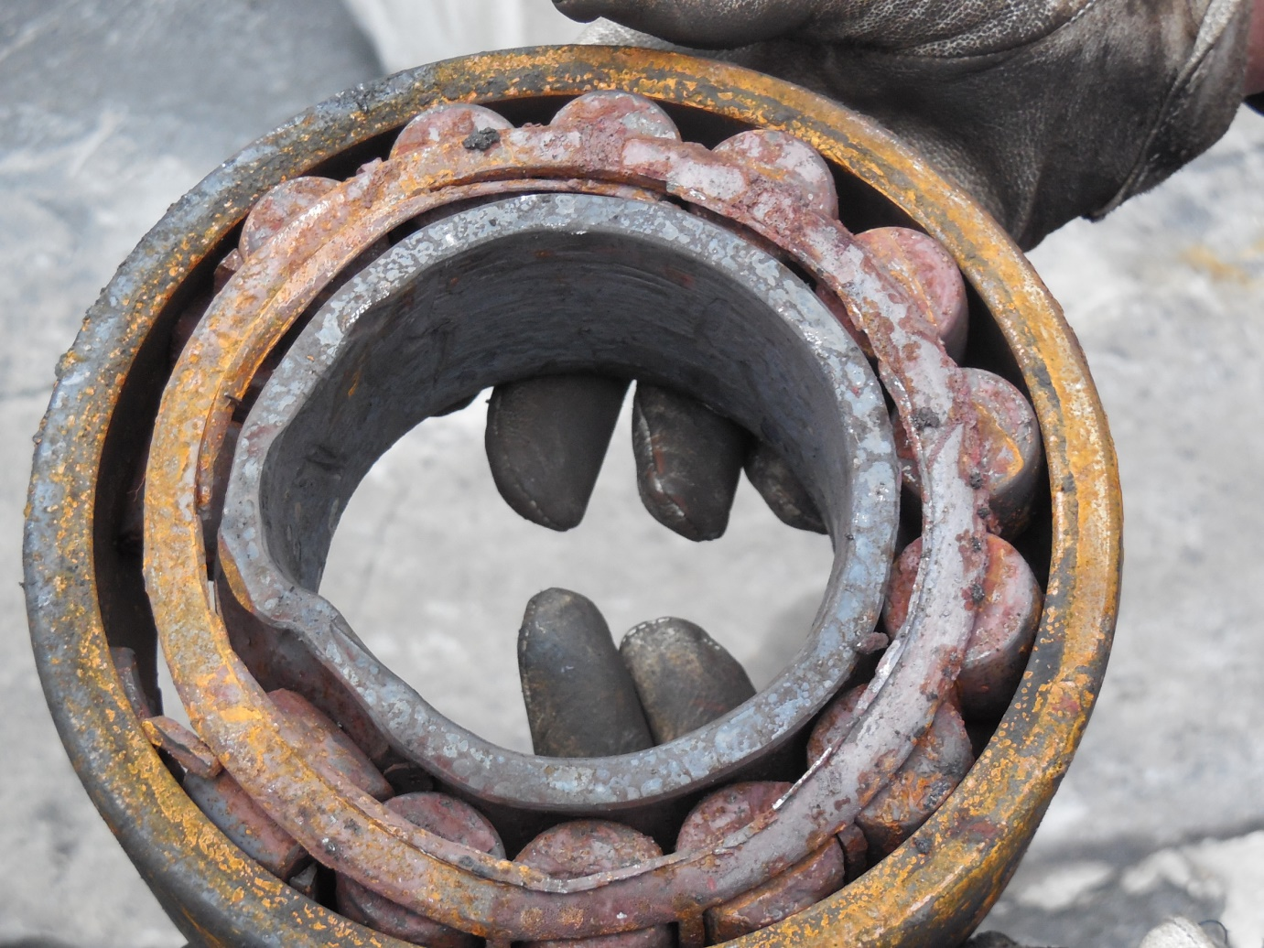
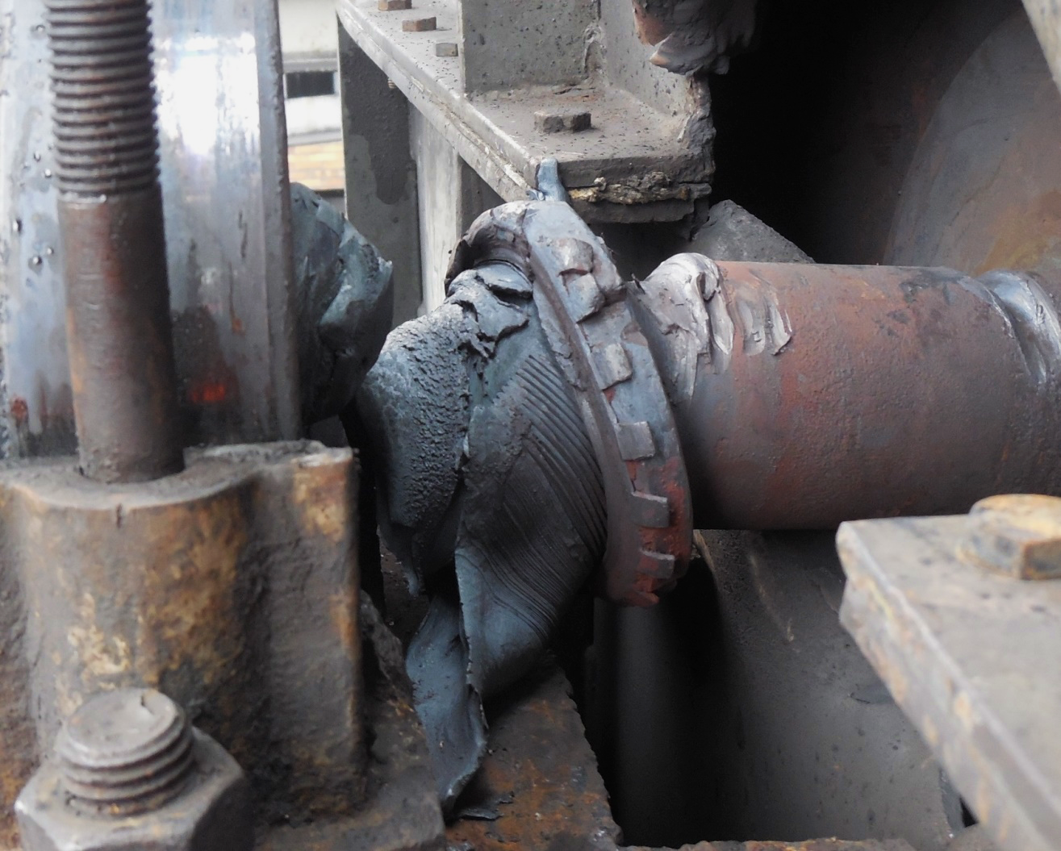
Preventive Maintenance
Disjointed
Management
Mechanics
Electricians
Maintenance Manager
online system for pumps
portble vibration analyser
ultrasound analyser
thermal camera
Warranty of machines and requirements of their maintenance to fulfill warranty obligations

Slide 8
Together
Connected
Management
Mechanics
Electrician
Maintenance Manager
Reliability Engineer
People
Training
Involvement
Processes
Planned
Reviewed
Total Cost of Ownership
Proactive mainenance
Design/Specification phase

Slide 9
What information do we need to change to proactive maintennce ?
Shopping list:
involved and trained people
plan
criticality,
cost of failures (repair, lost production, additional cost),
cost of maintenance,
amount of not scheduled maintenance hours,
working hours,
speed, load,
mechanical condition ( types of failures mode which can occur, their symptoms, method of detection asureness)
Preventative Maintenance
Predictive Maintenance
Proactive Maintenance

Slide 10
What machines may talk about ?
VIB/US
TEMP
OIL
To know condition
What data ?
Which technology will help us to understand particular asset best?

Slide 11

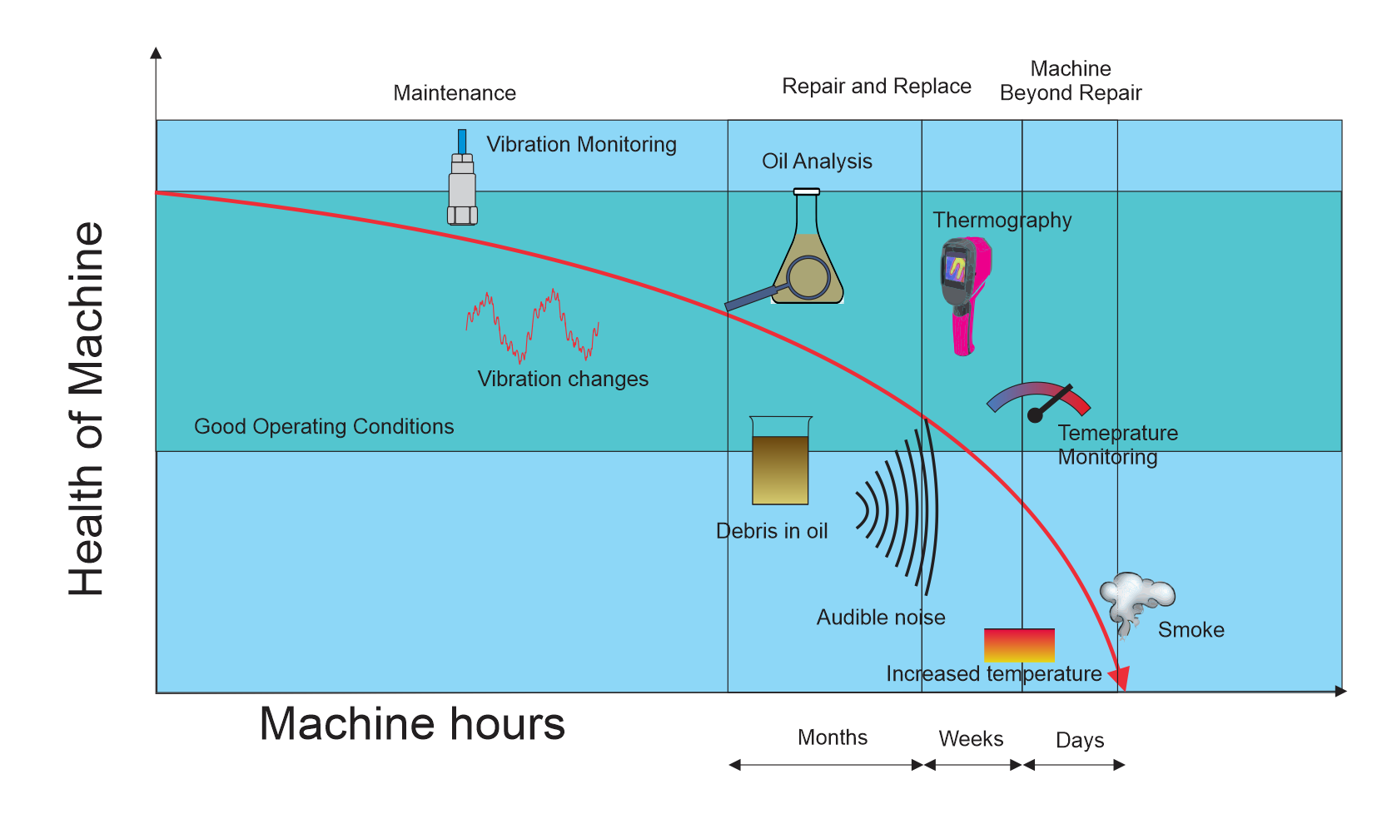
P-F with different technologies
Vibration measurement
It exists 30+ years
… but still I get suprised how many machines runs as a big unknown
TODAY ALREADY
D-I-P-F (DESIGN – INSTALLATION – POTENTIAL FAILURE - FAILURE
I-P > PROACTIVE MAINTENANCE

Slide 12

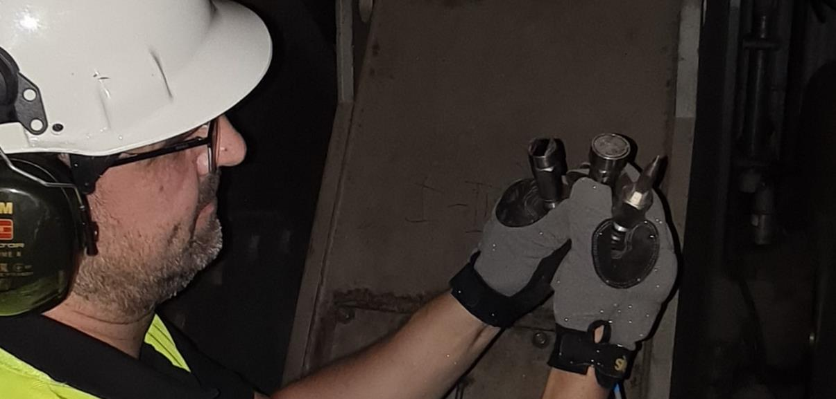
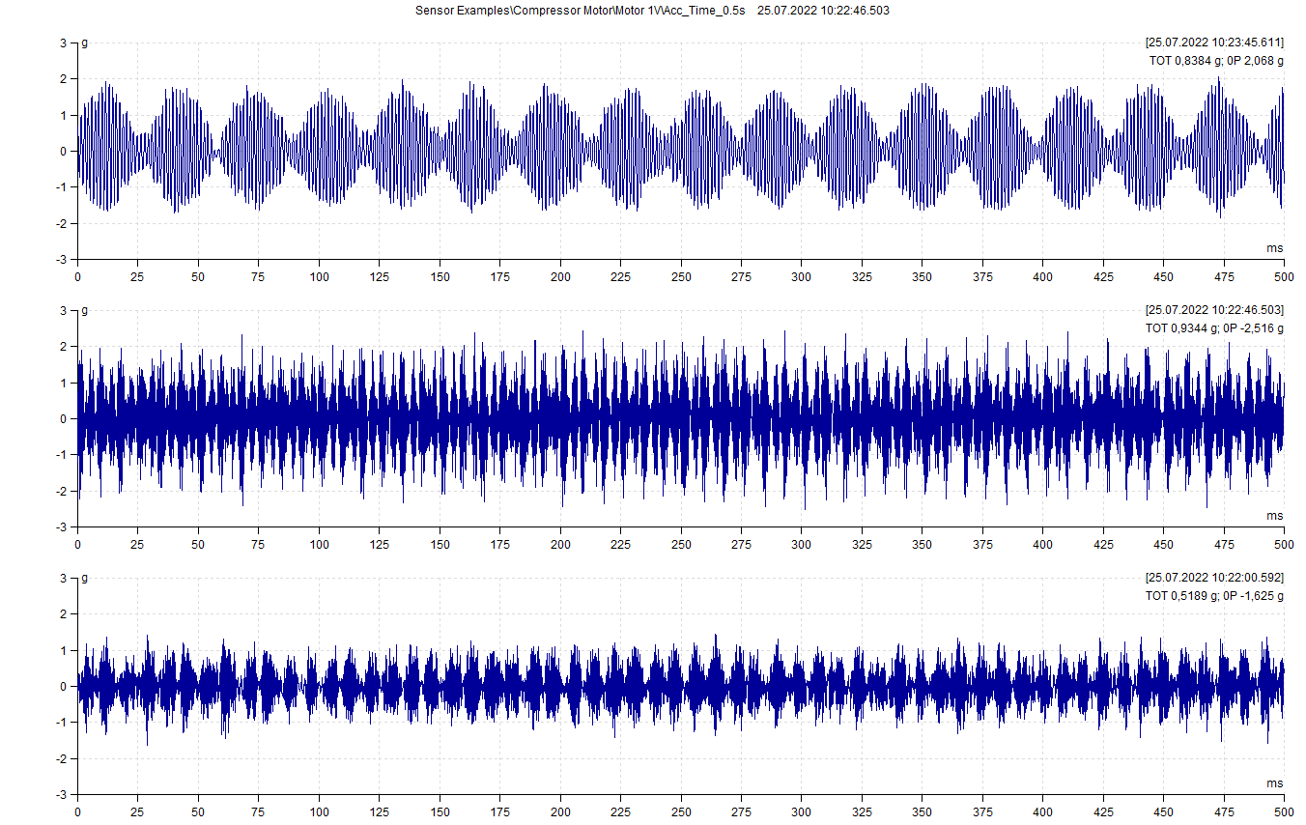
! Vibration >
> vibration sensors >
> lets put wireless sensors everywhere as it is easy
sorry guys it is not that quick and easy >
> invest time and learn yourself to understand it or trust someone who is an expert
expert is not a sales guy hwo leave you with the product but mesurement partner / reliability partner
you trust him so you build a plan together and he takes responsibility

Slide 13
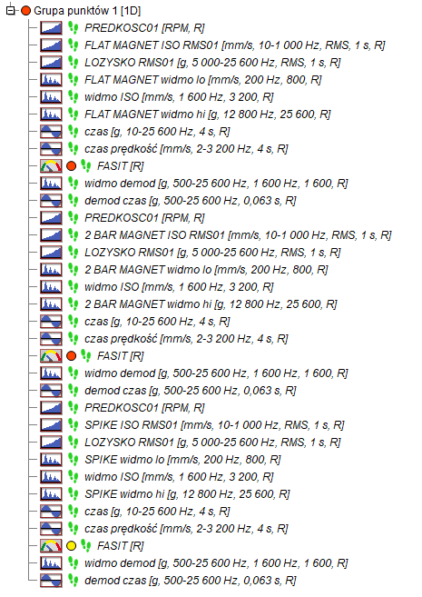

15 MW compressor – bearing housing
Flat magnet, 2-bar Magnet, Spike – simultaneously
Spike is always a challenge due to limited space or hot surfaces etc.
Measurements taken with spike – 2 very different values because of different angle, different pushing force etc.
For low frequency spectrum – no big difference
For high frequency spectrum – huge difference.
Compiled from materials.

Slide 14
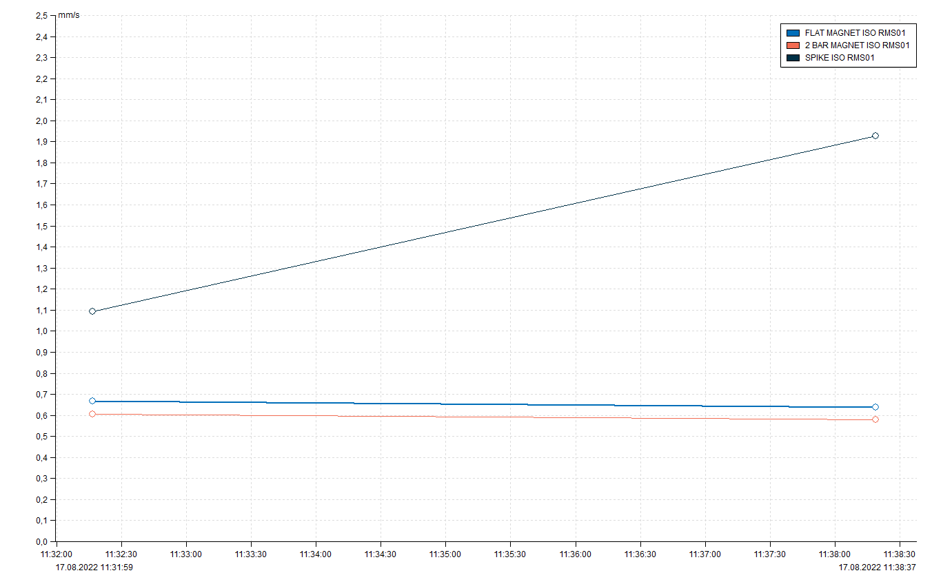
No repetable data taken with spike because of different force/angle
No comparible data between mouting methods
spike
flat magnet
2 bar magnet

Slide 15
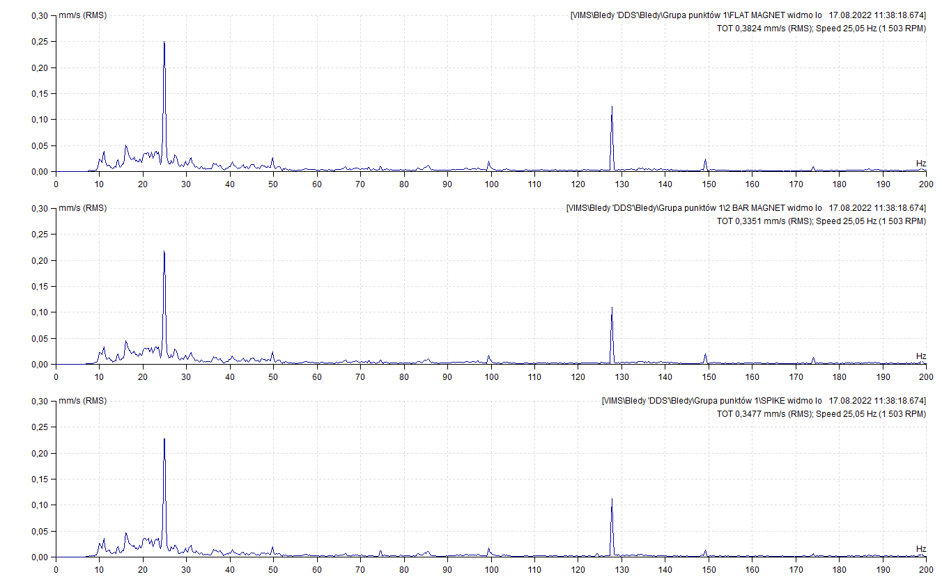
Low frequency spectra – almost the same shape

Slide 16
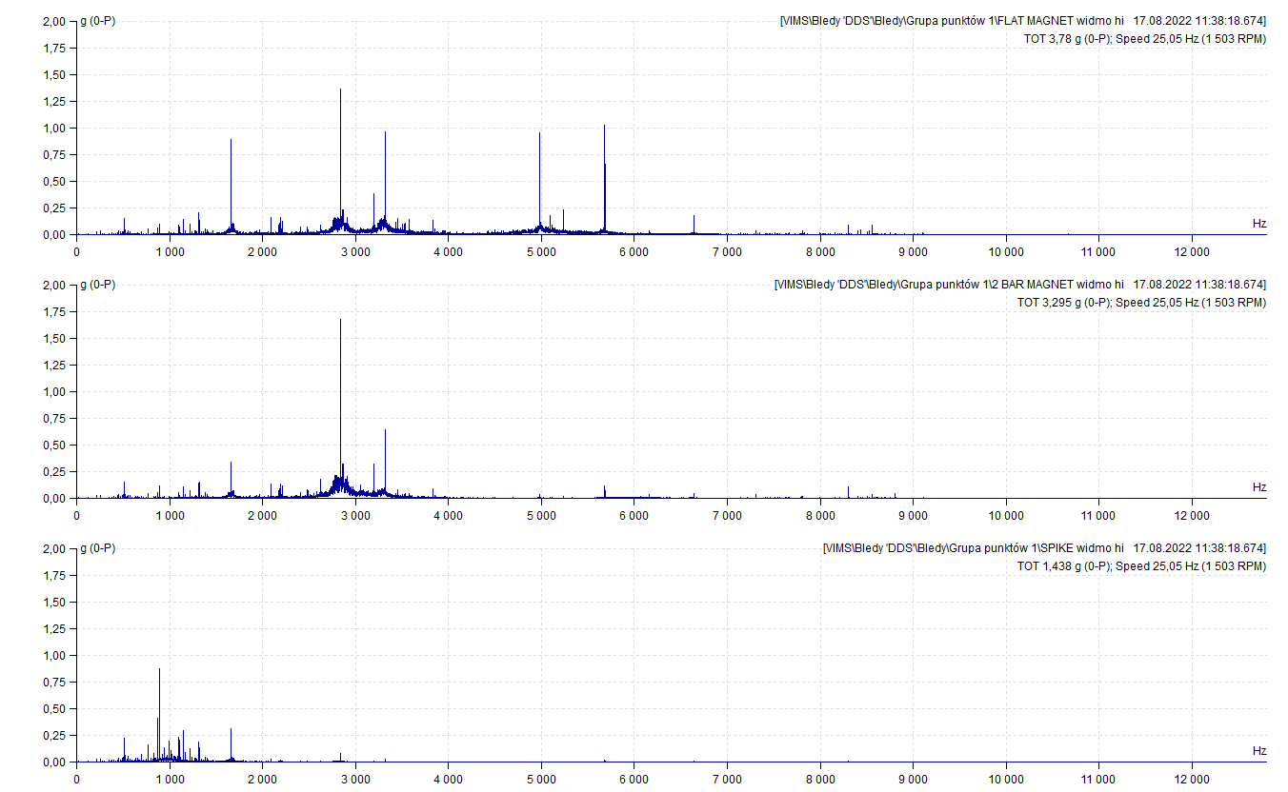
High frequency spectra – completely differet shape

Slide 17
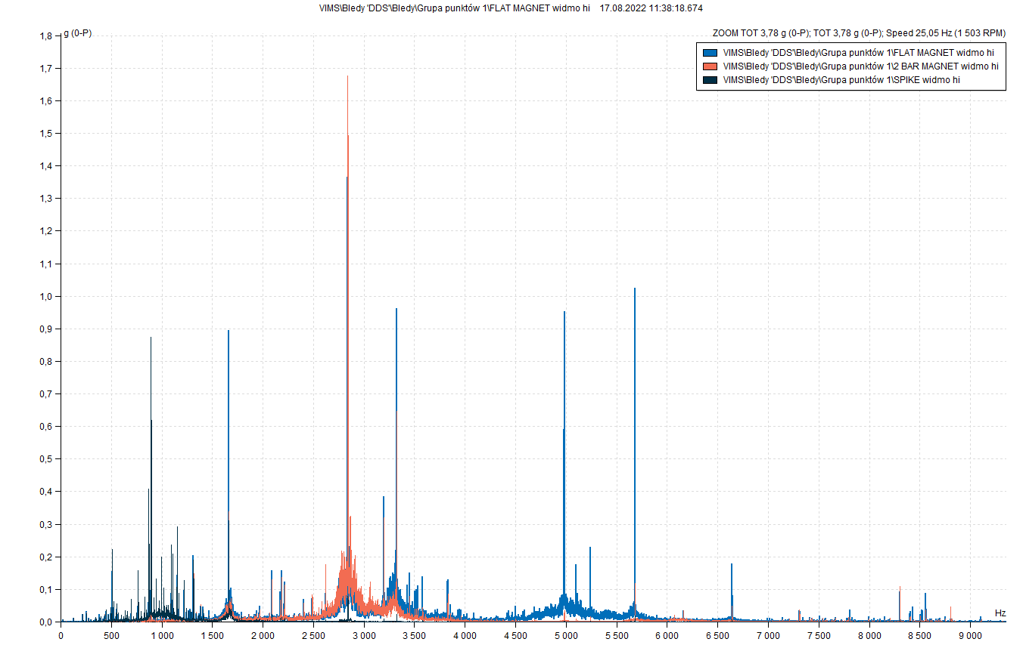
High frequency spectra – completely differet shape

Slide 18
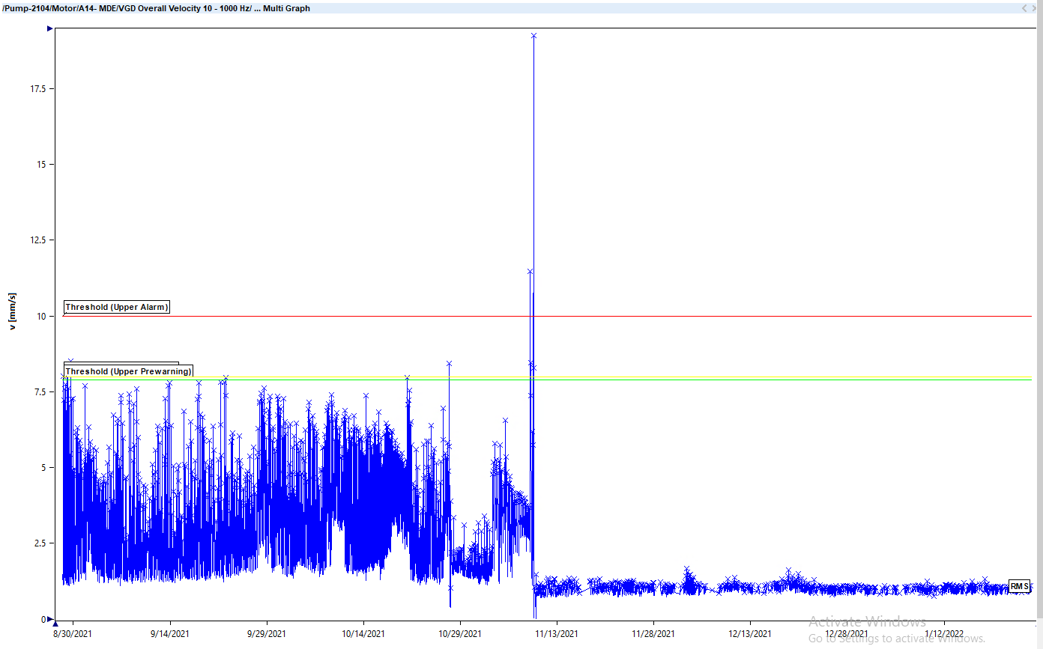
Grounding problem in on line system
Some systems require screen connected to the case of accelerometer and some not.
Example of trend of Vrms where there was no maintenance action on machine just system cabling improvement.

Slide 19
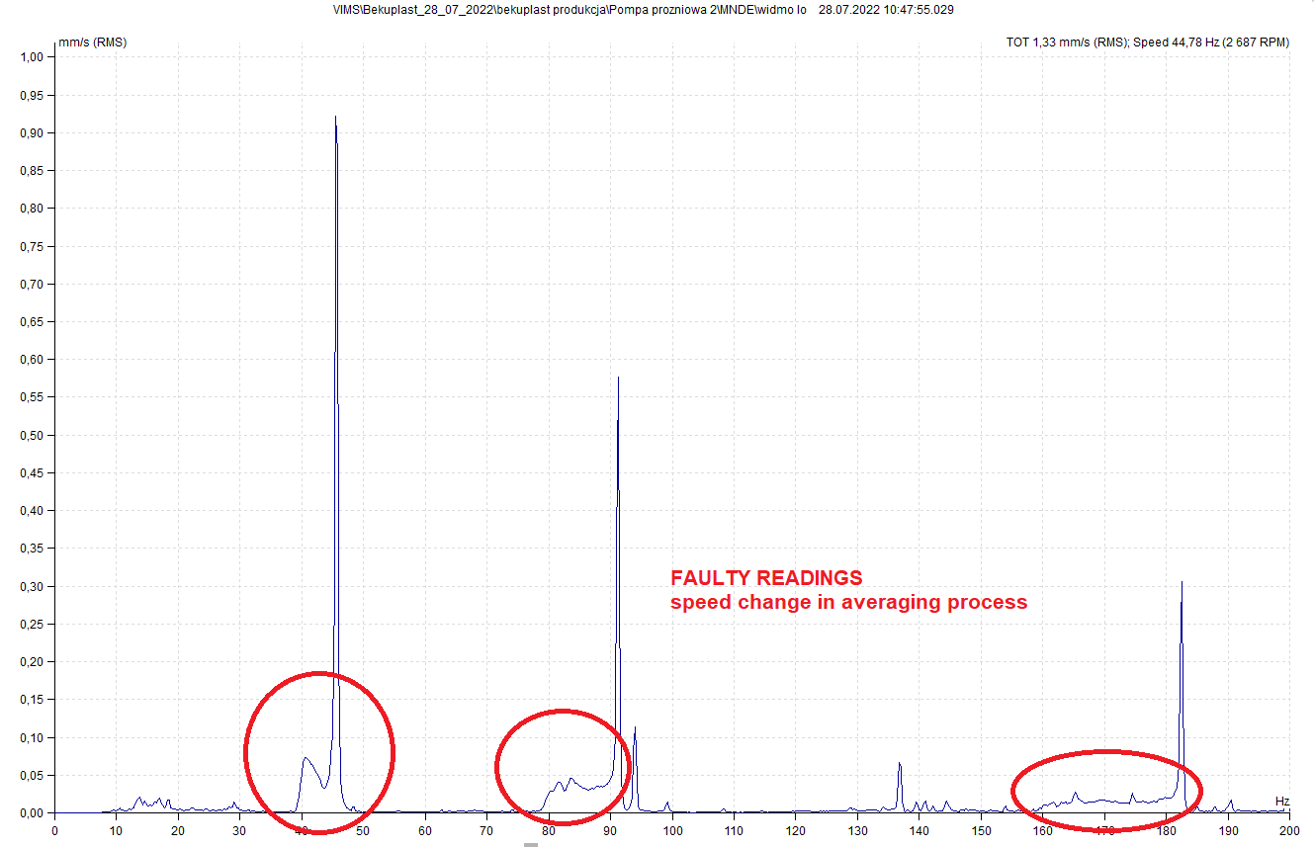
Vacuum Pump 2 with VFD
Poor spectrum quality when averaging used and speed is not stable without tacho synchronization

Slide 20
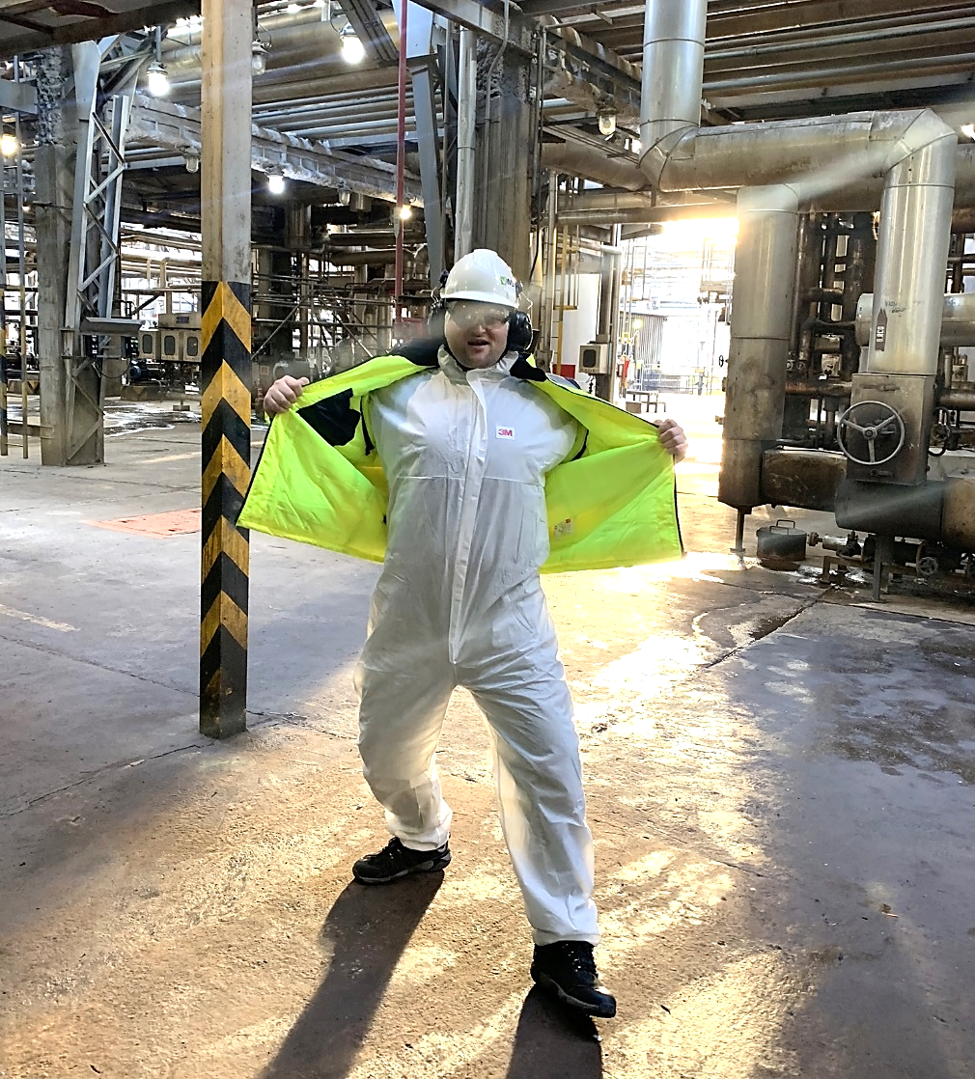
Why I am here
Understand why it is important
Are details important
How vibration measurement fits into Reliability Program
Point out some challenges
Provide practical tips
Validate theory / practise
To help you to be sure, relaxed
and happy in your work
Certified CMRP
Certified ARP
Certified VA II
Certified ITC
Mechanical and Automation Engineer
18 years in CBM
14 years in Hansford Sensors

Slide 21
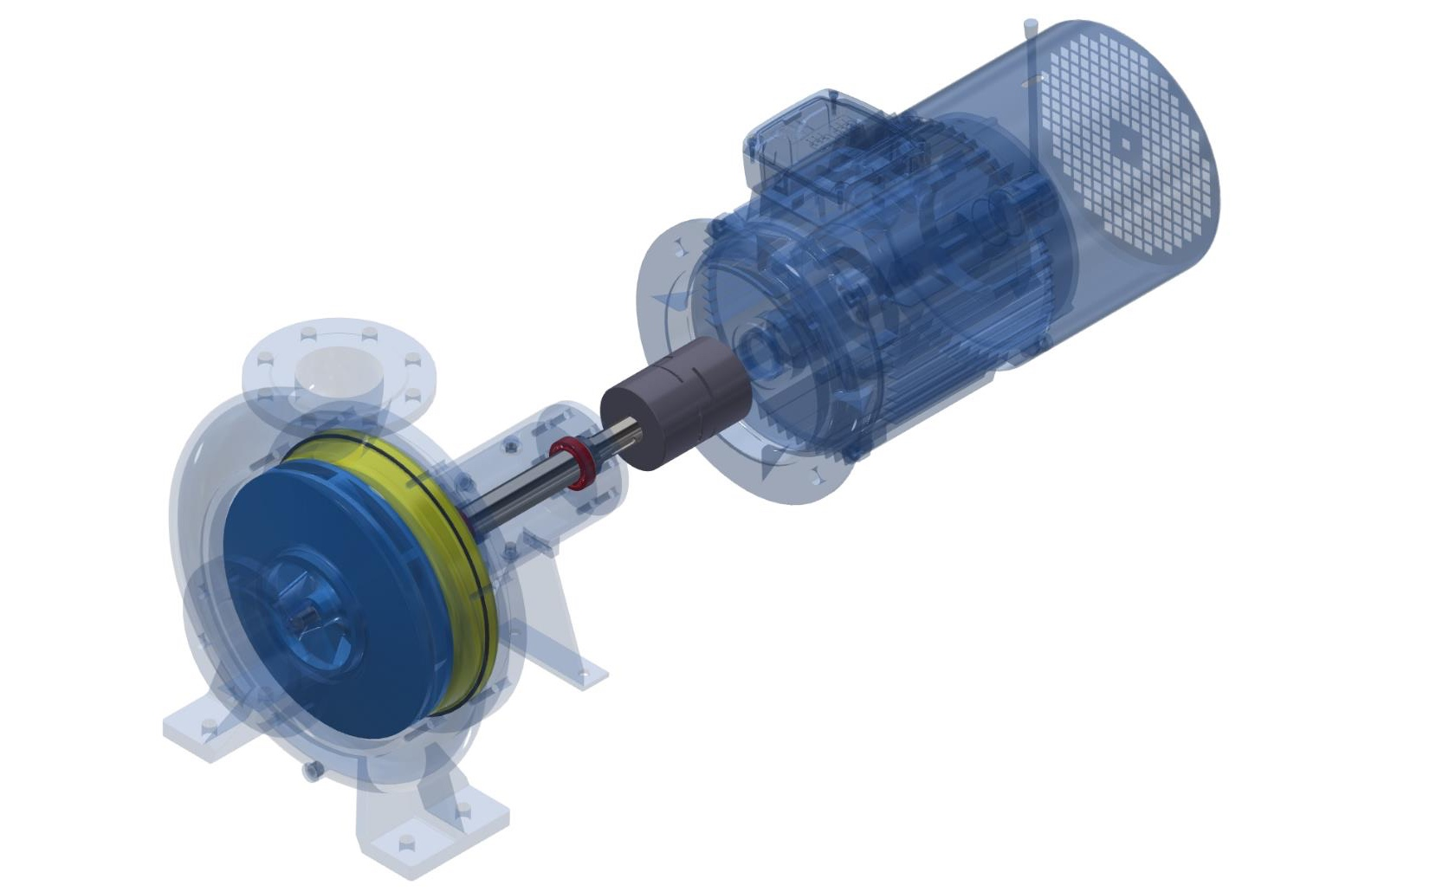
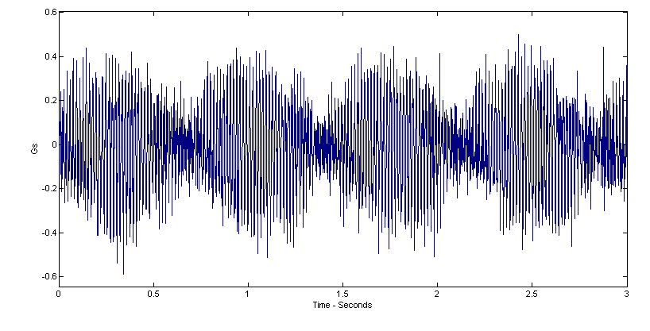
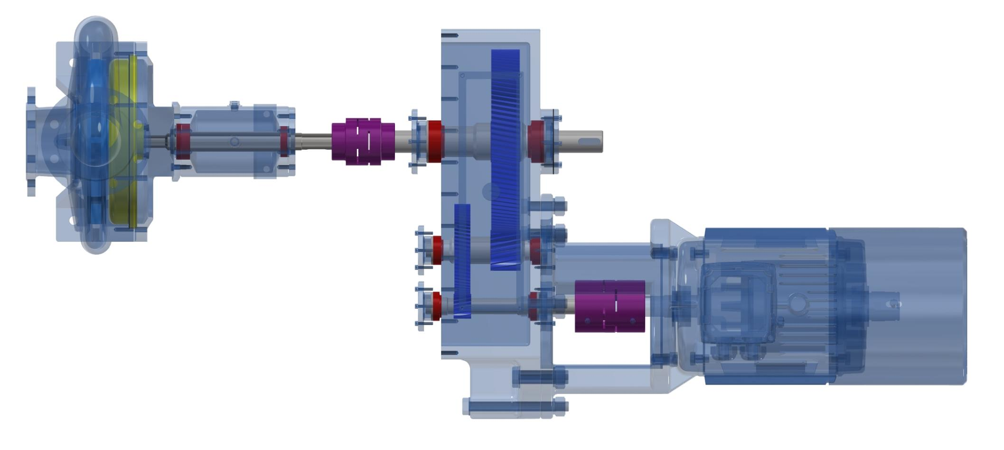
Indirect benefits of Vibration Program
Kinematics of asset and documentation
Rotation speed known
Working hours counted
OEE
Lubrication management performance controlled
Pre & Post Repair data
Energy efficiency benefits
Properly implemented:
Audit > Criticality > Potential Sources of Primary Malfunctions > Selection of Technology > Implementation > Verification > Calibration > Adjustments
10
9
8
7
5
6
4
3
2
1

Slide 22
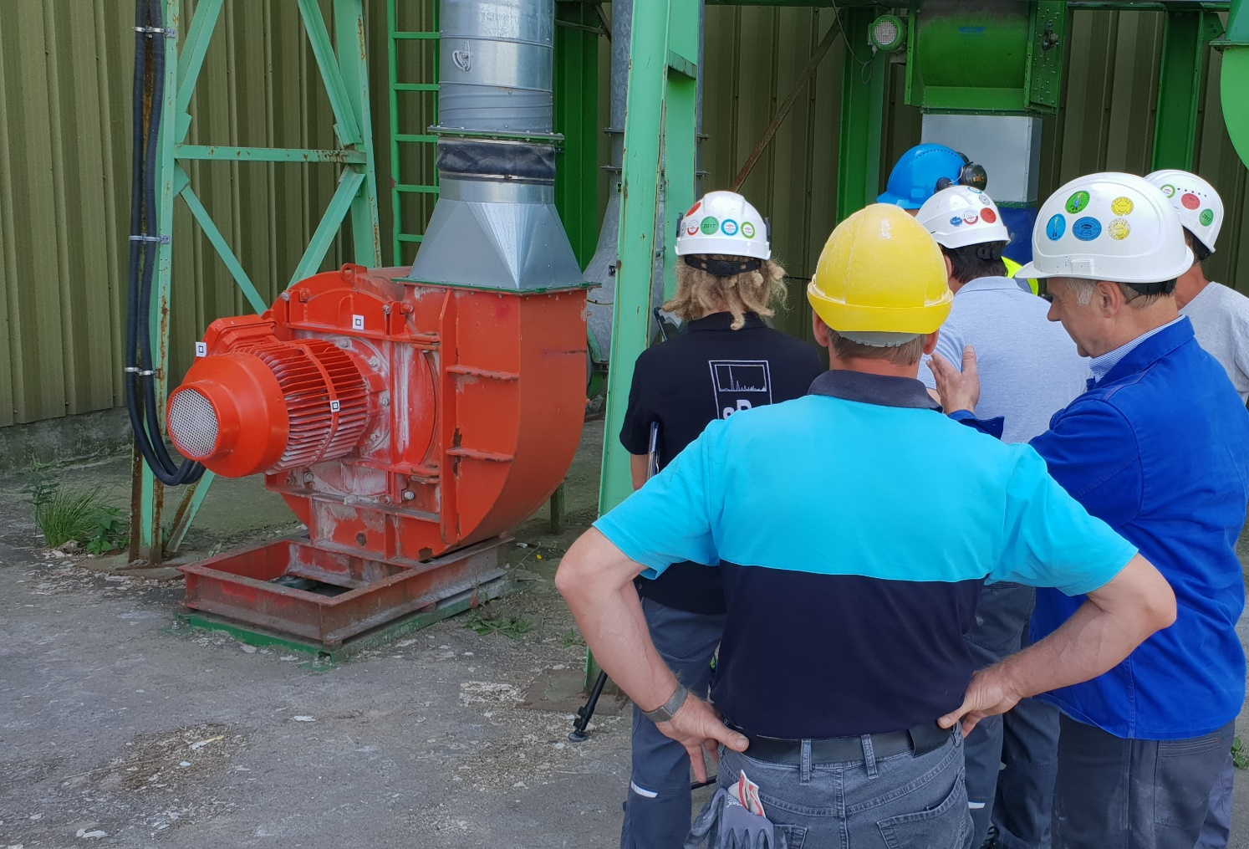
In house
Do monitoring because observation of change is clear
Adjust your warnings and alarms over time
Start with simple 1 value Vrms
Develop band pass (wide and specific) monitoring
Understand limitations and do not learn vibration analysis unless it is only job to do
Develop acceptance test criteria for new and repaired assets - not only ISO
Find trusted experts
Put wireless where it is justified not because it is trendy
Sub-contracted
Make sure they are real experts
ISO 18436 certified ?
Help them to have good, safe access to machines
Request clear recommendations
Provide the feedback of maintenance actions

Slide 23
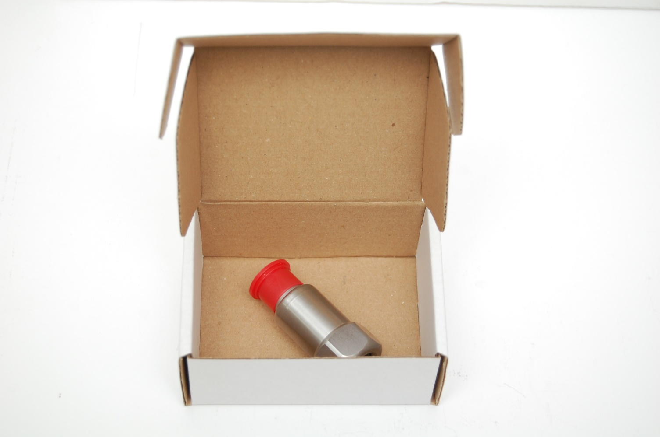
It all starts with vibration sensor
What type of sensor ?
Where to attach the sensor ?
How to attach it ?
How to connect it ?
To answer lets see what we are going to measure? …

Slide 24
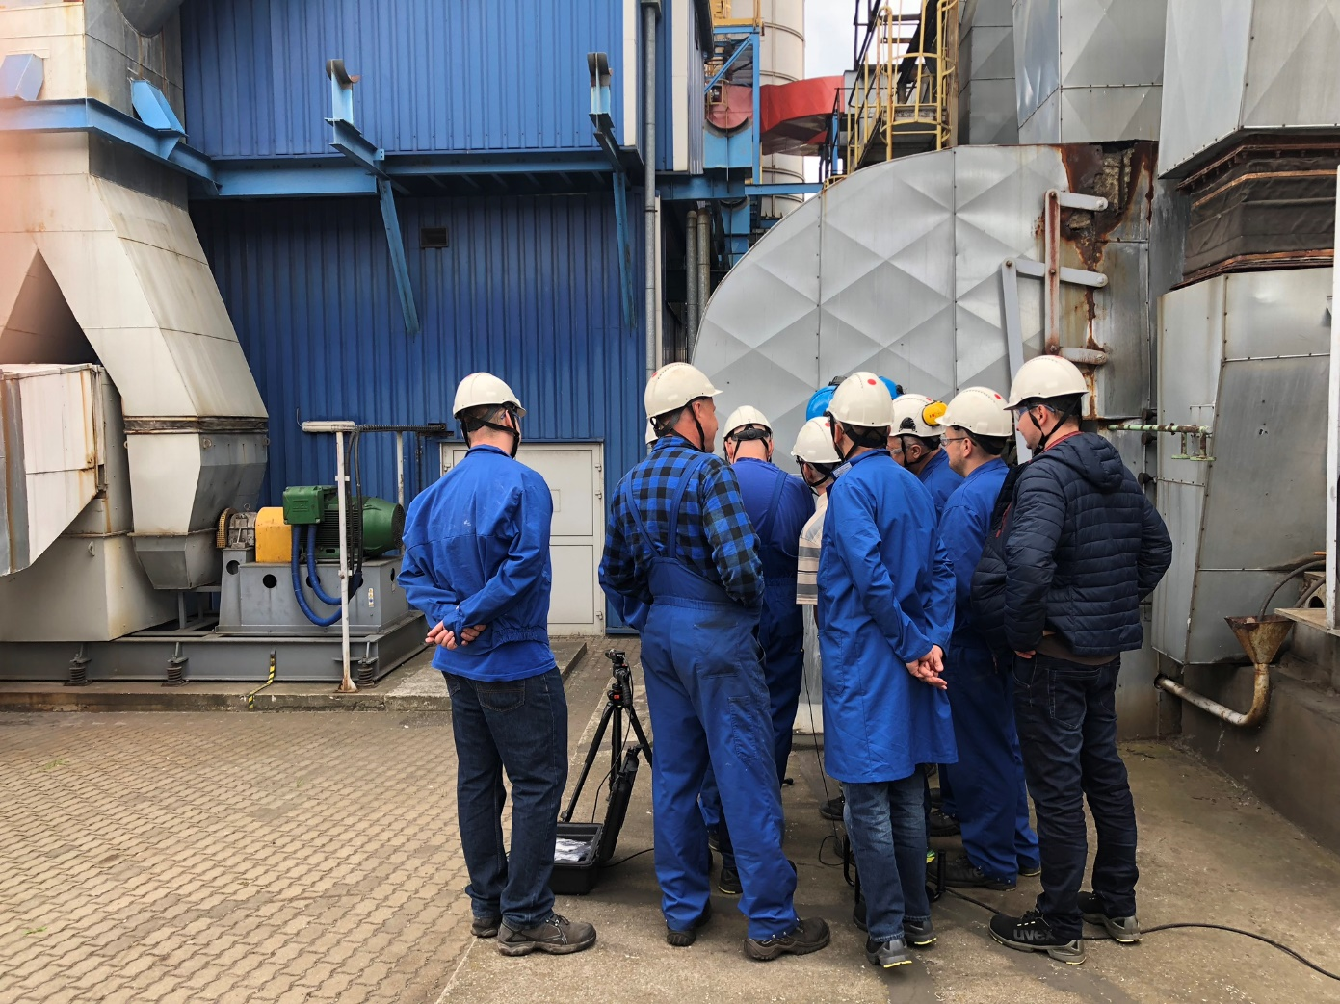

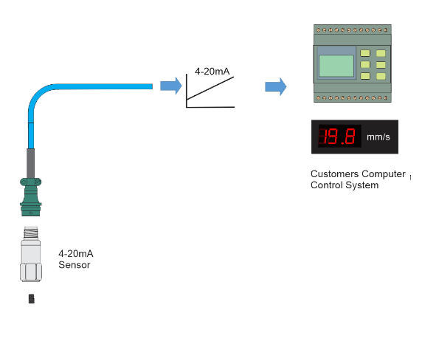
Online monitoring or offline diagnostics ?
Vibration Monitoring/Diagnostic Measurements
Periodical measurements
Uses Handheld Devices to diagnose problems on a periodic basis
Permanent Machine Monitoring
(Also called ‘online systems’)
Usually overall vibration levels to trend data to detect problems (do not determine what the problems are)

Slide 25
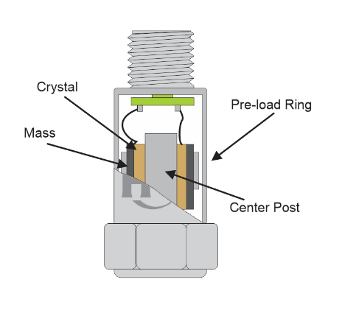
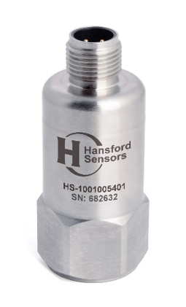
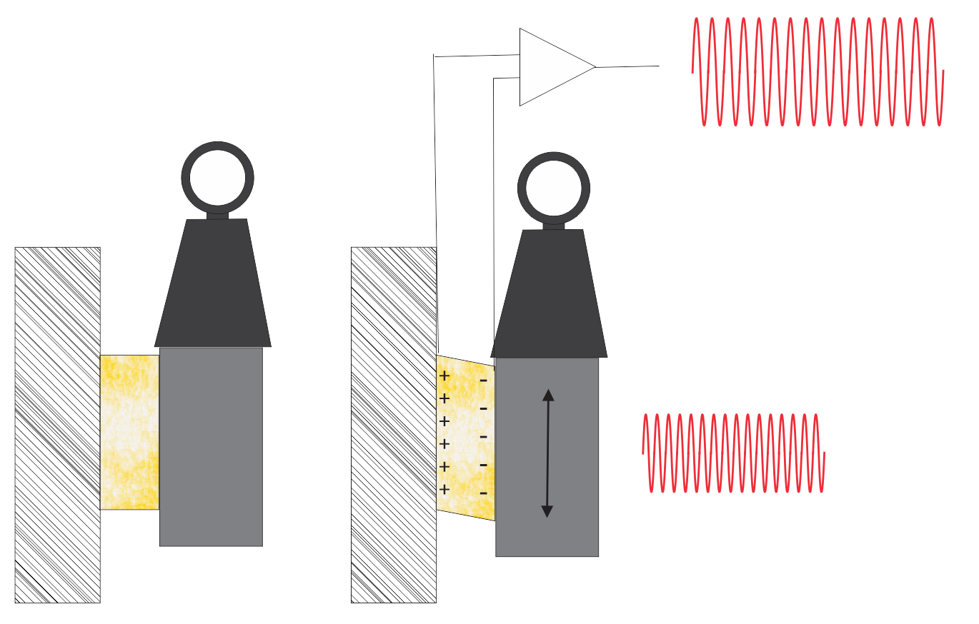
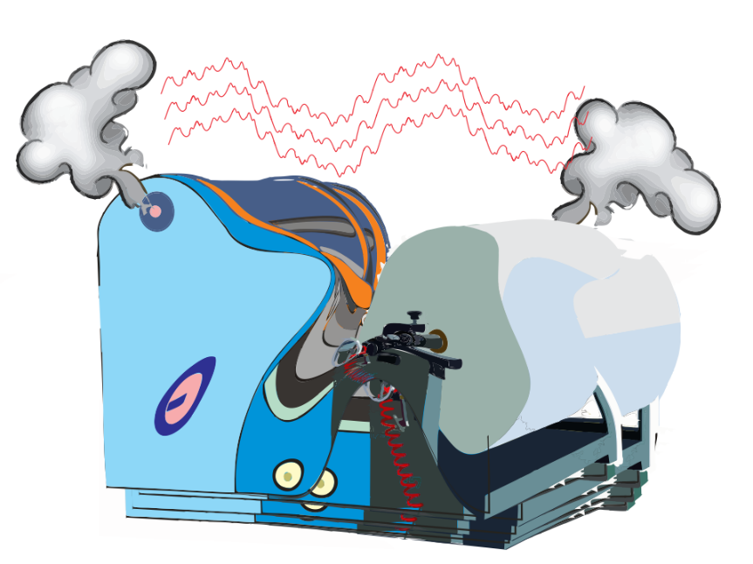
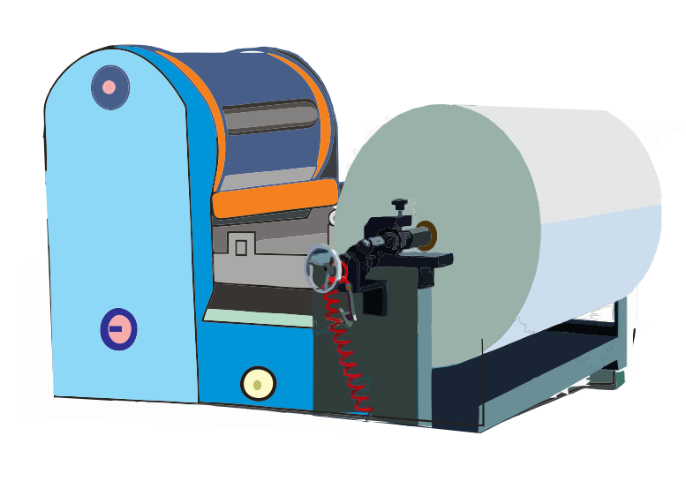
Converting Vibration to an AC voltage
we put the sensor on the machine
we start the machine…
…and inside of the sensor
If you keep the mass constant; charge proportional to acceleration
F=ma
Charge = S (constant for crystal) x Force
Force

Slide 26
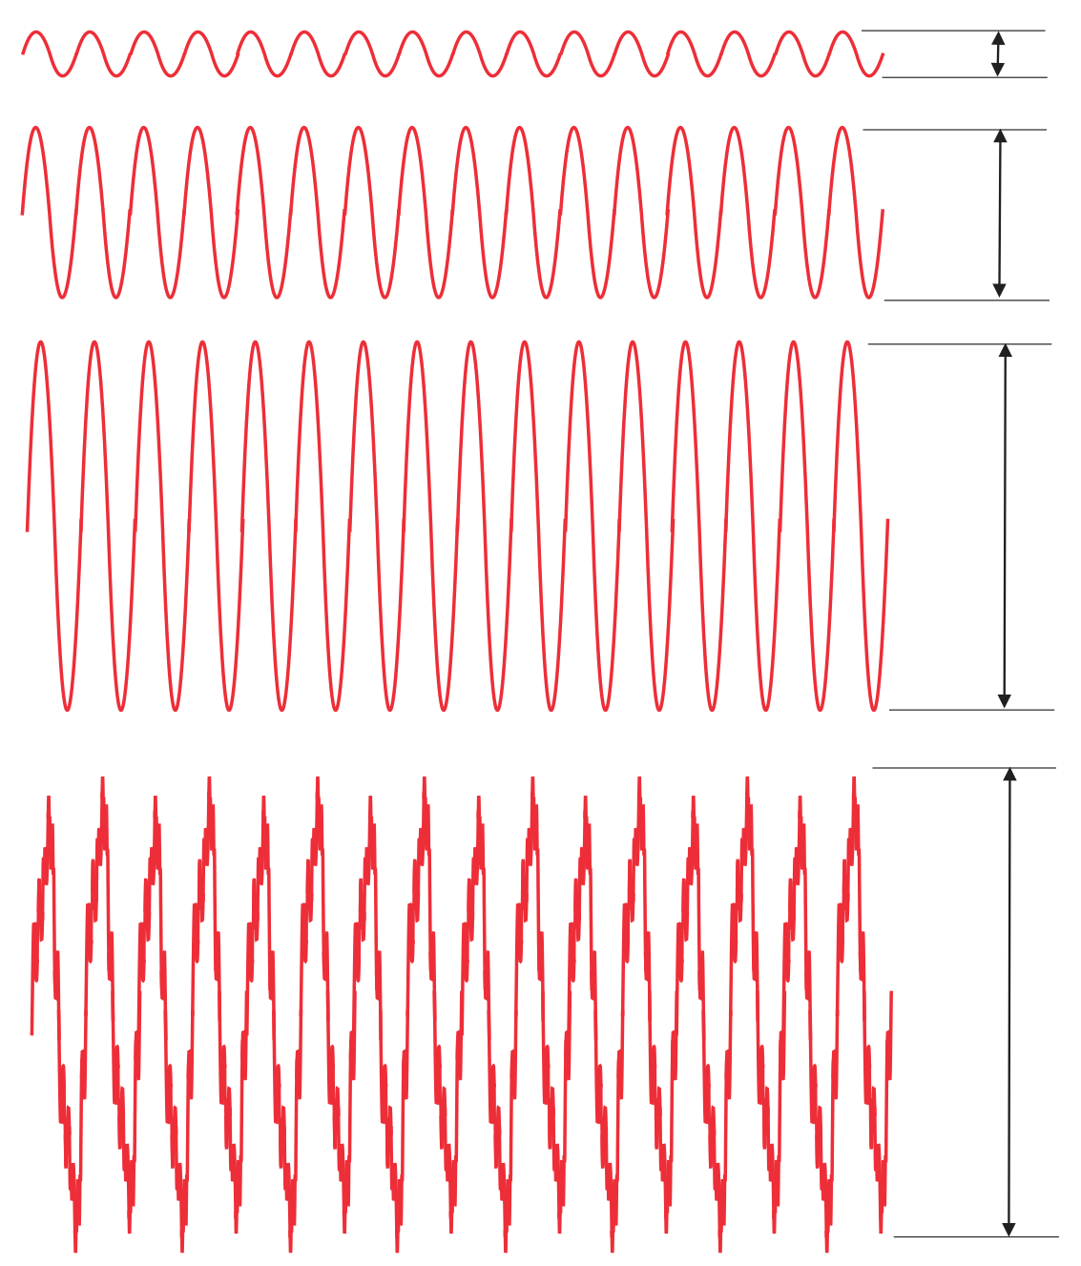
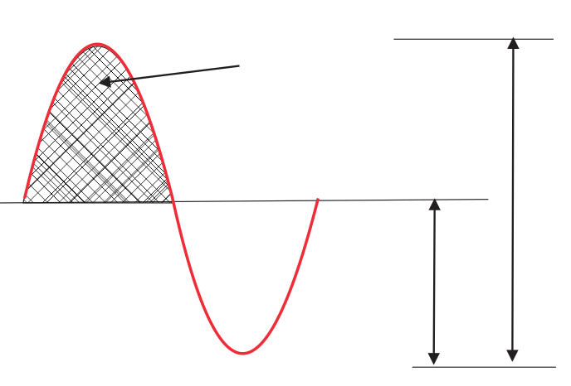
What to do with that signal ?
Smooth running machine
Vibration Amplitude Measurements
Fair running machine
RMS
Peak-Peak
Rough running machine
Peak
Rough running machine
(multiple potential failure
modes)

Slide 27
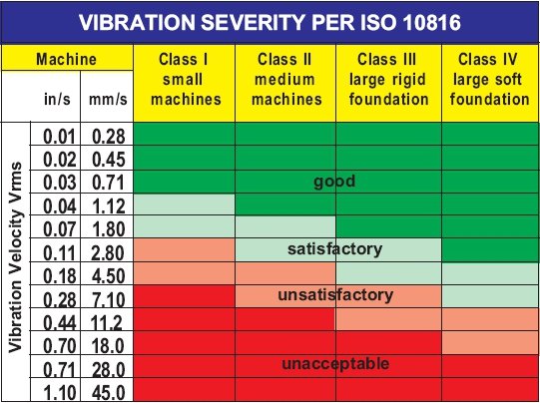
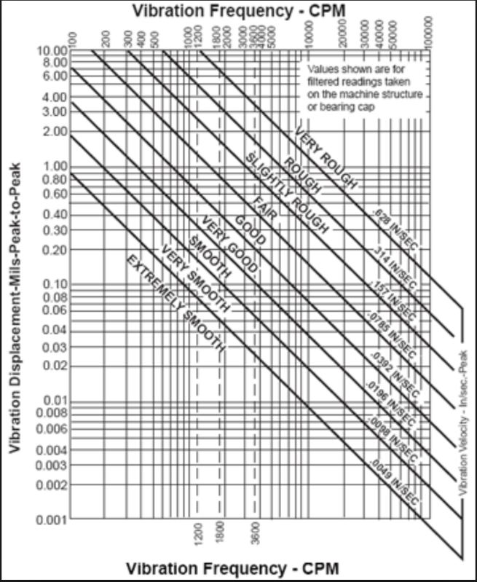
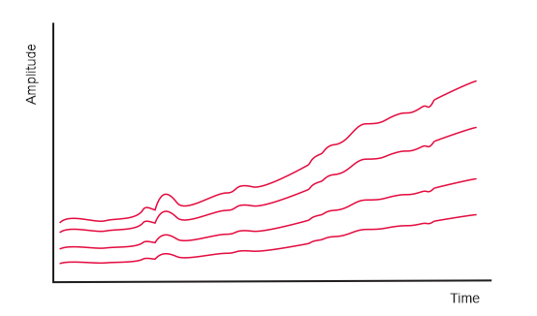
Vibration Amplitude vs Machine Health
Trending over time
Compare Values with International Standards

Slide 28
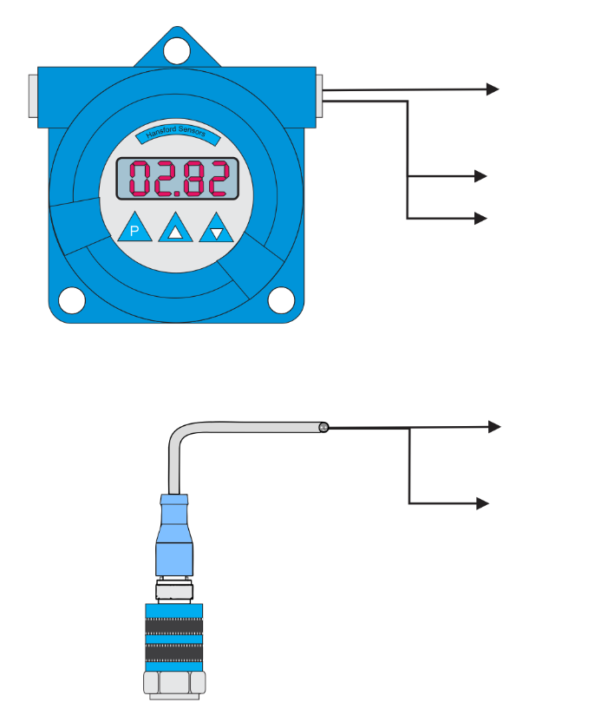
Vibration Level Trending
Can one value be more informative ?
Trending over time
Trending with relation to speed or load
Separated states of operation
on individual trends

Slide 29
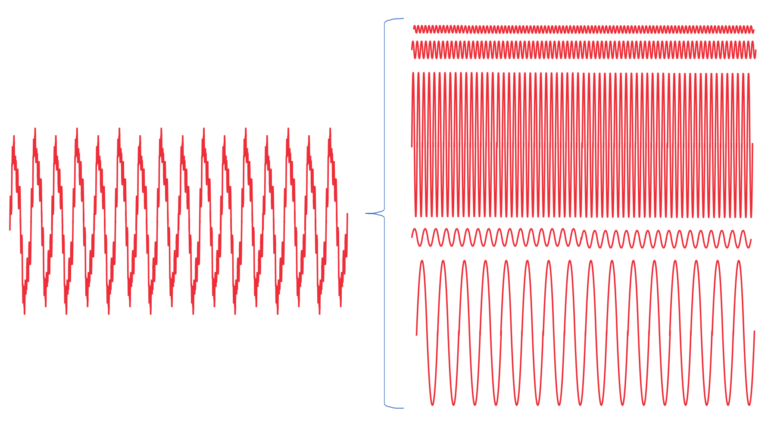
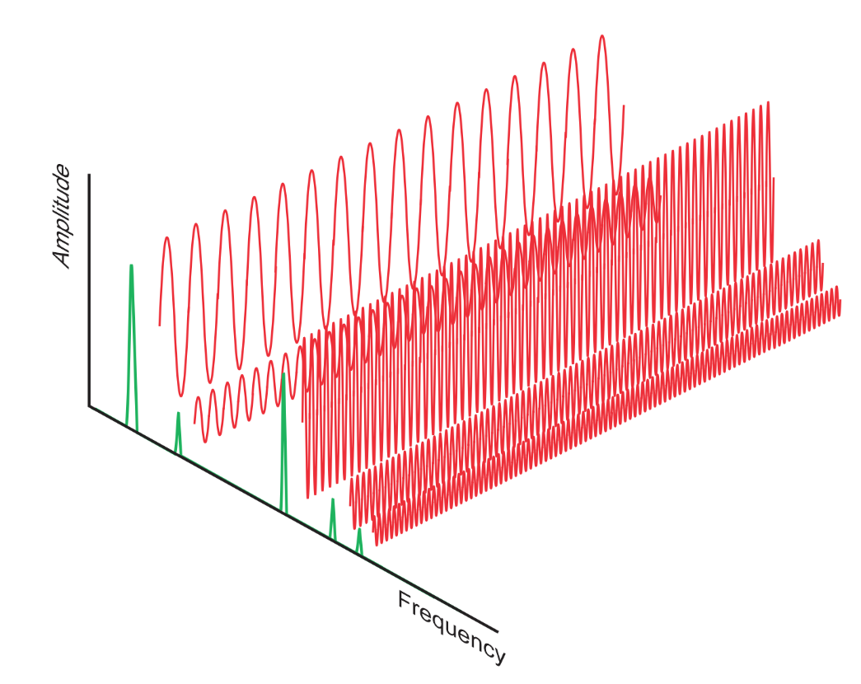
Time waveform, not only amplitude
Complex time signal can be separated into individual signals
FFT corresponds with waveform
and help to identify frequencies

Slide 30
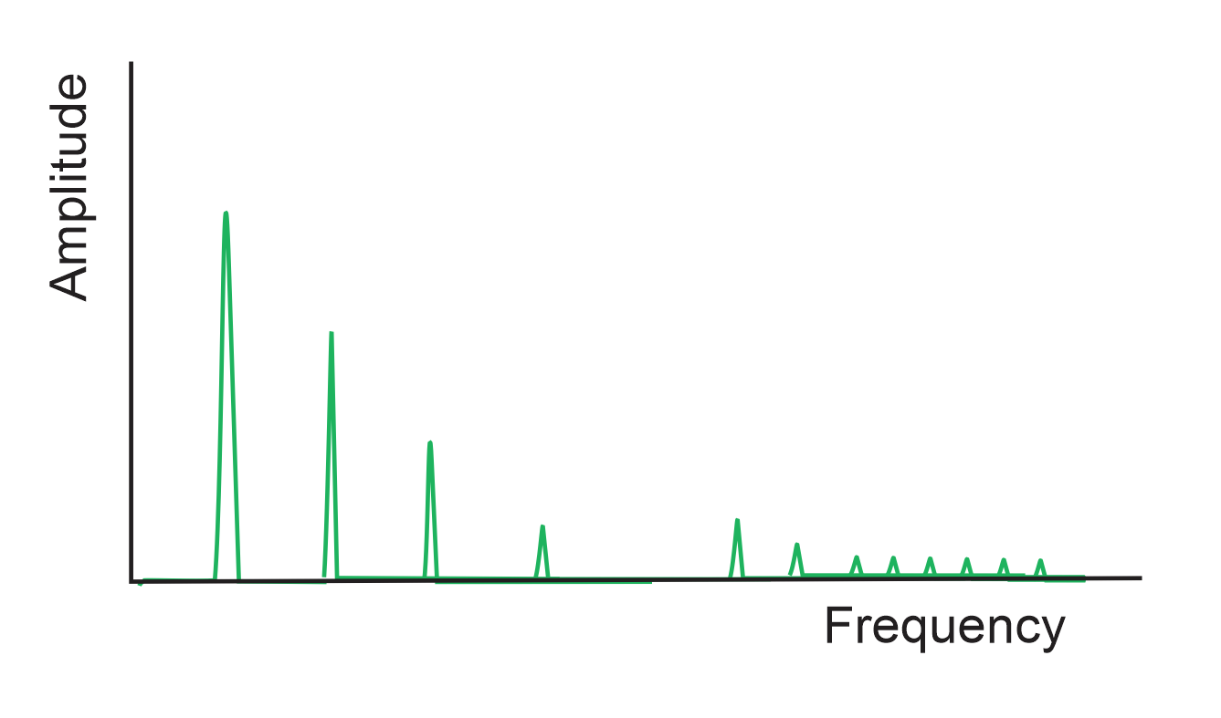
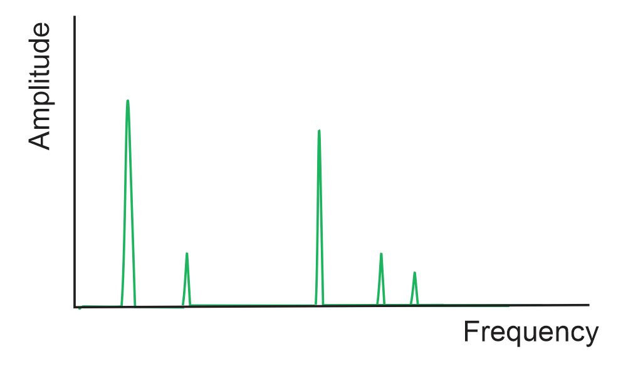
Spectrum and its correlation with assets and malfunctions
Spectrum
Unbalance
Misalignment
Mechanical Looseness
Roller Bearings and Gear-mesh

Slide 31
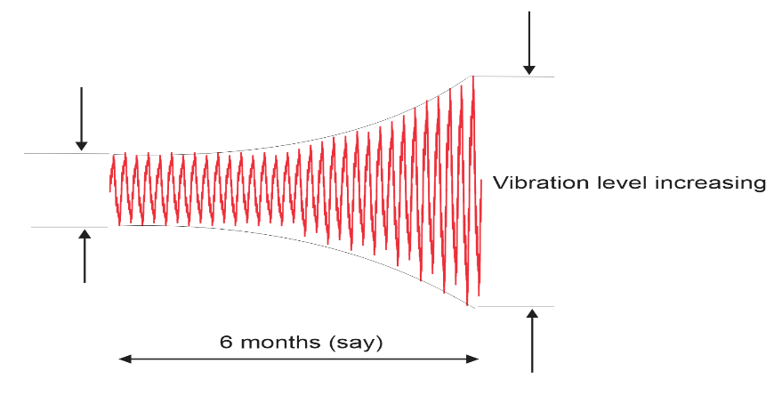
Band pass monitoring
Vrms (2/10 Hz – 1 kHz)
1x
2x
3x

Slide 32
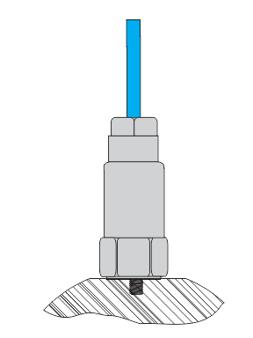
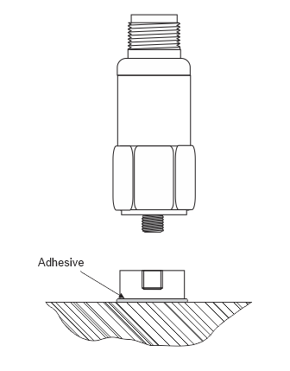
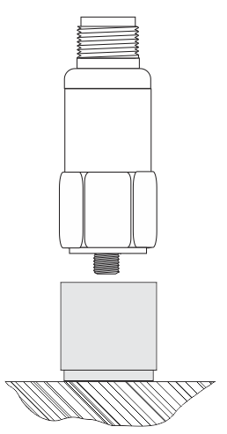
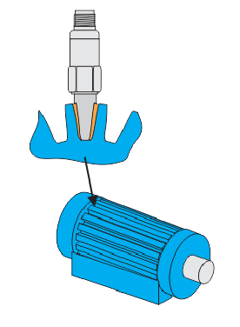
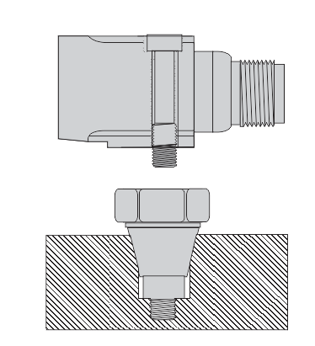
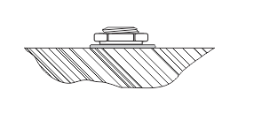
How to attach sensor to machine ?
7 main ways
Mounting Thread
Adhesive
Magnet
QuickFit Thread
Fin Mounts
Mounting Block
Conical Mount

Slide 33
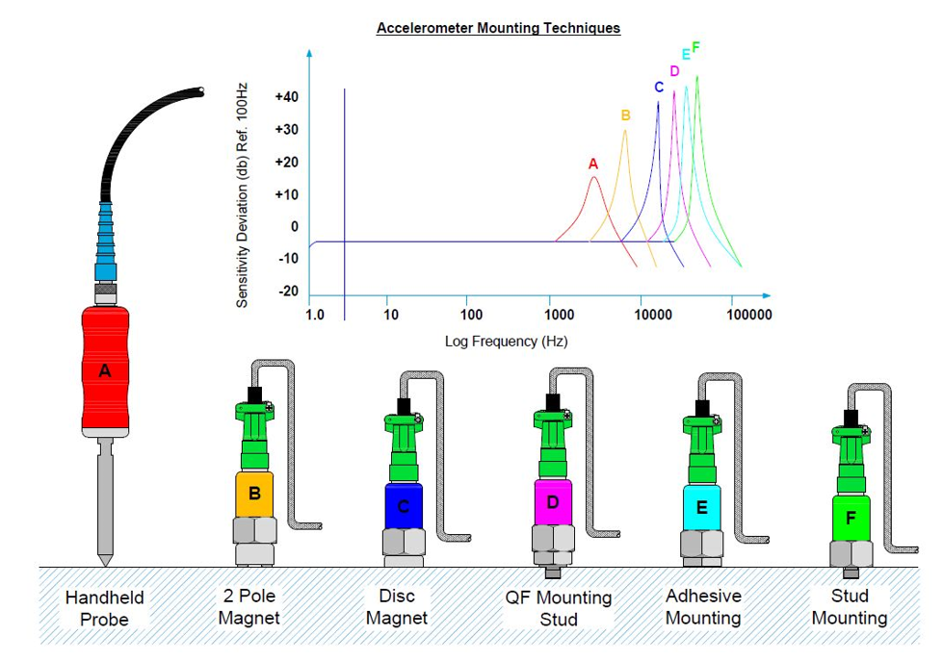
Low – mid frequencies
Vrms (2/10 Hz – 1 kHz)
Unbalance
Mechanical Looseness
Misalignment

Slide 34
High frequencies
Roller Bearing Lubrication
Roller Bearing Condition
Cavitation
Gearboxes

Slide 35
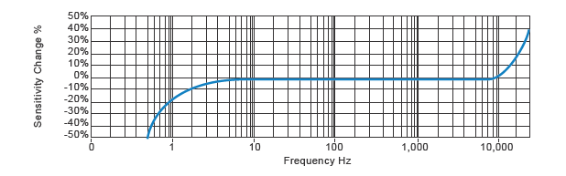
Is a sensor itself not a limitation ?
Accelerations at these frequencies greatly amplified
Accelerations at these frequencies greatly attenuated
Linear Range
99% of time this is never a problem
1% of time we have to address the issue

Slide 36
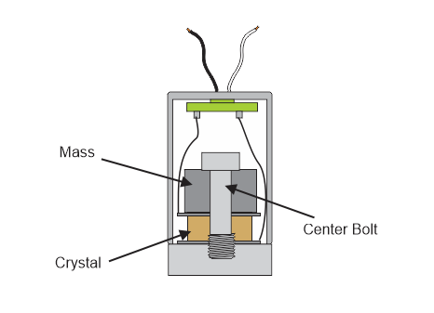
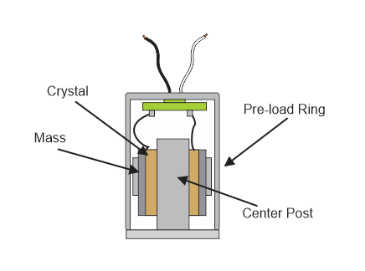
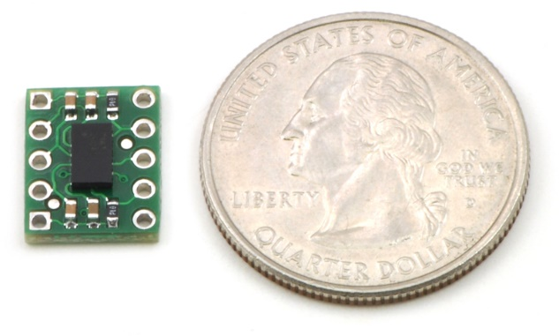
Is design important ?
Compression type
Shear type
MEMS type
More Robust
Better Performance
Continuous Development
Most popular
Types of Accelerometer Construction

Slide 37
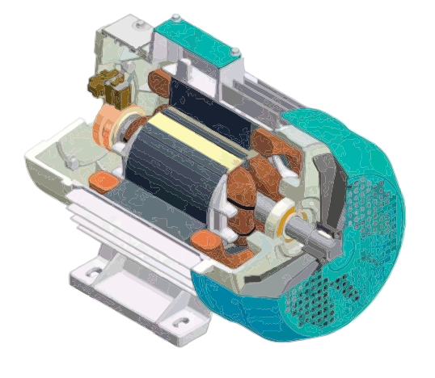
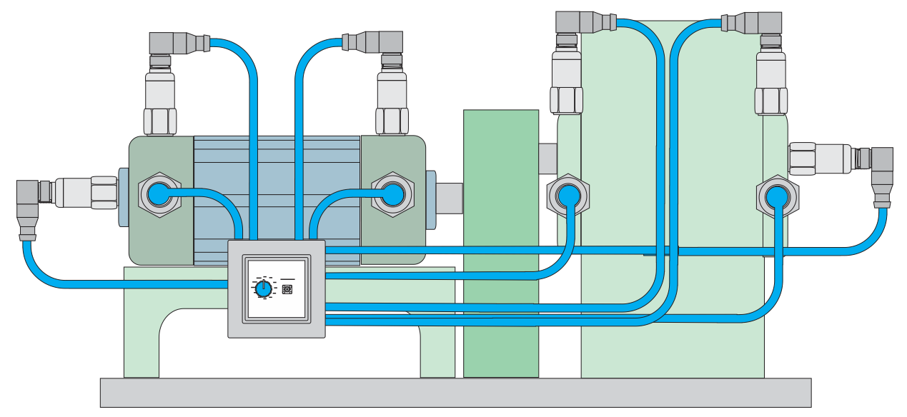
Installation
Pay attention to details, they will payback
As close as possible to signal source
Mounting location must be stiff
Motor covers are often flexible and liable to resonate
If base vibration is your focus

Slide 38
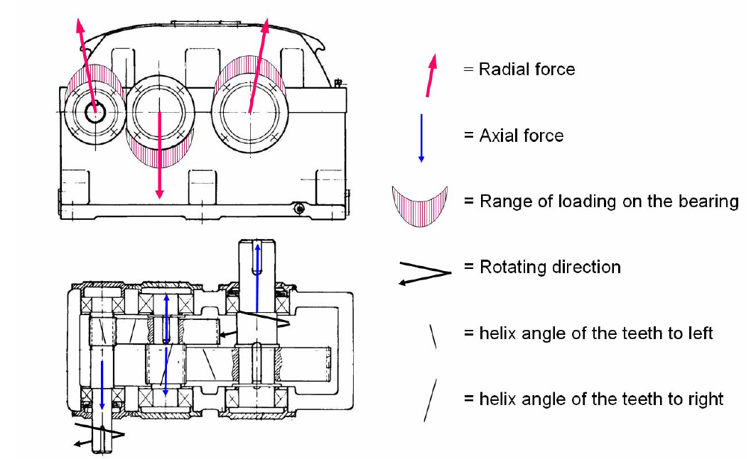
Best installation points
Look into documentation
Try to visualise crossection

Slide 39


Do not let loose cable influence the measurement
Secure cables

Slide 40


Enviromental protection summary

Slide 41







Installation
Drilling, spot facing, threading

Slide 42
Theory vs Practice

Slide 43


Theory vs Practice
On big machines usually it is easy to find a good place

Slide 44


Theory vs Practice

Slide 45


Theory vs Practice

Slide 46


Theory vs Practice
However more round there are and covered, …

Slide 47




Theory vs Practice
… or smaller
Help yourself with accesories

Slide 48


New technologies - Wireless
Which wireless transmission ?
How about predictive maintenance for sensors ?
What kind of data and where is the data ?
Random speed/load
MEMS mostly
Frequency response/range/temperature
Online with perdiodical measurements
Where is my data and how it links with proces data ?

Slide 49
My question to you ?
Vibration sensors are the best way
to understand machine condition
There is no proper safety of rotating equipment operation without vibration measurements
Many assets require predictivity of their avaiability and maintaiabilioty
Is it easy to apply
Subjects covered in that presentation are well known
Simple solutions are very cost effective
and advanced ones more and more
Why there is still so many machines which we do not listen ?

Slide 50

Questions and answers ?

