Slide 2
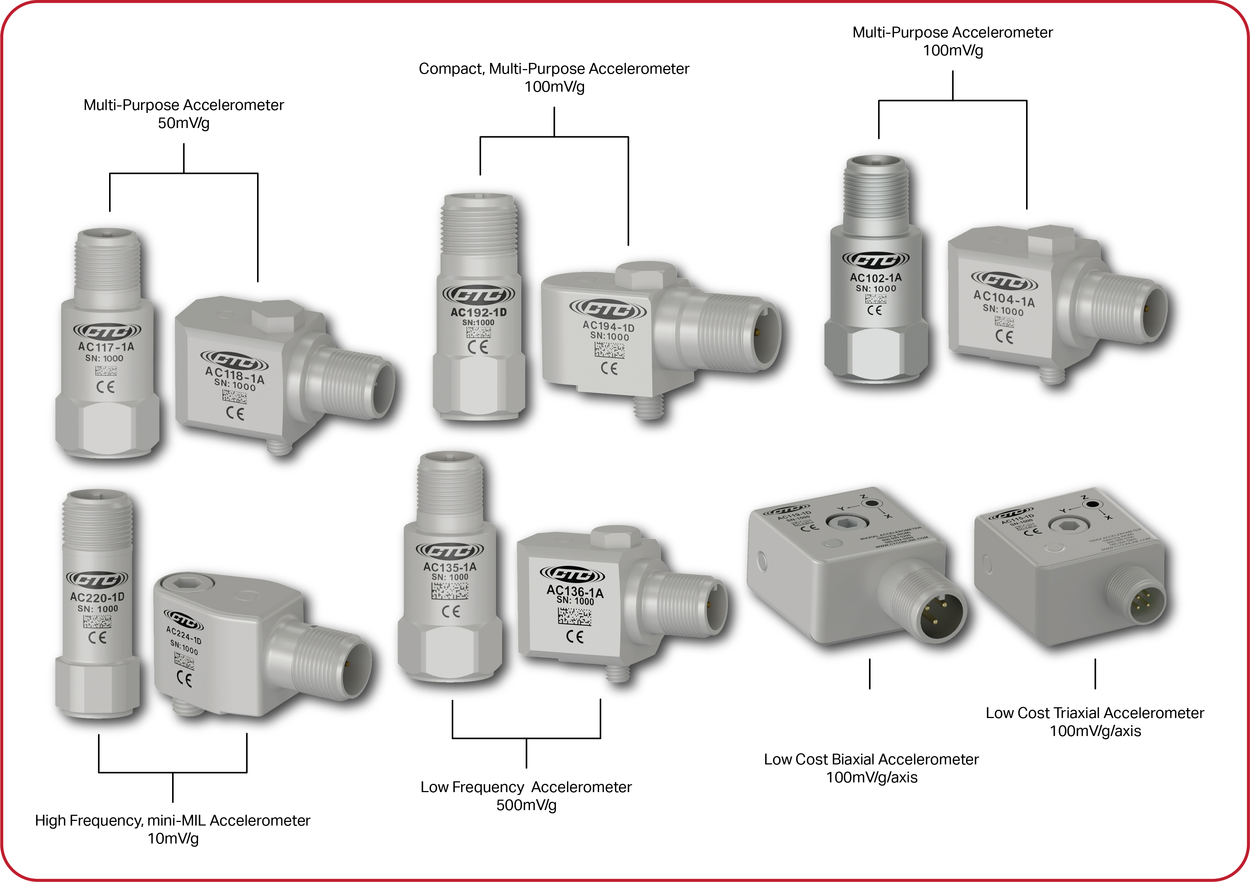
Accelerometers vs. Proximity Probes
Vibration analysis is one of the most helpful tools technicians use to diagnose machine faults and to observe the condition of the machinery. Analysts need to be able to identify the frequencies and amplitudes of the various vibrations occurring in the machine or order to detect and analyze the cause of the machine fault.

Slide 3
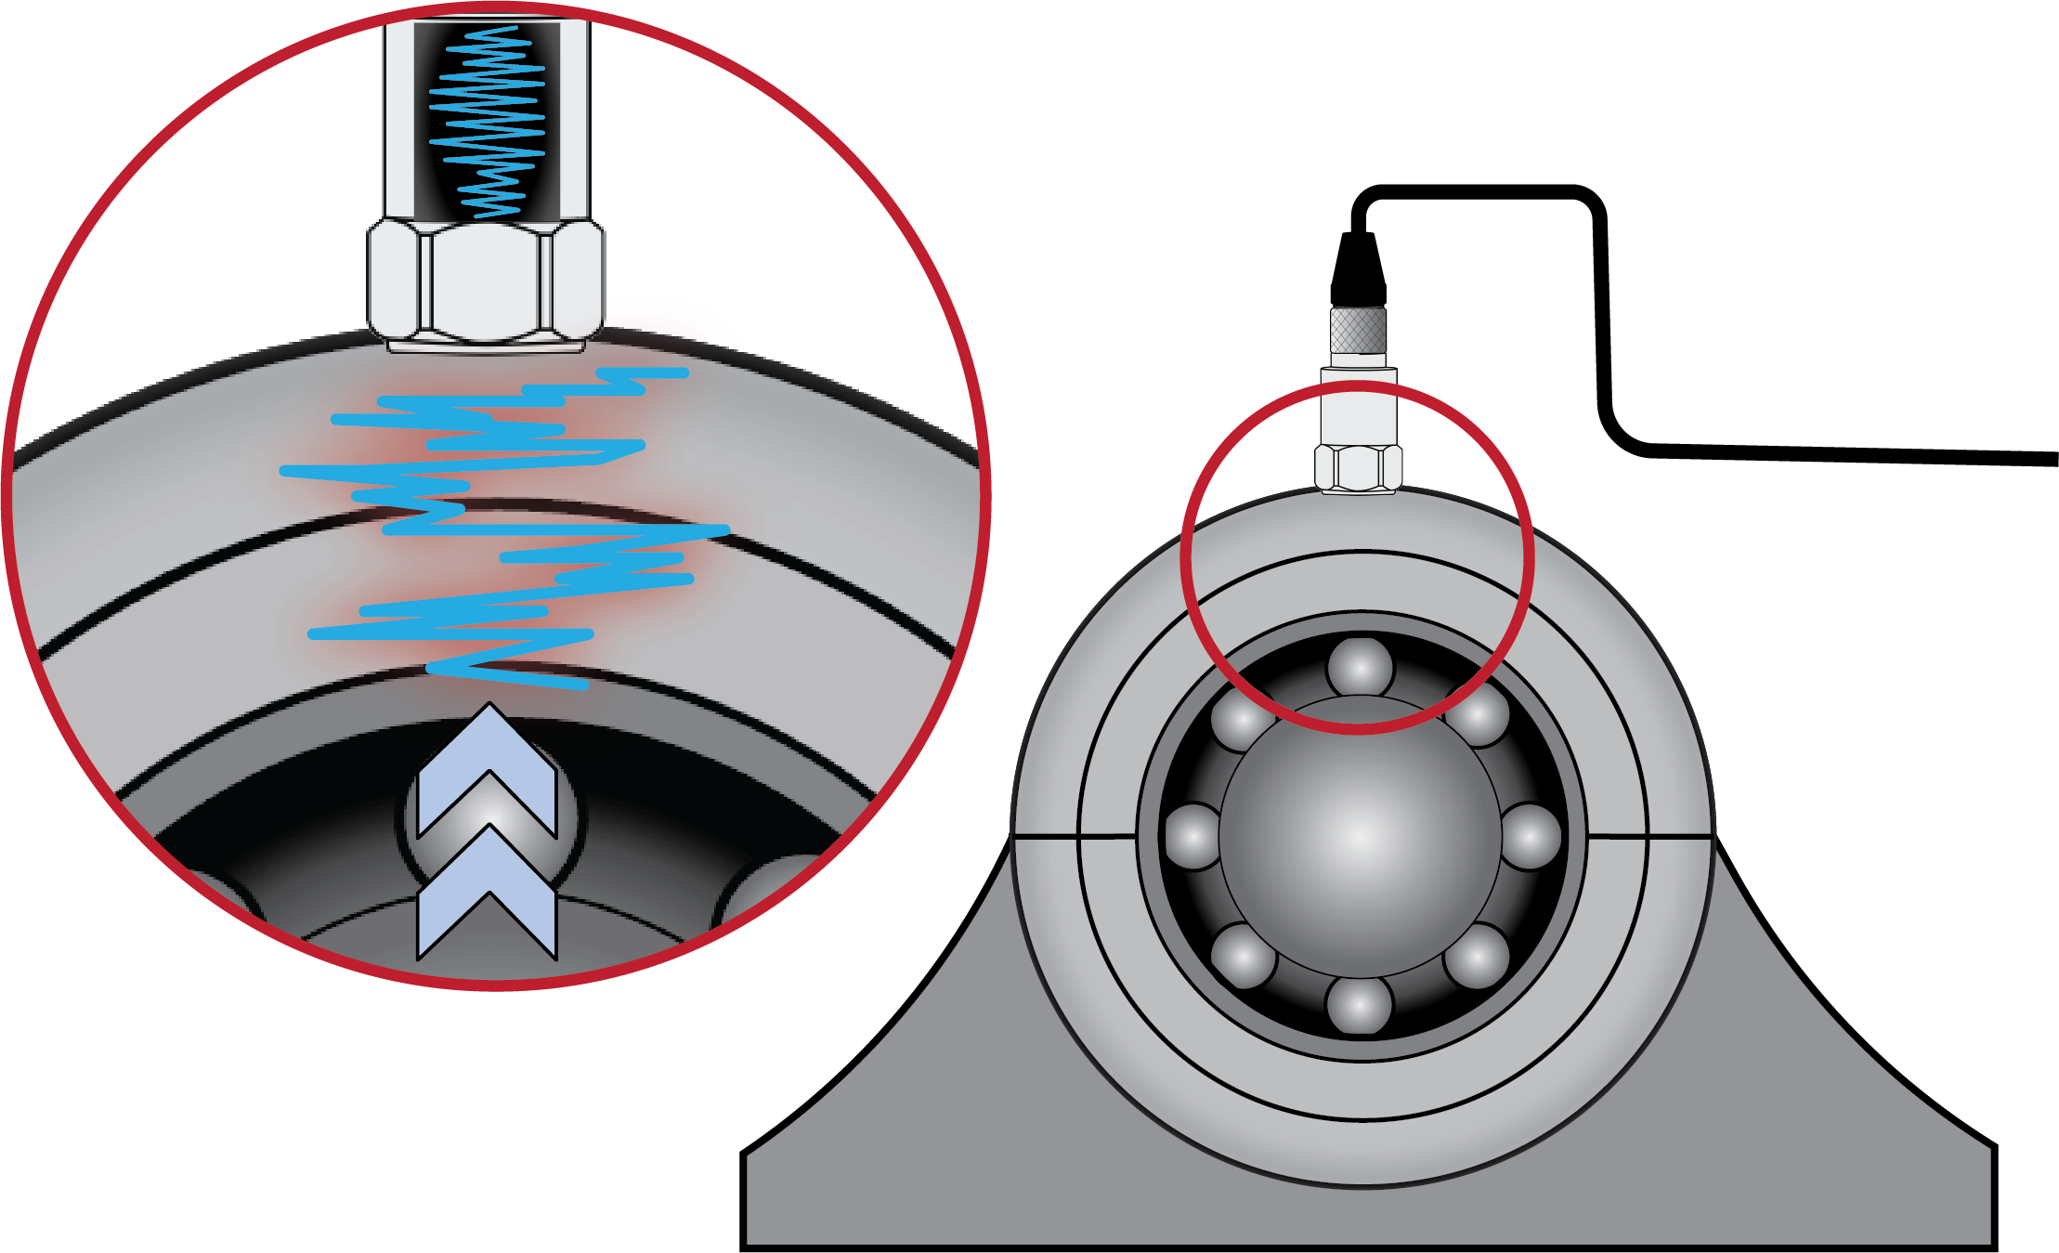
Accelerometers vs. Proximity Probes
Accelerometers are helpful tools used to measure mechanical vibrations in machines. They are typically used in applications utilizing rolling element bearings. Since these bearings have rolling elements that are in contact with both the inner and outer race of the bearing, they do a good job of transmitting vibration to the machine housing which is easily monitored by accelerometers.
Cross Section View of an Accelerometer Mounted on a Machine Above a Rolling Element Bearing

Slide 4
What if the machine being monitored is not using rolling element bearings?

Slide 5
Journal Bearings
A journal bearing, also known as a sleeve bearing, is a type of bearing in where the shaft is suspended in a pressurized regime of oil.
These are used on very large or powerful rotating machines in order to provide damping of vibration in order to pass through critical speeds and suppress instabilities. This damping of vibration makes it difficult for a regular accelerometer to get accurate vibration data from the machine housing.

Slide 6
So, if the oil in a journal bearing dampens the vibration of its shaft… How can we get accurate data on the shaft’s position and vibration relative to its housing without direct contact?

Slide 7
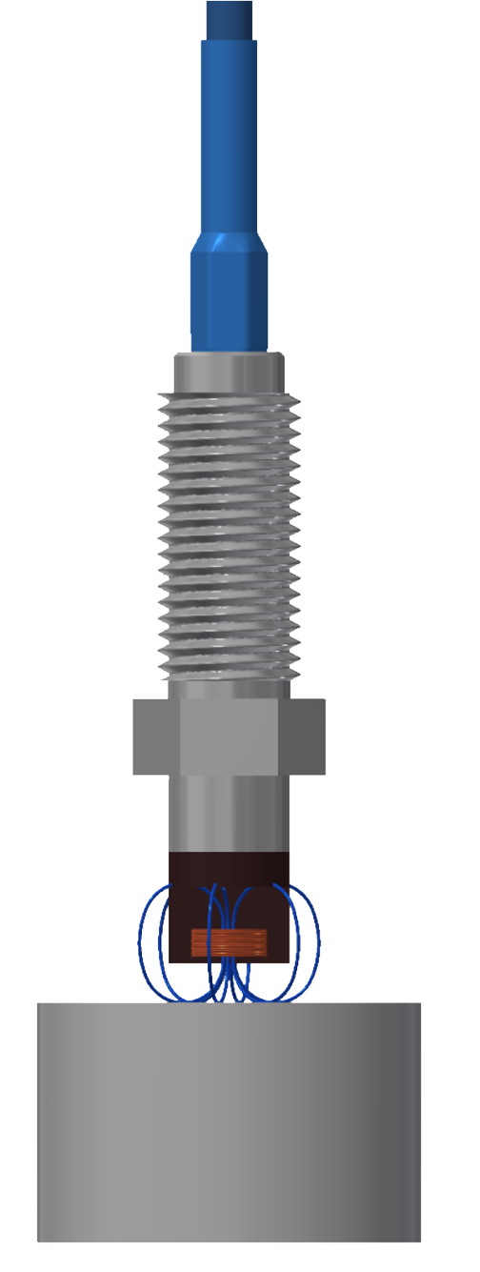
Proximity Probe Functionality
Proximity Probes are categorized as non-contact displacement sensors. This means that their signal output is proportional to the amount of displacement between the probe tip and the conductive target material.
Proximity Probes use Eddy Current principles to generate a primary and secondary magnetic field that cause the output signal voltage of a Proximity Probe system to drop as the probe tip gets closer to the material being monitored.

Slide 8
What is a Complete Proximity Probe System?
A complete Proximity Probe System consists of a Probe, an Extension Cable, and a Driver
Proximity Probe Systems are typically 5 or 9 meters in length
A standard Proximity Probe System will have a signal output of -7.87 V/mm

Slide 9
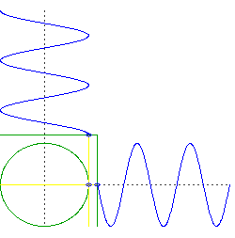
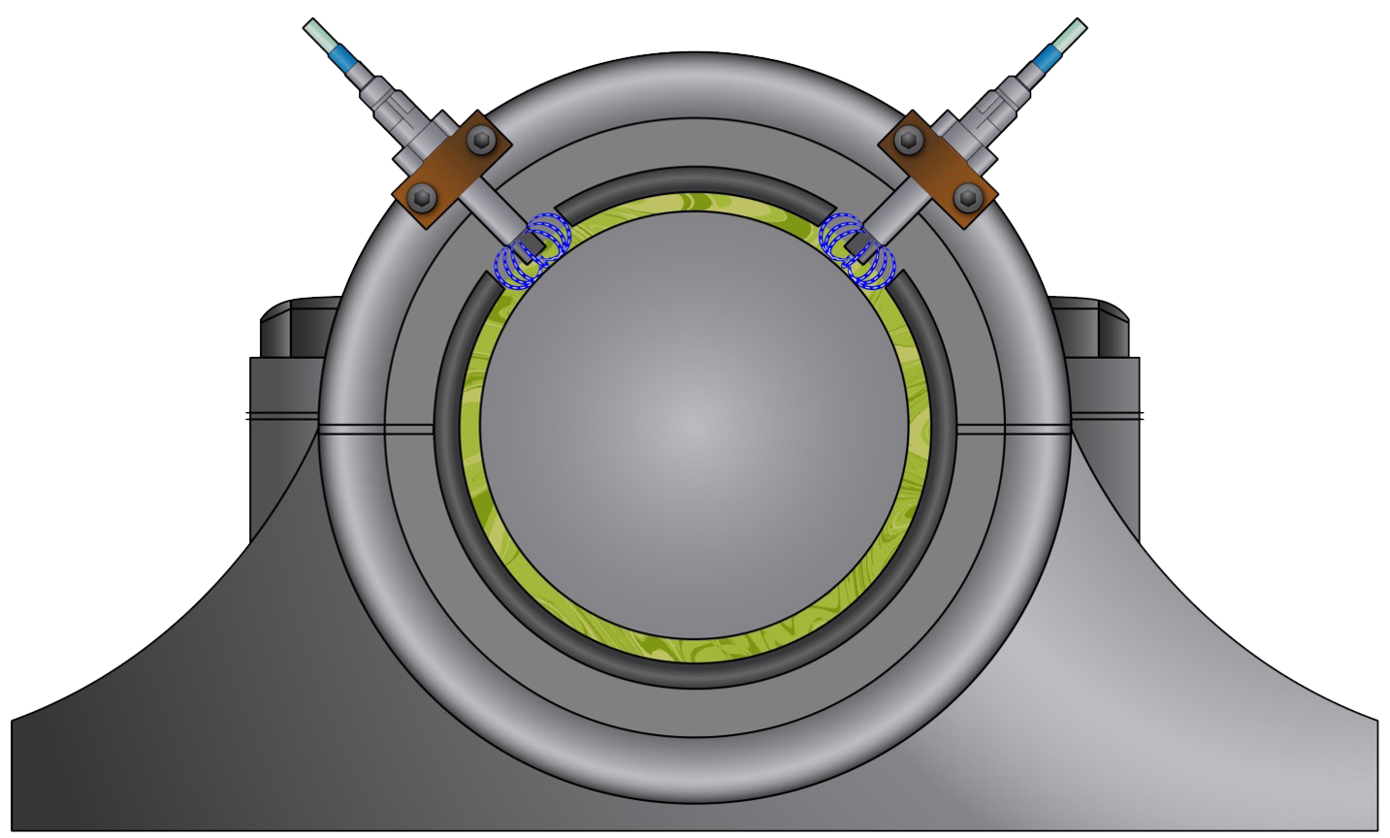
Radial Proximity Probe Applications
90°
Y
X

Slide 10
Proximity Probes for Orbital Analysis
Orbital Analysis involves plotting the orbit of the shaft’s centerline as it rotates in it’s bearing, which can help identify any misalignment or imbalance that may be causing excessive vibration or wear
By analyzing a shaft’s orbit, it is possible to identify the frequency and amplitude of any vibration or change in position which can indicate potential issues with the bearing or surrounding machinery

Slide 11
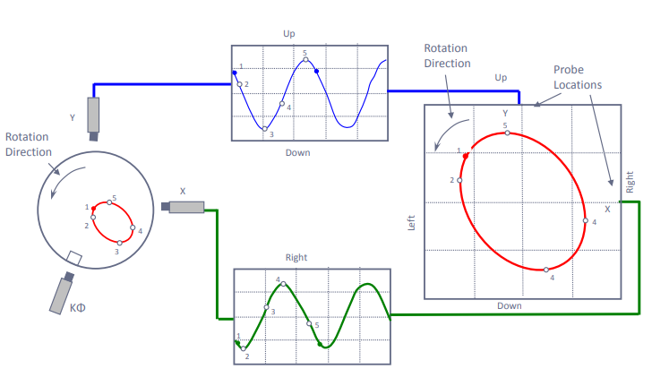
Orbital Analysis
Orbital Analysis can be used identify many issues such as:
Misalignment between the rotor and bearing
Journal Eccentricity
Oil Whirl
Oil Whip
Bearing Wear or Rubs
Hydrodynamic Instability

Slide 12
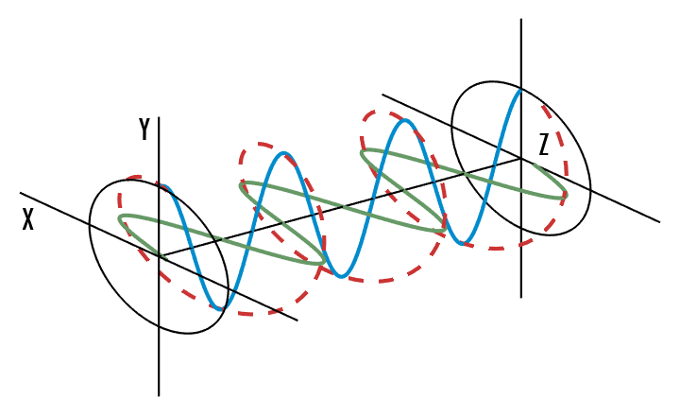

Slide 13
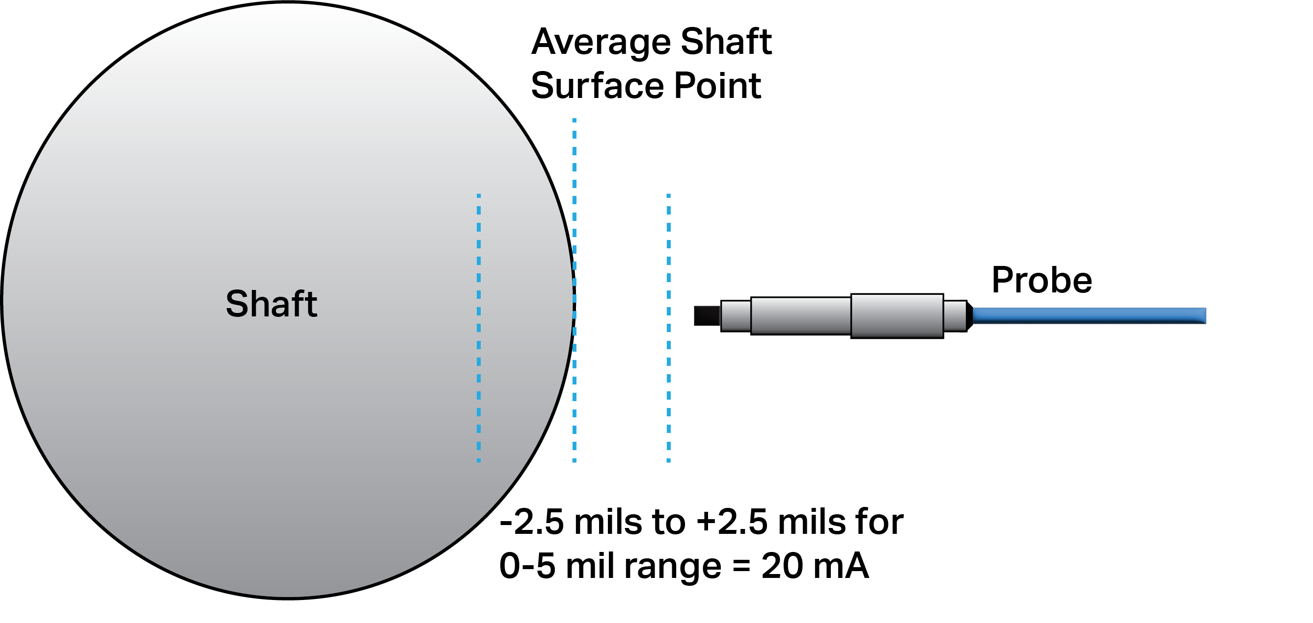
4-20mA Shaft Vibration Monitoring
Another cost-effective way to monitor the vibration of a shaft in a journal bearing is by using a 4-20mA Radial Probe Driver
These Drivers have a 4-20mA output that is proportional to the overall peak-to-peak vibration occurring in the shaft relative to it’s bearing housing
This is an easy way to monitor the condition of a journal bearing without the need for an expensive rack or MPS system

Slide 15
Axial Monitoring Proximity Probe Applications
Axial monitoring is important because excessive axial movement or displacement can case damage to bearings, seals, and other components of the machinery
Proximity Probes used for axial monitoring are often used to trigger alarm or shutdown thresholds to protect machinery from catastrophic failures

Slide 16
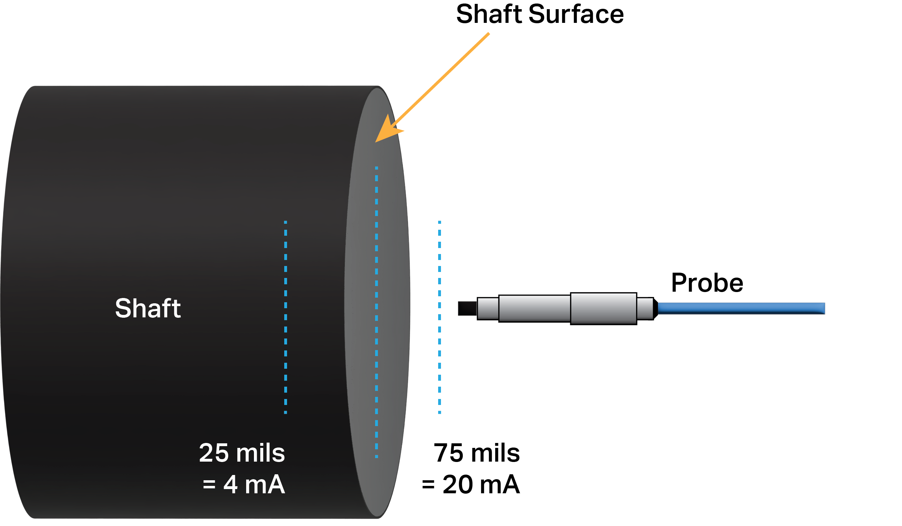
4-20mA Axial Probe Applications
A 4-20mA Axial Probe Driver will provide an output signal that is proportional to the displacement between the probe tip and the target material
This type of probe driver filters out the AC component of the probe’s dynamic signal and provides a process signal output proportional to the DC gap

Slide 17
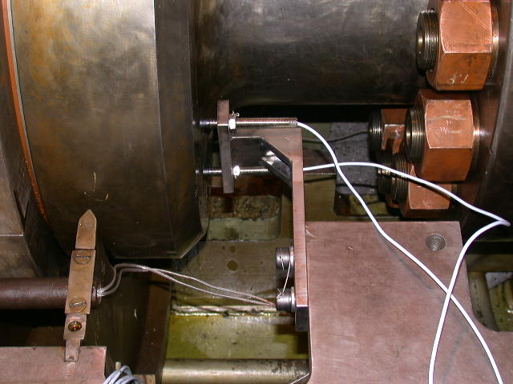

Slide 18
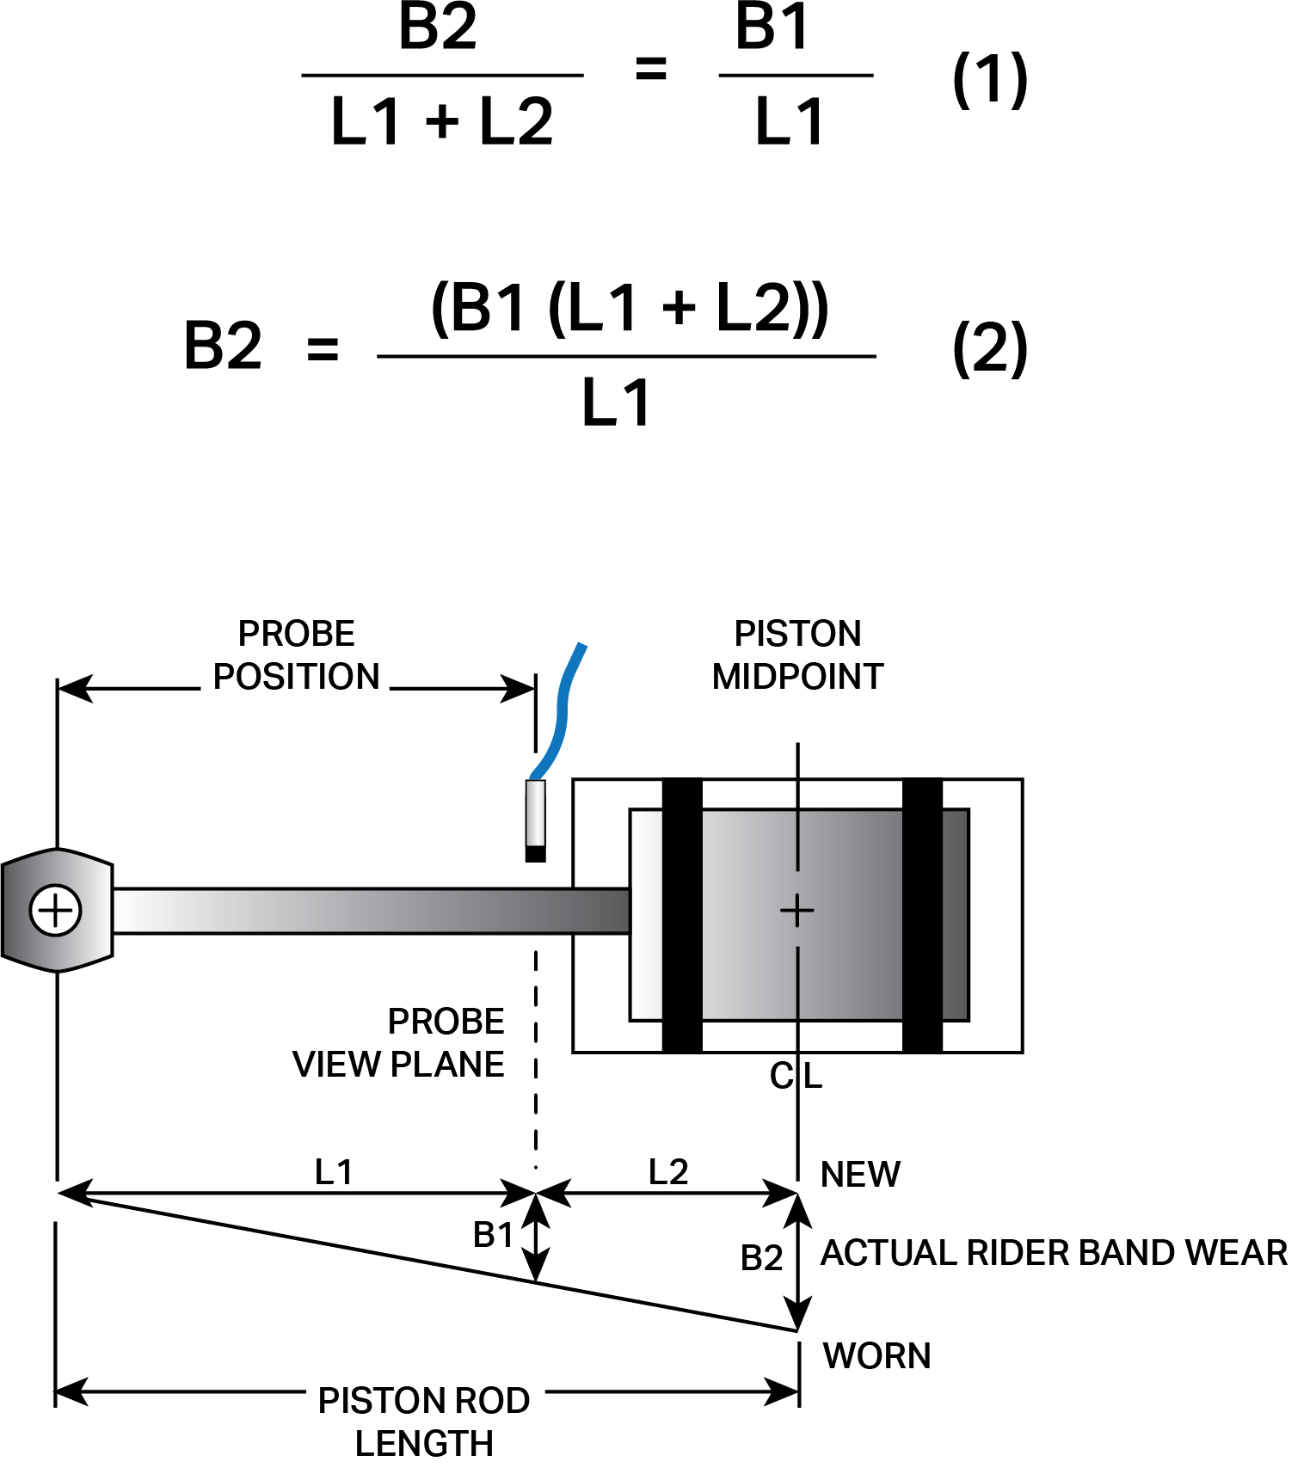
Rod Drop Monitoring for Reciprocating Compressors
Another common application that utilizes Proximity Probes is measuring the wear of the rider bands that hold the pistons in place as they move in the cylinder
Rider bands are a critical part of a reciprocating compressor; they carry the full weight of the piston as while it is moving inside the cylinder
This is done by monitoring the change in position of the piston rod with a proximity probe system that is mounted 90° above or below the rod and using that measurement to extrapolate the absolute position of the piston itself

Slide 19
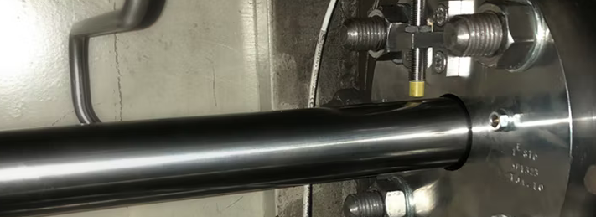

Slide 20
OEM Partnerships

